Slide 1
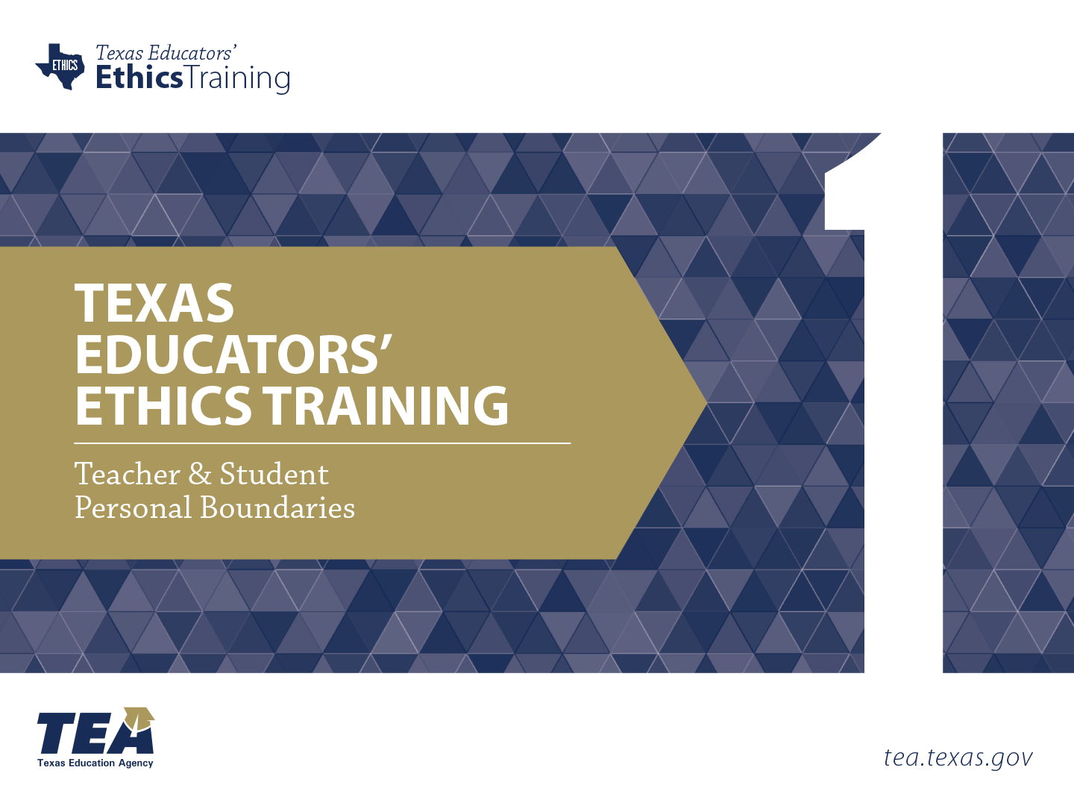
Notes:
Directions for Presenter: Italics
Information for Presenter to Convey: Bold
Presenter’s Notes: (Time: 30 Seconds)
Welcome participants. If this is a new group of participants, introduce yourself to the group.
SAY: This is the first of six ethics training modules for Texas educators. Module 1 will focus on Teacher and Student Personal Boundaries.
It is advisable to have participants seated at tables to encourage group dialogue. Participants will also be provided with a reflection journal.
Materials for Participants:
Journal
Copy of Texas Educators’ Code of Ethics
Materials for Presenter:
PowerPoint for Module 1
LCD Projector, Screen, Speakers, and Computer
Slide Advancer
Participant Toolbox is recommended (index cards, sticky notes, markers, pencils/pens, etc.)
Copies of Module Assessment
Performance Task Key
Assessment Key

Slide 2


Create an awareness of educator/student boundaries that maintain a safe, healthy, and secure learning environment for all students.
Notes:
Directions for Presenter: Italics
Information for Presenter to Convey: Bold
Presenter’s Notes: (Time: 30 Seconds)
Discuss the purpose of the training by reading each item on the slide.
You may choose to take a quick poll of the room to determine participants’ familiarity with the Texas Educators’ Code of Ethics.
SAY: Every good training has a direct purpose. Today, our purpose is to become familiar with ethical behavior and expectations for all Texas educators. More importantly, the purpose of this training is to create an awareness of teacher and student boundaries that should NEVER be crossed.

Slide 3

Stimulating Thinking
How does the educator/student relationship evolve appropriately to impact student learning?
Notes:
Directions for Presenter: Italics
Information for Presenter to Convey: Bold
Presenter’s Notes: (Time: 1 Minute)
SAY: As we prepare to begin our training session, this is the overarching essential question that we will conceptualize today. Please respond to the essential question while you wait for the training session to begin. You may use the Module 1 note-taking section in your journal to record your responses.
Note-Taking Strategy: Ask participants to use the Module 1 note-taking section of their journal to record their response to the essential question. They can respond to the essential question while they are waiting for the session to begin.

Slide 4

Participants will
develop an understanding of proper and improper educator/student relationships and the life-changing impact they have on a student;
discuss strategies to avoid a boundary violation;
know and understand educator/student boundaries; and
identify acceptable and unacceptable behaviors when developing a relationship with a student.
Notes:
Directions for Presenter: Italics
Information for Presenter to Convey: Bold
Presenter’s Notes: (Time: 1 Minute)
Convey to participants the learning objective for Module 1.
SAY: Our training objectives will be directly tied to our training assessment. Today we will help you determine what constitutes professional boundaries between a teacher and a student; understand the consequences of boundary violations; and discuss developing positive relationships and professionally connecting with students.

Slide 5
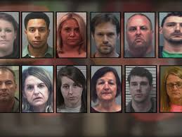
In the News
Cases of improper relationships between teachers and students are on the rise nationwide.
Notes:
Directions for Presenter: Italics
Information for Presenter to Convey: Bold
Presenter’s Notes: (Time: 30 Seconds)
Read the slide information to participants.
SAY: What is happening in the area of educator/student boundaries? If you read the news or watch TV, you may have seen some of these headlines. It is a disturbing trend that is at its highest level ever, nationwide. These are crimes being committed against our students in record numbers.
Source Cited: Hope, M. (2015, March). 41% increase in Texas teacher-student sexual misconduct cases. Breitbart Texas Online News. Retrieved from http://www.breitbart.com/texas/2015/03/19/41-increase-in-texas-teacher-student-sexual-misconduct-cases/

Slide 6

Inappropriate Teacher-Student Relations in Texas Kept Going Up in 2015
Notes:
Directions for Presenter: Italics
Information for Presenter to Convey: Bold
Presenter’s Notes: (Time: 30 Seconds)
Read the slide and pause, for effect, before advancing to the headline on the next slide.
SAY: “Inappropriate Teacher-Student Relations in Texas Kept Going Up in 2015”
Source Cited: Levin. M. (2015, December). Inappropriate teacher-student relations in Texas kept going up in 2015. Houston Chronicle. Retrieved from http://www.chron.com/news/education/article/Inappropriate-teacher-student-relations-in-Texas-6719904.php

Slide 7
Texas Teacher, Student Seen
in Sex Tape to Appear on Dr. Phil
Notes:
Directions for Presenter: Italics
Information for Presenter to Convey: Bold
Presenter’s Notes: (Time: 30 Seconds)
Read the slide and pause, for effect, before advancing to the headline on the next slide.
SAY: “Texas Teacher, Student Seen in Sex Tape to Appear on Dr. Phil”
Source Cited: Hamilton, J. (2016, February). Texas teacher, student seen in sex tape to appear on Dr. Phil. Houston Chronicle. Retrieved from http://www.chron.com/news/houston-texas/texas/article/Texas-teacher-student-seen-in-sex-tape-to-appear-6848839.php

Slide 8
Teacher Charged, Says She ‘Fell in Love’ With 15-Year-Old Student
Notes:
Directions for Presenter: Italics
Information for Presenter to Convey: Bold
Presenter’s Notes: (Time: 30 Seconds)
Read the slide and pause, for effect, before advancing to the headline on the next slide.
SAY: “Teacher Charged, Says She ‘Fell in Love’ With 15-Year-Old Student”
Source Cited: Teacher charged, says she ‘fell in love' with 15-year-old student. (2015, December). Lansington State Journal. Retrieved from http://www.lansingstatejournal.com/story/news/local/2015/12/16/teacher-charged-says-she-fell-in-love-with-15-year-old-student/77464844/

Slide 9
Teacher-Student Sex Rampant in Texas:
Lawmakers Seek Solutions
Notes:
Directions for Presenter: Italics
Information for Presenter to Convey: Bold
Presenter’s Notes: (Time: 30 Seconds)
Read the slide and pause, for effect, before advancing to the headline on the next slide.
SAY: “Teacher-Student Sex Rampant in Texas: Lawmakers Seek Solutions”
Source Cited: Hope, M. (2015, December). Teacher-student sex rampant in Texas: Lawmakers seek solutions. Breitbart Texas Online News. Retrieved from http://www.breitbart.com/texas/2015/12/11/texas-lawmakers-seek-solutions-rampant-teacher-student-sexual-misconduct/

Slide 10
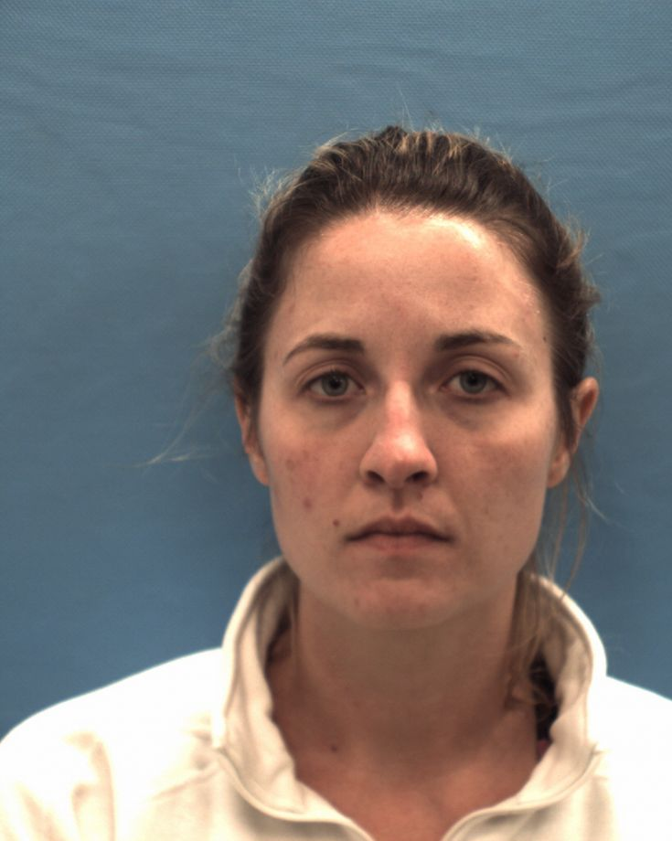
Former Seguin High School Teacher Who Pleaded Guilty to Having
Sex with a Student
Lands on “Most Wanted” List
Photo: Guadalupe County Jail
Notes:
Directions for Presenter: Italics
Information for Presenter to Convey: Bold
Presenter’s Notes: (Time: 30 Seconds)
The photo on the slide will appear. Next, advance the slide. The text will appear. Read the statement on the slide to participants.
SAY: Being the top news story of the day should NEVER be for this reason.
This former Texas high school teacher was added to the “Most Wanted” list after she was caught with a 17-year-old student during a traffic stop.
This is the SAME student with whom she previously pleaded guilty to having sexual relations.
She was released from jail on probation in January of that year after being convicted for having sexual relations with the student.
She violated probation when she was caught with the teenager soon after her jail release.
A warrant was issued for her arrest, but at the time, her whereabouts were unknown.
Source Cited: Fechter, J. (2015, March). Former Seguin high school teacher who pleaded guilty to sex with student lands on 'Most Wanted’ list. San Antonio Express-News. Retrieved from http://www.mysanantonio.com/news/local/crime/article/Former-Texas-high-school-teacher-who-pleaded-6167573.php

Slide 11

Somber Headlines
Improper Teacher-Student Cases on Track to Break Texas Record
Notes:
Directions for Presenter: Italics
Information for Presenter to Convey: Bold
Presenter’s Notes: (Time: 30 Seconds)
Read the headline on the slide.
SAY: What is happening in our schools? (rhetorical question)
Source Cited: Chang, J. (2016, May). Improper teacher-student cases on track to break Texas record. Austin American-Statesman. Retrieved from http://www.mystatesman.com/news/news/improper-teacher-student-cases-on-track-to-break-t/nrK42/

Slide 12

Current Statistics for Texas Public Schools
In FY 2017, the Texas Education Agency opened 302 cases related to inappropriate relationships for the ninth consecutive year of growth.
Notes:
Directions for Presenter: Italics
Information for Presenter to Convey: Bold
Presenter’s Notes: (Time: 30 Seconds)
Read the information found on the slide.
SAY: Unfortunately, Texas has not fared well in ethical violations. There has been a 41 percent increase in cases in less than six months.
Source Cited: Chang, J. (2016, May). Improper teacher-student cases on track to break Texas record. Austin American-Statesman. Retrieved from http://www.mystatesman.com/news/news/improper-teacher-student-cases-on-track-to-break-t/nrK42/

Slide 13
TEA Educator Investigations
Cases pending at beginning of FY
Notes:
Directions for Presenter: Italics
Information for Presenter to Convey: Bold
Presenter’s Notes: (Time: 1 Minute)
Read the information found on the slide.
SAY: As you can see, longitudinally, the number of open cases continue to rise in the state of Texas. These statistics account for all cases under investigation, including inappropriate relationship cases.
Source Cited: Phillips, D. (2014). Inappropriate Relationships Between Educators and Students [PDF Document]. Retrieved from www.taspa.org/mpage/2014sumconfHandouts

Slide 14
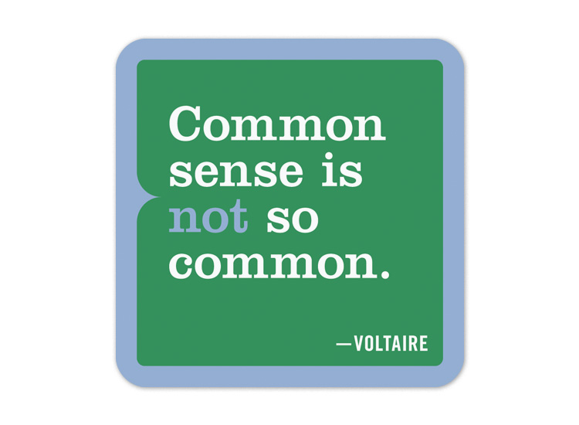
Common sense should prevail, but “The absence of reason is usually at the heart of inappropriate relationships.”
Where is this quote from? We need to cite it.
Notes:
Directions for Presenter: Italics
Information for Presenter to Convey: Bold
Presenter’s Notes: (Time: 30 Seconds)
Read the information found on the slide.
SAY: If only it was as easy as that, and if only everyone was known for having common sense.
Advance to the next slide for the brief group dialogue segment.
Source Cited: Phillips, D. (2014). Inappropriate Relationships Between Educators and Students [PDF Document]. Retrieved from www.taspa.org/mpage/2014sumconfHandouts

Slide 15

Table Talk
What is happening?
Why are there more cases each year?
Notes:
Directions for Presenter: Italics
Information for Presenter to Convey: Bold
Presenter’s Notes: (Time: 4 Minutes)
Note that two minutes are for the group discussion and two minutes are for the sharing of responses.
SAY: So what IS happening in our profession?
Why are we seeing more cases each year?
Discuss these questions in your group and be prepared to share your thoughts.
Let’s watch a video that addresses educator/student boundaries.

Slide 16
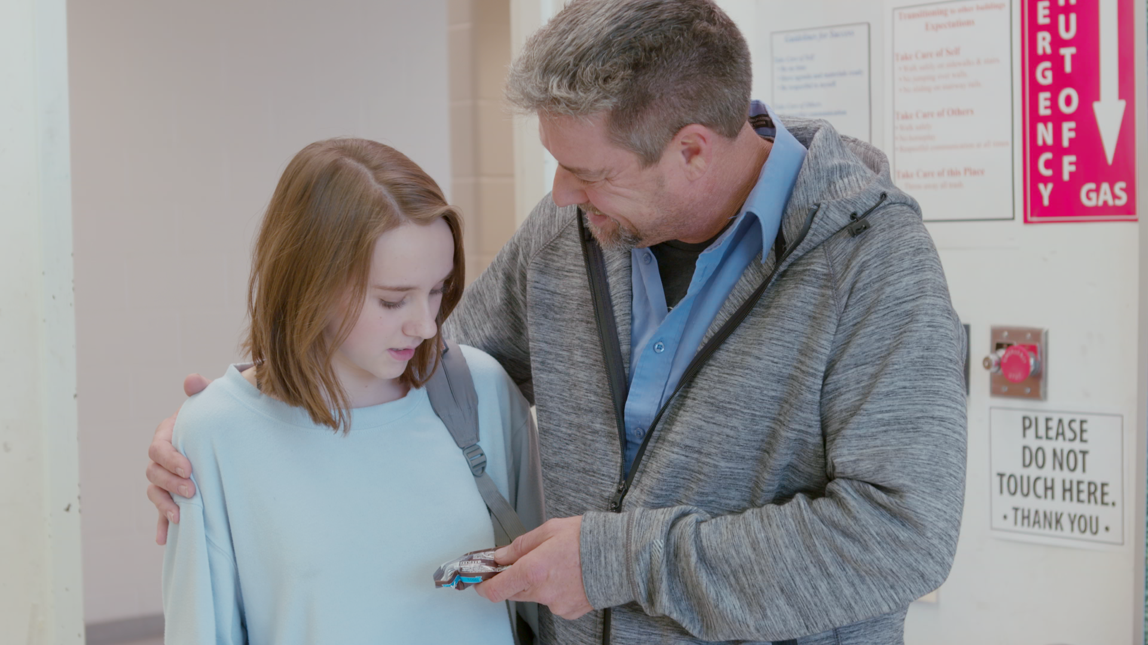

Video Scenario
Notes:
Directions for Presenter: Italics
Information for Presenter to Convey: Bold
Presenter’s Notes: (Time: 6 Minutes)
Video Scenario for Presenter’s Reference:
Mr. Goode is a veteran teacher who is popular among colleagues and students. He often greets students with hugs and shoulder rubs, and he sometimes escorts female students into his classroom by placing his hand on the small of their backs. A female student in his fifth period class reported to another teacher that Mr. Goode’s physical greetings make her feel uncomfortable and invade her personal space.

Slide 17

Video Scenario Debrief
Notes:
Directions for Presenter: Italics
Information for Presenter to Convey: Bold
Presenter’s Notes: (Time: 2 Minutes)
SAY: The data indicate that this could be a real example of what is happening in some schools. What boundary violations were presented in the video?
Allow participants to respond. Participants should note that the violations included, but were not limited to, inappropriate touching, singling out a student, inappropriate teasing, and inappropriate attention to a student. Allow for large group responses as time permits.
Refer back to the video scenario throughout the remainder of the module.

Slide 18

Enough is enough!
Notes:
Directions for Presenter: Italics
Information for Presenter to Convey: Bold
Presenter’s Notes: (Time: 1 Minute)
Read the statement found on the slide.
SAY: How are we going to make the changes necessary to stop educators from having improper relationships with students?
We can impact this disturbing trend by ensuring that all Texas educators are aware of the issues, receive training, and comply with district policies regarding ethical conduct toward students.
We must maintain the dignity of the profession, respect and obey the law, demonstrate personal integrity, and exemplify honesty.
Let’s start with parameters as they relate to professional boundaries.
Source Cited: 19. Tex. Admin. Code §247.1.

Slide 19
Professional Boundaries
Parameters describe the limits of a relationship between an educator and a student.
Set Boundaries
Know Your Limits
Notes:
Directions for Presenter: Italics
Information for Presenter to Convey: Bold
Presenter’s Notes: (Time: 1 Minute)
This slide introduces the concept of professional boundaries between teachers and students.
SAY: In a recent study, the term “professional boundaries” was defined as:
Parameters that describe the limits of a relationship where one person entrusts his or her welfare and safety to a professional and often in circumstances where a power imbalance might exist.
One of the most significant aspects of the teaching profession is the professional relationship between teachers and students.
Source Cited: Bird, S. (2013). Managing professional boundaries. Australian Family Physician (AFP), 42(9). Retrieved from http://www.racgp.org.au/afp/2013/September/managing-professional-boundaries

Slide 20

Professional Boundaries
The educator/student relationship is not equal.
(Bird, 2015)
Notes:
Directions for Presenter: Italics
Information for Presenter to Convey: Bold
Presenter’s Notes: (Time: 2 Minutes)
SAY: When we talk about educator/student relationships it is important to note that the relationship is not equal. Educators are in a unique position of trust, authority, and influence with their students, which means that there is always an inherent power imbalance between teachers and students.
Why is the educator/student relationship NOT equal?
Allow participants to respond to the question. Then state the following:
SAY: The relationship between an educator and a student could also be viewed as a power relationship.
Educators have more power than imagined. Not only do they shape minds and guide learning, they also have the power to impact a student emotionally, mentally, and physically.
The educator/student relationship is DEFINTELY NOT EQUAL.
Source Cited: Bird, S. (2013). Managing professional boundaries. Australian Family Physician (AFP), 42(9). Retrieved from http://www.racgp.org.au/afp/2013/September/managing-professional-boundaries

Slide 21

Boundary Violations
Emotional
Relationship
Communication
Notes:
Directions for Presenter: Italics
Information for Presenter to Convey: Bold
Presenter’s Notes: (Time: 30 Seconds)
SAY: There are different types of boundaries that we need to discuss in reference to educator/student relationships. While this is not an inclusive list, the majority of boundary violations fall within these categories. The boundary violations include:
Emotional
Relationship
Communication
Source Cited: Teacher Registration Board, Northern Territory. (2015, September). Managing Professional Boundaries. Retrieved from http://www.trb.nt.gov.au/__data/assets/pdf_file/0019/40915/Managing-Professional-Boundaries-Guidelines-for-Teachers-.pdf

Slide 22
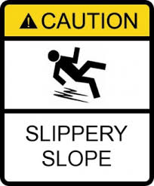
Emotional Violations
“Playing favorites” with certain students
Using subtle forms of control
Showing preferential treatment
Notes:
Directions for Presenter: Italics
Information for Presenter to Convey: Bold
Presenter’s Notes: (Time: 1 Minute)
SAY: The first type of boundary violation relates to emotional aspects of the educator/student relationship.
How many of you believe this statement to be true? “Teachers do not have favorites in their classrooms.”
Allow participants to respond, and then read the information on the slide.
SAY: While this seems innocent enough, it can lead to a boundary violation where the educator/student relationship is compromised. Many students come to school with an emotional need to connect with an adult.
There are two types of relationships with students, a professional relationship and a personal relationship.
It is critical for educators to focus on developing a professional relationship that does not cross a personal boundary. When crossing lines emotionally with a student, you begin to slide down a slippery slope.
Source Cited: Teacher Registration Board, Northern Territory. (2015, September). Managing Professional Boundaries. Retrieved from http://www.trb.nt.gov.au/__data/assets/pdf_file/0019/40915/Managing-Professional-Boundaries-Guidelines-for-Teachers-.pdf
(Teacher Registration Board, 2015)

Slide 23
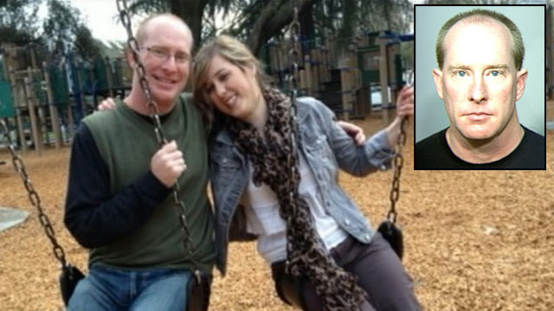
Relationship Violations
Forming intimate relationships with students
Having a romantic relationship with a student
Meeting a student alone outside of school
(Teacher Registration Board, 2015)
Notes:
Directions for Presenter: Italics
Information for Presenter to Convey: Bold
Presenter’s Notes: (Time: 1 Minute)
SAY: The second type of boundary violation pertains to inappropriate relationships with students. This boundary violation is the MOST life-changing for all involved.
Read the information on the slide.
SAY: How many of you have read in a newspaper, seen on television, or personally know a teacher who has had an inappropriate relationship with a student?
(Most hands should be raised.)
SAY: As you can see, most of us have seen examples of this type of boundary violation.
We should take note of the consequences that follow from such action.
When discussing intimate relationships with students, this includes both current and former students.
Intimate behavior includes physical, emotional, or mental interactions with a student.
Meeting a student alone outside of school without a valid context is seen as a relationship violation.
Source Cited: Teacher Registration Board, Northern Territory. (2015, September). Managing Professional Boundaries. Retrieved from http://www.trb.nt.gov.au/__data/assets/pdf_file/0019/40915/Managing-Professional-Boundaries-Guidelines-for-Teachers-.pdf

Slide 24

Communication Violations
Providing a student with advice on personal matters
Using social media to communicate romantically or sexually
Notes:
Directions for Presenter: Italics
Information for Presenter to Convey: Bold
Presenter’s Notes: (Time: 30 Seconds)
SAY: The third type of boundary violation relates to the area of communication. In the 21st century, communication violations are extremely common due to the prevalence of technological advancements.
Read the information on the slide.
SAY: Social media is a term we throw around frequently. When you think about “social media,” what does the term mean to you?
Allow participants to respond. They should respond with any of the following: texting, email, Facebook, Instagram, Snapchat, Twitter, Tumblr, Flicker, Vine, Tagged, MeetMe, etc.
If the participants don’t mention some of these examples, the presenter should make them aware of the various types of social media. It should be emphasized that these are just a few of the social media sites that teens are using to communicate.
SAY: Module 2 will provide in-depth information on communication via social media.
Source Cited: Teacher Registration Board, Northern Territory. (2015, September). Managing Professional Boundaries. Retrieved from http://www.trb.nt.gov.au/__data/assets/pdf_file/0019/40915/Managing-Professional-Boundaries-Guidelines-for-Teachers-.pdf

Slide 25

Boundary Violations
Emotional
Relationship
Communication
Notes:
Directions for Presenter: Italics
Information for Presenter to Convey: Bold
Presenter’s Notes: (Time: 1 Minute)
SAY: While it’s important to avoid all three types of boundary violations, the focus of this module is on RELATIONSHIP boundary violations.
Which of these boundary violations, do you think, occurs most commonly in our schools?
Why do you think this module focuses on this boundary and not the others?
Allow participants to respond. You should hear that this boundary violation can cause long-term emotional, mental, and physical harm to the student.
Source Cited: Teacher Registration Board, Northern Territory. (2015, September). Managing Professional Boundaries. Retrieved from http://www.trb.nt.gov.au/__data/assets/pdf_file/0019/40915/Managing-Professional-Boundaries-Guidelines-for-Teachers-.pdf

Slide 26

The Teacher/Student Relationship
The overwhelming majority of educators in Texas exercise their professional responsibility with care and conviction.
Notes:
Directions for Presenter: Italics
Information for Presenter to Convey: Bold
Presenter’s Notes: (Time: 30 Seconds)
SAY: The overwhelming majority of educators in Texas exercise their professional responsibility with care and conviction. The few who breach their duties, however, undermine the profession and leave a trail of devastation, particularly for students who become victims.
Source Cited: Pennsylvania Professional Standards and Practices Commission. (n.d.). Unit 3: The teacher/student relationship. Educator Ethics and Conduct Toolkit. Retrieved from http://www.pspc.education.pa.gov/Promoting-Ethical-Practices-Resources/Ethics-Toolkit/Unit3/Pages/The-Teacher---Student-Relationship.aspx

Slide 27
Not all sexual misconduct cases begin with the intention to victimize a student.
Some teachers fall prey to the slippery slope of misconduct.
Notes:
Directions for Presenter: Italics
Information for Presenter to Convey: Bold
Presenter’s Notes: (Time: 30 Seconds)
SAY: As discussed earlier, it is important to note that not all cases begin with the intention to cross boundaries. Here is that slippery slope again. Sliding down that slope creates life-changing ramifications for the student and the educator.
The definition of sexual misconduct includes:
• sexual acts with a student
• romantic acts with a student
• erotic contact with a student
• verbal, non-verbal, written or electronic communication of romantic or sexual misconduct
• physical activity designed to establish a romantic or sexual relationship
Source Cited: Pennsylvania Professional Standards and Practices Commission. (n.d.). Unit 3: The teacher/student relationship. Educator Ethics and Conduct Toolkit. Retrieved from http://www.pspc.education.pa.gov/Promoting-Ethical-Practices-Resources/Ethics-Toolkit/Unit3/Pages/The-Teacher---Student-Relationship.aspx

Slide 28

Unintentional Boundary Violation
Some educator/student relationships may initially be appropriate and well-intentioned, but at some point they can shift to serving the needs of the teacher and not the needs of the student.
Notes:
Directions for Presenter: Italics
Information for Presenter to Convey: Bold
Presenter’s Notes: (Time: 1 Minute)
Read the information on the slide.
SAY: An educator must be aware if and when a relationship shifts to serving the needs of the adult and not the needs of the student.
There may be an increase in the frequency of interaction, as well as an increased level of intimacy, which may lead to a sexual relationship.
The lines become blurred. The blurred lines help foster inappropriate actions and educator misconduct.
Source Cited: Pennsylvania Professional Standards and Practices Commission. (n.d.). Unit 3: The teacher/student relationship. Educator Ethics and Conduct Toolkit. Retrieved from http://www.pspc.education.pa.gov/Promoting-Ethical-Practices-Resources/Ethics-Toolkit/Unit3/Pages/The-Teacher---Student-Relationship.aspx

Slide 29
Table Talk
A teacher’s conversation with a student after class:
Teacher: Maria, I’ve noticed that you’ve been absent for the last three days. I’m glad you are here today. Is everything OK?
Student: No, my father walked out on us and my boyfriend broke up with me. I wish more guys were like you.
How would you respond to the student’s comment?
Notes:
Directions for Presenter: Italics
Information for Presenter to Convey: Bold
Presenter’s Notes: (Time: 4 Minutes)
Note that two minutes are for the group discussion and two minutes are for the sharing of responses.
SAY: Let’s practice. Discuss this question and determine an appropriate response.
At your table, read the conversation that Mr. R and his student, Maria, had after class. Determine the best response to Maria’s comment. Be prepared to share your response.
Allow participants to respond. Participant responses may include:
The teacher should not respond at all.
A response could be formal and recommend counseling services.
A response could be simply ignoring the comment but redirecting the message to a formal educational purpose.

Slide 30

Intentional Boundary Violations
Some teachers intentionally groom a student for the purpose of engaging in sexual misconduct.
Notes:
Directions for Presenter: Italics
Information for Presenter to Convey: Bold
Presenter’s Notes: (Time: 30 Seconds)
SAY: On the other end of the spectrum, there are educators who intentionally seek out students and groom them for the purpose of engaging in sexual misconduct.
Sexual misconduct can include any act or conduct directed toward or with a student of a romantic or sexual nature regardless of the age of the student, including:
Sexual acts;
Romantic acts;
Erotic contact with a student;
Verbal, non-verbal, written, or electronic communication of a romantic or sexual nature; or
Physical activity designed to establish a romantic or sexual relationship.
Source Cited: Pennsylvania Professional Standards and Practices Commission. (n.d.). Unit 3: The teacher/student relationship. Educator Ethics and Conduct Toolkit. Retrieved from http://www.pspc.education.pa.gov/Promoting-Ethical-Practices-Resources/Ethics-Toolkit/Unit3/Pages/The-Teacher---Student-Relationship.aspx

Slide 31
A Student’s Response
Actual statement submitted by a student to the Texas Education Agency Division of Educator Investigations:
“I’m writing this letter not to stir up drama or controversy, but because I now have the confidence and courage to say that Mr. Benedict is a predator. He gains the trust of female students and slowly makes advances at them. He exploits his power and authority as a teacher to manipulate female students.”
(Name has been changed.)
Notes:
Directions for Presenter: Italics
Information for Presenter to Convey: Bold
Presenter’s Notes: (Time: 30 Seconds)
SAY: This is the opening paragraph from a statement that a student provided the Texas Education Agency Division of Educator Investigations. When you read a statement like this from a student, it goes against everything that we as educators stand for and believe. For the most part, educators are heroes and role models, not predators. The student’s pain is very evident.
Read the statement to participants or allow them to read the statement silently.
Source Cited: Texas Education Agency Division of Education Investigations.

Slide 32

Sexual Grooming
Finding a vulnerable student and engaging in inappropriate boundary invasions
Notes:
Directions for Presenter: Italics
Information for Presenter to Convey: Bold
Presenter’s Notes: (Time: 30 Seconds)
SAY: Sexual grooming is a term that is associated with intentional actions that result in sexual misconduct between educators and students. It involves finding a vulnerable student and engaging in inappropriate boundary invasions.
Source Cited: Cook, R., and Smith, M. (2009). Improper Staff/Student Relationships: What You Need to Know About Sexual Grooming. Property and Casualty for Education. Retrieved from http://sdao.com/ref/PACE/improper_staff_student_relationships.pdf

Slide 33

Grooming Process: Phase 1
Picking a student
Notes:
Directions for Presenter: Italics
Information for Presenter to Convey: Bold
Presenter’s Notes: (Time: 1 Minute)
SAY: The following slides provide examples of “look-fors” related to each phase of the grooming process. As each phase is discussed, think back to the video scenario we just discussed. Phase 1 of the grooming process begins with picking a student.
When predators are looking for a student to victimize, they often look for families under stress, students not close to their parents, or someone with low self-esteem or a lack of self-confidence.
Predators often choose students with special needs, depressed or anxious students, or even students who have been previously victimized.
They often make the student feel like they are going to “save” them. They become the confidante and friend to the student.
Often, students who are assigned to in-school suspension are picked as possible victims.
The predators often provide extra coaching and extra tutoring. They seek the trust of the family first.
Source Cited: Cook, R., and Smith, M. (2009). Improper Staff/Student Relationships: What You Need to Know About Sexual Grooming. Property and Casualty for Education. Retrieved from http://sdao.com/ref/PACE/improper_staff_student_relationships.pdf

Slide 34

Grooming Process: Phase 2
Engaging with a student in student-like behaviors
Notes:
Directions for Presenter: Italics
Information for Presenter to Convey: Bold
Presenter’s Notes: (Time: 30 Seconds)
SAY: Phase 2 involves engaging with the student in student-like behaviors.
The predator is more involved with the student than with peers. He or she “hangs out” with the student and engages in activities that attract younger kids, like video games or student-based interests.
Source Cited: Cook, R., and Smith, M. (2009). Improper Staff/Student Relationships: What You Need to Know About Sexual Grooming. Property and Casualty for Education. Retrieved from http://sdao.com/ref/PACE/improper_staff_student_relationships.pdf

Slide 35
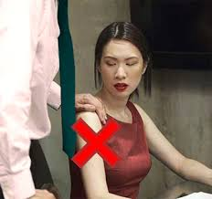
Grooming Process: Phase 3
Desensitizing the student to touch
Notes:
Directions for Presenter: Italics
Information for Presenter to Convey: Bold
Presenter’s Notes: (Time: 30 Seconds)
SAY: Phase 3 is desensitizing the student to touch.
The boundaries become blurred between appropriate and inappropriate touching.
There is teasing and joking around.
There is accidental touching.
Touch becomes a common practice and is seen as a loving and caring gesture on the part of the educator.
Think back to the touching that occurred in the video scenario.
Source Cited: Cook, R., and Smith, M. (2009). Improper Staff/Student Relationships: What You Need to Know About Sexual Grooming. Property and Casualty for Education. Retrieved from http://sdao.com/ref/PACE/improper_staff_student_relationships.pdf

Slide 36

Grooming Process: Phase 4
Isolating the student
Notes:
Directions for Presenter: Italics
Information for Presenter to Convey: Bold
Presenter’s Notes: (Time: 30 Seconds)
SAY: Phase 4 is isolating the student.
Usually there is private coaching, tutoring, and even providing transportation for school- and non-school-sponsored events.
The student might stay overnight at the teacher’s house.
Sometimes the educator hires the student for babysitting, housekeeping, and yard maintenance.
Many cases have involved camping or overnight trips.
Source Cited: Cook, R., and Smith, M. (2009). Improper Staff/Student Relationships: What You Need to Know About Sexual Grooming. Property and Casualty for Education. Retrieved from http://sdao.com/ref/PACE/improper_staff_student_relationships.pdf

Slide 37

Grooming Process: Phase 5
Making the student feel responsible
Notes:
Directions for Presenter: Italics
Information for Presenter to Convey: Bold
Presenter’s Notes: (Time: 30 Seconds)
SAY: The last phase of grooming is when the adult makes the child feel responsible.
The adult makes the student think he or she will get in trouble if anyone finds out.
The adult stresses that people would not believe the student.
This phase is especially effective if alcohol, drugs, or pornography is involved.
SAY: So what would guidelines look like at a campus? Let’s take a look.
Source Cited: Cook, R., and Smith, M. (2009). Improper Staff/Student Relationships: What You Need to Know About Sexual Grooming. Property and Casualty for Education. Retrieved from http://sdao.com/ref/PACE/improper_staff_student_relationships.pdf

Slide 38

What are the teacher behavior
expectations on your campus?
Notes:
Directions for Presenter: Italics
Information for Presenter to Convey: Bold
Presenter’s Notes: (Time: 2½ Minutes)
SAY: On your campus, are the expectations clear regarding educator/student relationships? If so, what are they?
Are they formally presented and in written form?
Is there any room for confusion or misunderstanding?
Allow the group to respond and encourage them to review and discuss local district/campus policies.

Slide 39
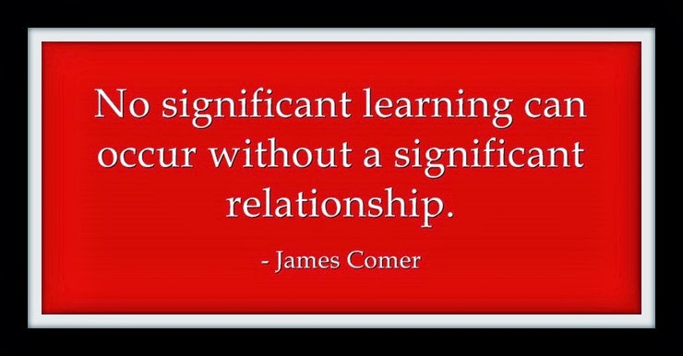
Maintaining Professional Boundaries
Notes:
Directions for Presenter: Italics
Information for Presenter to Convey: Bold
Presenter’s Notes: (Time: 30 Seconds)
SAY: We have discussed the negative impact of crossing boundaries with students.
We have talked about inappropriate relationships between educators and students.
Let’s stop for a moment and consider the importance of this quote: “No significant learning can occur without a significant relationship.”
SAY: We cannot and will not downplay the importance of strong relationships between students and educators. To ensure great academic success, a school system must have educators who care about and relate to their students. How can we support our students and still remain within the ethical boundaries? (rhetorical question)

Slide 40

Maintaining Professional Boundaries
Professional boundaries can be maintained by making them transparent, approved, and timely.
Notes:
Directions for Presenter: Italics
Information for Presenter to Convey: Bold
Presenter’s Notes: (Time: 1 Minute)
SAY: It sounds easy, yet we continue to have ethical violations. As a rule of thumb, consider the three indicators that can help you determine if an action is an ethical violation.
Is it transparent for all to see?
Is it approved by my supervisor?
Does it occur during the regular school day or at a school-approved activity?
SAY: If so, most likely, it is not an ethical violation. Educators are responsible for their behavior at all times.
Example: A student needs a ride home. What do you do?

Slide 41

Maintaining Professional Boundaries
Notes:
Directions for Presenter: Italics
Information for Presenter to Convey: Bold
Presenter’s Notes: (Time: 30 Seconds)
SAY: There are SO many students who NEED a positive educator in their life. For some, the educator will be the only role model around. Are you up for the challenge? Let’s see what skills are necessary to build that supportive relationship.

Slide 42
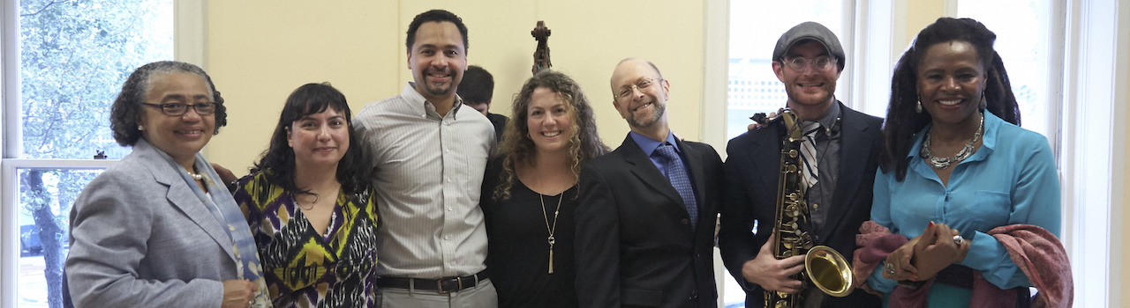
Maintaining Professional Boundaries
Build a supportive relationship by being a teacher and not a friend.
We listen, guide, praise, correct, respect, honor, discipline, and TEACH effectively.
Notes:
Directions for Presenter: Italics
Information for Presenter to Convey: Bold
Presenter’s Notes: (Time: 1 Minute)
SAY: Educators must possess a skill set that provides the opportunity to build a supportive relationship with students. This supportive relationship will foster good attendance, good grades, and even good behavior. A few essential skills are:
Listening
Guiding
Praising
Correcting
Respecting
Honoring
Disciplining
Teaching effectively
We owe that to our students and the communities we serve. It is why we chose this honorable profession.

Slide 43
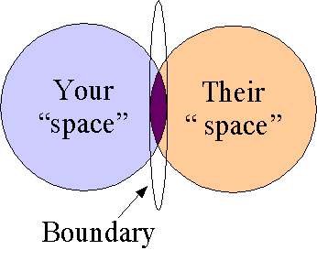
Guideline Expectations
Don’t have one-on-one meetings behind closed doors or personal social media exchanges.
Do listen, praise, and guide your students.
Notes:
Directions for Presenter: Italics
Information for Presenter to Convey: Bold
Presenter’s Notes: (Time: 30 Seconds)
The information contained in the next three slides provides recommendations to help teachers ensure they avoid ethical boundary violations. This is not an inclusive list. However, these are some of the most common occurrences that lead to sanctions against teachers.
Read the information on the slide.
SAY: It is important to follow guidelines as specified in the district policy.
If you’re alone with a student, the door must remain open.
Social media exchanges include personal emails, Facebook posts, tweets, and any other form of social media interaction between you and your students.

Slide 44
Guideline Expectations
Don’t have meetings with your students away from school, and don’t exchange personal gifts.
Do respect, discipline, and honor your students.
Notes:
Directions for Presenter: Italics
Information for Presenter to Convey: Bold
Presenter’s Notes: (Time: 30 Seconds)
Read the information on the slide.

Slide 45
Guideline Expectations
Don’t have physical contact with your students.
Do correct and teach your students.
Notes:
Directions for Presenter: Italics
Information for Presenter to Convey: Bold
Presenter’s Notes: (Time: 30 Seconds)
Read the information on the slide.
SAY: Keep your hands and other body parts to yourself.
Remember to refer students to the appropriate person for counseling and/or other discussions about personal matters.
Maintain a professional barrier between you and your students.
You are the adult, the educator, and the professional; act like the expert at all times.
Most of all, avoid putting yourself in a position where you have to defend, explain, or justify your behavior or actions.

Slide 46

Notes:
Directions for Presenter: Italics
Information for Presenter to Convey: Bold
Presenter’s Notes: (Time: 8 Minutes)
Ask participants to find the section in their journal titled “What Would You Do?” Participants will work in table groups but also record their responses in their respective journals.
Once participants have finished completing the activity, call on a couple of groups and ask them to provide their responses to each of the scenarios. Afterward, provide participants with any additional correct responses listed in the Performance Task Key.
SAY: Take a few minutes to complete the performance task in the journal section titled “What Would You Do?” Read and review each scenario. Use the information that was just presented to you regarding strategies to maintain professional boundaries. Think about that boundary between your space and your students’ space.
Discuss the issues surrounding the scenario and determine what you would do if you were the teacher to avoid a boundary violation. Record your determination.

Slide 47

Notes:
Directions for Presenter: Italics
Information for Presenter to Convey: Bold
Presenter’s Notes: (Time: 2 Minutes)
Ask participants to find the section in their journal titled “Module 1 Reflection Activity” and respond to the reflection question. Participants will work in table groups but also record their responses in their respective journals.
SAY: Complete the reflection assignment by responding to the question in your journal.

Slide 48

Notes:
Directions for Presenter: Italics
Information for Presenter to Convey: Bold
Presenter’s Notes: (Time: 5 Minutes or completed by an assigned time after the training)
SAY: Each participant is required to complete an assessment based on the information received in this training. You must receive a score of 100 to receive credit for this module training.
You can provide each participant with the Module 1 assessment to complete as a culminating activity. Districts can alternately choose to have participants complete the assessment during a follow-up session or have them complete the assessment on their own within a designated period of time and submit it to their campus principal.

Slide 49

Notes:
Directions for Presenter: Italics
Information for Presenter to Convey: Bold
Presenter’s Notes: (Time: 1 Minute)
Before concluding the training session, ask participants if they have any questions about the information they received today. Answer any questions as applicable.

Slide 50
References
Bird, S. (2013). Managing professional boundaries. Australian Family Physician (AFP), 42(9). Retrieved from http://www.racgp.org.au/afp/2013/September/managing-professional-boundaries
Chang, J. (2016, May). Improper teacher-student cases on track to break Texas record. Austin American-Statesman. Retrieved from http://www.mystatesman.com/news/news/improper-teacher-student-cases-on-track-to-break-t/nrK42/
Cook, R., & Smith, M. (2009). Improper Staff/Student Relationships: What You Need to Know About Sexual Grooming. Property and Casualty for Education. Retrieved from http://sdao.com/ref/PACE/improper_staff_student_relationships.pdf
Fechter, J. (2015, March). Former Seguin high school teacher who pleaded guilty to sex with student lands on 'Most Wanted’ list. San Antonio Express-News. Retrieved from http://www.mysanantonio.com/news/local/crime/article/Former-Texas-high-school-teacher-who-pleaded-6167573.php
Hamilton, J. (2016, February). Texas teacher, student seen in sex tape to appear on Dr. Phil. Houston Chronicle. Retrieved from http://www.chron.com/news/houston-texas/texas/article/Texas-teacher-student-seen-in-sex-tape-to-appear-6848839.php
Hope, M. (2015, March). 41% increase in Texas teacher-student sexual misconduct cases. Breitbart Texas Online News. Retrieved from http://www.breitbart.com/texas/2015/03/19/41-increase-in-texas-teacher-student-sexual-misconduct-cases/
Notes:
Directions for Presenter: Italics
Information for Presenter to Convey: Bold
References for sources cited. You do not need to reference this slide.

Slide 51
References
Hope, M. (2015, December). Teacher-student sex rampant in Texas: Lawmakers seek solutions. Breitbart Texas Online News. Retrieved from http://www.breitbart.com/texas/2015/12/11/texas-lawmakers-seek-solutions-rampant-teacher-student-sexual-misconduct/
Levin, M. (2015, December). Inappropriate teacher-student relations in Texas kept going up in 2015. Houston Chronicle. Retrieved from http://www.chron.com/news/education/article/Inappropriate-teacher-student-relations-in-Texas-6719904.php
Pennsylvania Professional Standards and Practices Commission. (n.d.). Unit 3: The teacher/student relationship. Educator Ethics and Conduct Toolkit. Retrieved from http://www.pspc.education.pa.gov/Promoting-Ethical-Practices-Resources/Ethics-Toolkit/Unit3/Pages/The-Teacher---Student-Relationship.aspx
Phillips, D. (2014). Inappropriate Relationships Between Educators and Students [PDF Document]. Retrieved from www.taspa.org/mpage/2014sumconfHandouts
Teacher charged, says she ‘fell in love' with 15-year-old student. (2015, December). Lansington State Journal. Retrieved from http://www.lansingstatejournal.com/story/news/local/2015/12/16/teacher-charged-says-she-fell-in-love-with-15-year-old-student/77464844/
Teacher Registration Board, Northern Territory. (2015, September). Managing Professional Boundaries. Retrieved from http://www.trb.nt.gov.au/__data/assets/pdf_file/0019/40915/Managing-Professional-Boundaries-Guidelines-for-Teachers-.pdf
19. Tex. Admin. Code §247.1.
Notes:
Directions for Presenter: Italics
Information for Presenter to Convey: Bold
References for sources cited. You do not need to reference this slide.

