Slide 1
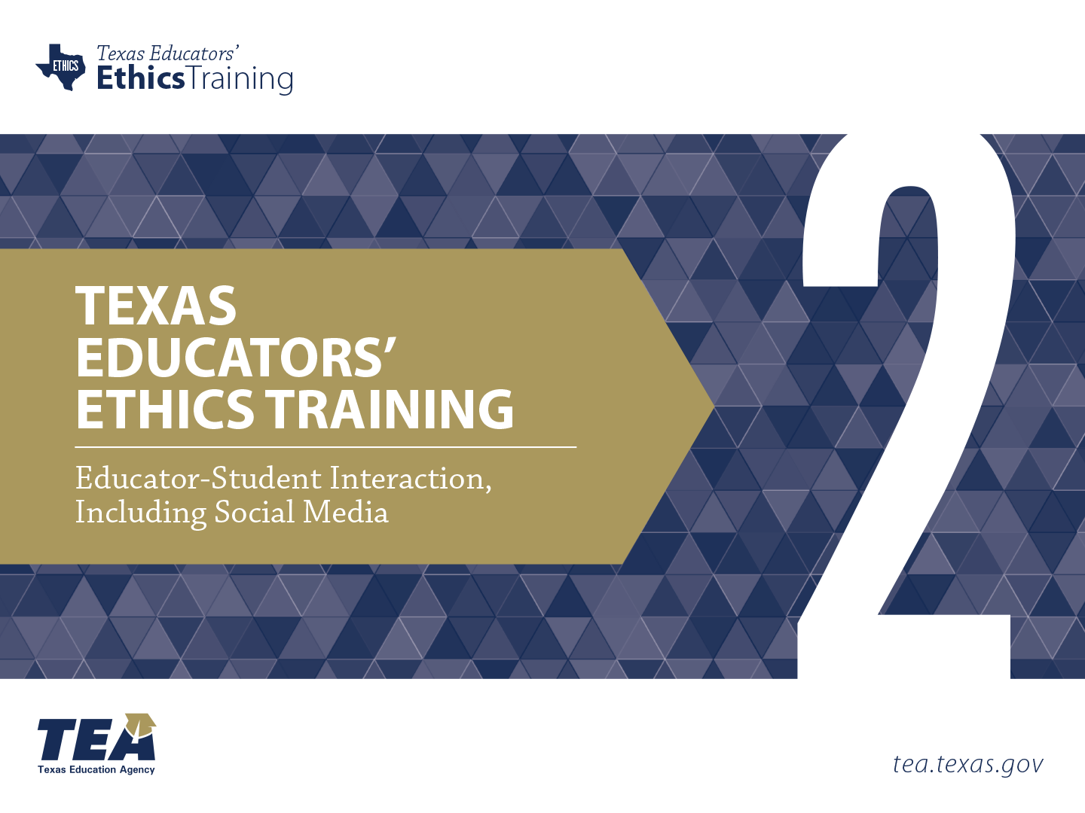
Notes:
Directions for Presenter: Italics
Information for Presenter to Convey: Bold
Presenter’s Notes: (Time: 1 Minute)
Welcome participants. If this is a new group of participants, introduce yourself to the group.
SAY: This is the second of six ethics training modules for Texas educators. Module 2 will focus on Educator-Student Interaction, Including Social Media.
It is advisable to have participants seated at tables to encourage group dialogue. Participants will also be provided with a reflection journal.
Materials for Participants:
Journal
Materials for Presenter:
PowerPoint for Module 2
LCD Projector, Screen, Speakers, and Computer
Slide Advancer
Participant Toolbox is recommended (index cards, sticky notes, markers, pencils/pens, etc.)
Copies of Module Assessment
Performance Task Key
Assessment Key

Slide 2


Purpose
The session will focus on interactions between educators and students, with a special emphasis on the utilization of social/electronic media.
Notes:
Directions for Presenter: Italics
Information for Presenter to Convey: Bold
Presenter’s Notes: (Time: 1 Minute)
Discuss the purpose of the training by reading or verbally summarizing the information on the slide.
State that for the purpose of the discussion, participants should consider both social media, such as Facebook, as well as electronic media, such as text messages.

Slide 3

Stimulating Thinking
How does social media influence my work with students?
How do interactions with students influence laws and policies?
Notes:
Directions for Presenter: Italics
Information for Presenter to Convey: Bold
Presenter’s Notes: (Time: 2 Minutes)
SAY: As we prepare to begin our training session, these are the overarching essential questions that we will conceptualize today. Please respond to the essential questions while you wait for the training session to begin. You may use the Module 2 note-taking section in your journal to record your responses.
Note-Taking Strategy: Participants can use the Module 2 note-taking section of their journal to record their responses to the essential questions. They can respond to the essential question while they are waiting for the session to begin.

Slide 4

Participants will
articulate effective uses of social media to enhance student learning;
gain an understanding of appropriate and inappropriate social media interactions;
identify social media grooming actions used to initiate inappropriate teacher -student relationships; and
make connections between social media utilization guidelines, recommendations, and educator misconduct consequences.
Notes:
Directions for Presenter: Italics
Information for Presenter to Convey: Bold
Presenter’s Notes: (Time: 1 Minute)
SAY: Let’s take a moment to review the session objectives. Today we will discuss how to use social media to enhance student learning; learn about appropriate and inappropriate social media interactions; identify social media grooming actions used to initiate inappropriate educator-student relationships; and discover the connections between social media utilization guidelines, recommendations, and educator misconduct consequences.

Slide 5


Positive Impact of Social Media
Enhancing Learning Outcomes
Notes:
Directions for Presenter: Italics
Information for Presenter to Convey: Bold
Presenter’s Notes: (Time: 1 Minute)
SAY: Although social media tools and platforms can expose students to a variety of inappropriate situations, it is important to emphasize that research indicates using social media as a learning tool can have a positive impact on student learning.
Educators are doing a great job increasing their expertise in creating real-world lessons that engage learners and make learning experiences more relevant through the integration of technology.

Slide 6

How can the utilization of social media by educators cross serious teacher-student boundaries?
Notes:
Directions for Presenter: Italics
Information for Presenter to Convey: Bold
Presenter’s Notes: (Time: 30 Seconds)
Read the question on the slide before making the following statement.
SAY: When you’ve heard or read stories about teachers crossing boundaries with students, I’m sure you asked yourself, “WOW, how does something like that even happen?” The point of no return happens in the blink of an eye.
The increased use of social media is having an impact on the number of educator misconduct cases.
It is important to remember that social media allows for direct, unsupervised contact between an educator and a student.

Slide 7

Social Media Boundary Crossings
What begins with an innocent string of social media communications (intentional or not) can soon lead to a strong emotional connection with a student.
Notes:
Directions for Presenter: Italics
Information for Presenter to Convey: Bold
Presenter’s Notes: (Time: 30 Seconds)
Read the statement on the slide. This slide ties to the previous slide. Elaborate with the following information.
SAY: These incidents of misconduct do not begin with the intention of being inappropriate with a student. However, social media communications can accelerate inappropriate dialogue.
Very quickly, educators find themselves on a slippery slope where a teacher-student boundary is crossed.

Slide 8
An Inappropriate Relationship Begins
Voluntary statement given to law enforcement:
“I began playing Words With Friends with several students before the end of the school year, including Gabriella. I often chatted with students about the game. My conversations began innocently, but after school let out in June my conversations with Gabriella became more intense.”
(Name has been changed.)
Notes:
Directions for Presenter: Italics
Information for Presenter to Convey: Bold
Presenter’s Notes: (Time: 1 Minute)
SAY: This is an actual statement from a teacher to law enforcement. This is how an inappropriate teacher-student relationship began, in the words of the teacher.
Ask for a volunteer or select a participant to read the slide information.
Advance the slide.
Source Cited: Texas Education Agency Division of Educator Investigations. Redacted Case Files.

Slide 9
An Inappropriate Relationship Ends
Voluntary statement given to law enforcement:
“I told my wife that I had an emotional relationship with Gabriella and it moved beyond an appropriate boundary between a teacher and student. My wife was angry and demanded that I terminate contact with Gabriella entirely. I then emailed Gabriella and asked her to not try and contact me or my wife and I apologized for any emotional harm I had caused her.”
(Name has been changed.)
Notes:
Directions for Presenter: Italics
Information for Presenter to Convey: Bold
Presenter’s Notes: (Time: 1 Minute)
SAY: This is a direct quote taken from the teacher’s statement indicating how he ended the inappropriate relationship.
Ask for a volunteer or select a participant to read the slide information.
Source Cited: Texas Education Agency Division of Educator Investigations. Redacted Case Files.

Slide 10

Outcome of This Case
The teacher voluntarily surrendered
his teaching certificate.
Notes:
Directions for Presenter: Italics
Information for Presenter to Convey: Bold
Presenter’s Notes: (Time: 30 Seconds)
SAY: This teacher voluntarily surrendered his teaching certificate.
While the entire statement was not included, you are able to see how a relationship can begin quite innocently before crossing a boundary within a short period of time.
Many people were hurt by this teacher’s actions.
Our responsibility, however, is to the student. We are responsible for our students’ safety and well-being at all times.
Source Cited: Texas Education Agency Division of Educator Investigations. Redacted Case Files.

Slide 11
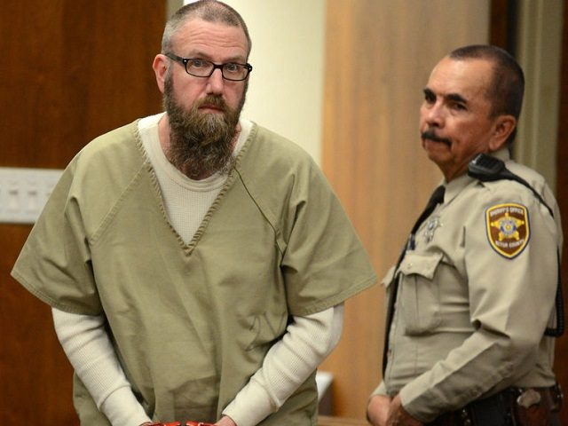
Sentenced to 60 Years in Prison
Photo Source: Sterkel, M. (2016, February). Burns rejects plea deal [digital image]. Odessa American Online. Retrieved from http://www.oaoa.com/news/crime_justice/courts/article_f56a1608-d7db-11e5-b352-43f5acd290c0.html
Notes:
Directions for Presenter: Italics
Information for Presenter to Convey: Bold
Presenter’s Notes: (Time: 1 Minute)
Once this slide comes up, make it a point not to say anything at first. Let the participants take in the powerful impact of the picture. Wait about 10 seconds and then read the headline and emphasize that this is often the end result of social media communications that crossed the line into sexual misconduct between a teacher and a student.
SAY: This former Texas teacher and academic decathlon coach was sentenced to 60 years in prison for sexual misconduct with two students.
Both victims testified they had sexual encounters with the teacher.
They stated that their relationships with their teacher began on social media, specifically on Tumblr and the fetish website FetLife. The relationships also included communications over encrypted phone apps such as Kik and Wickr.
Advance the slide.
Sources Cited:
Miller, N. (2016, May). Jay Dee Burns receives sentence of 60 years in prison. Odessa American Online. Retrieved from http://www.oaoa.com/news/crime_justice/courts/article_28b9a59e-1203-11e6-911e-8bdd8ad682d3.html
Sterkel, M. (2016, February). Burns rejects plea deal [digital image]. Odessa American Online. Retrieved from http://www.oaoa.com/news/crime_justice/courts/article_f56a1608-d7db-11e5-b352-43f5acd290c0.html

Slide 12
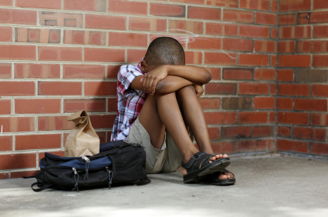
15 times EVERY week in this country
Notes:
Directions for Presenter: Italics
Information for Presenter to Convey: Bold
Presenter’s Notes: (Time: 30 Seconds)
SAY: Fifteen times a week, a school employee is convicted or accused of having an inappropriate relationship with a student. That’s 15 times too many. It’s happening to the very students who trust us to do what we are hired to do as educators.
Source Cited: Bacon-Blood, L. (2015, January). Louisiana No. 3 for inappropriate teacher-student relationships, former U.S. education official says. The Times-Picayune. Retrieved from http://www.nola.com/education/index.ssf/2015/01/llouisiana_no_3_for_inappropriate_teacher-student_relationships_former_us_education_official_says.html

Slide 13

Is Social Media to Blame for Inappropriate Student-Teacher Relationships?
Notes:
Directions for Presenter: Italics
Information for Presenter to Convey: Bold
Presenter’s Notes: (Time: 2 Minutes)
Paired and Large Group Discussion
SAY: This is a news headline from a TV station in Texas.
What are your thoughts? Do you believe that social media could be a catalyst for inappropriate teacher-student relationships? Please share your viewpoint on this question.
This is an evaluative segment to determine if participants believe social media communications are causing educator misconduct. Give participants one minute to discuss this question with a partner at their table. Ask for volunteers to share their viewpoints. It is important for participants to identify possible reasons this is happening. Stress that there should never be an acceptable reason or excuse for engaging in an inappropriate teacher-student relationship. As an example, an educator who is depressed or lonely should seek help from a medical professional, support group, etc., but never from a student.
Source Cited: Stiner, L. (2012). Is social media to blame for inappropriate student-teacher relationships? ABC News 7 The Panhandle Spirit. Retrieved from http://abc7amarillo.com/news/local/is-social-media-to-blame-for-inappropriate-student-teacher-relationships

Slide 14

The Impact of Social Media
In Texas, social media and text messaging continue to be the driving factors in the number of sexual misconduct cases investigated.
Notes:
Directions for Presenter: Italics
Information for Presenter to Convey: Bold
Presenter’s Notes: (Time: 30 Seconds)
SAY: While there can be many factors that lead to inappropriate relationships with students, social media is the no. 1 factor in cases involving sexual misconduct that are being investigated by the Texas Education Agency.
Many social media platforms can be used to conduct communication secretly, thus making it easier for incidents to occur.
Emphasize the point below:
SAY: It is important for every campus to clarify and provide clear guidelines regarding the use of social media for educational purposes.

Slide 15

Technology Tools and Platforms
.
Notes:
Directions for Presenter: Italics
Information for Presenter to Convey: Bold
Presenter’s Notes: (Time: 2 Minutes)
SAY: We use our cell phones, we text, and we communicate using Facebook, Snapchat, and other social media platforms many times a day. The technology icons shown on the slide are just a few of the numerous technology tools and platforms available for users.
There is a fine line between utilizing technology and social media to enhance learning AND using technology and social media to enhance personal relationships with students.
Unfortunately, concern is rapidly growing that these forms of interactive communication are bringing teachers and students too close for comfort. This should be stated with great emphasis.
SAY: What does your local policy require regarding the utilization of social media with students? Can you share some examples?
The school district may choose to insert an image of their local policy or highlights from their policy to discuss with staff members during this session. If participants are not aware of their local policy, this will be helpful information in order to provide greater training support for staff members.

Slide 16

Social media leaves a digital footprint.
Notes:
Directions for Presenter: Italics
Information for Presenter to Convey: Bold
Presenter’s Notes: (Time: 30 Seconds)
SAY: The reality of social media is that it leaves a digital footprint for investigators to follow. It makes it easier to identify the victims.
Voicemails, emails, texts, Facebook posts, tweets, and even messages on apps where messages disappear (they don’t ever really disappear) will forever be in existence.
A record of social media interactions is aiding investigations by providing evidence needed to sanction educators who have improper relationships with their students. It also provides investigators with specific evidence of educator misconduct.
The fact remains that the majority of educators have been charged after social media or text messages with their alleged victims are exposed. (Emphasize this.)
Let’s watch a video that addresses this situation.
Source Cited: Niederberger, M. (2015, May). Schools tighten social media contacts. The Washington Times. Retrieved from http://www.washingtontimes.com/news/2015/may/30/schools-tighten-teacher-student-social-media-conta/?page=all

Slide 17
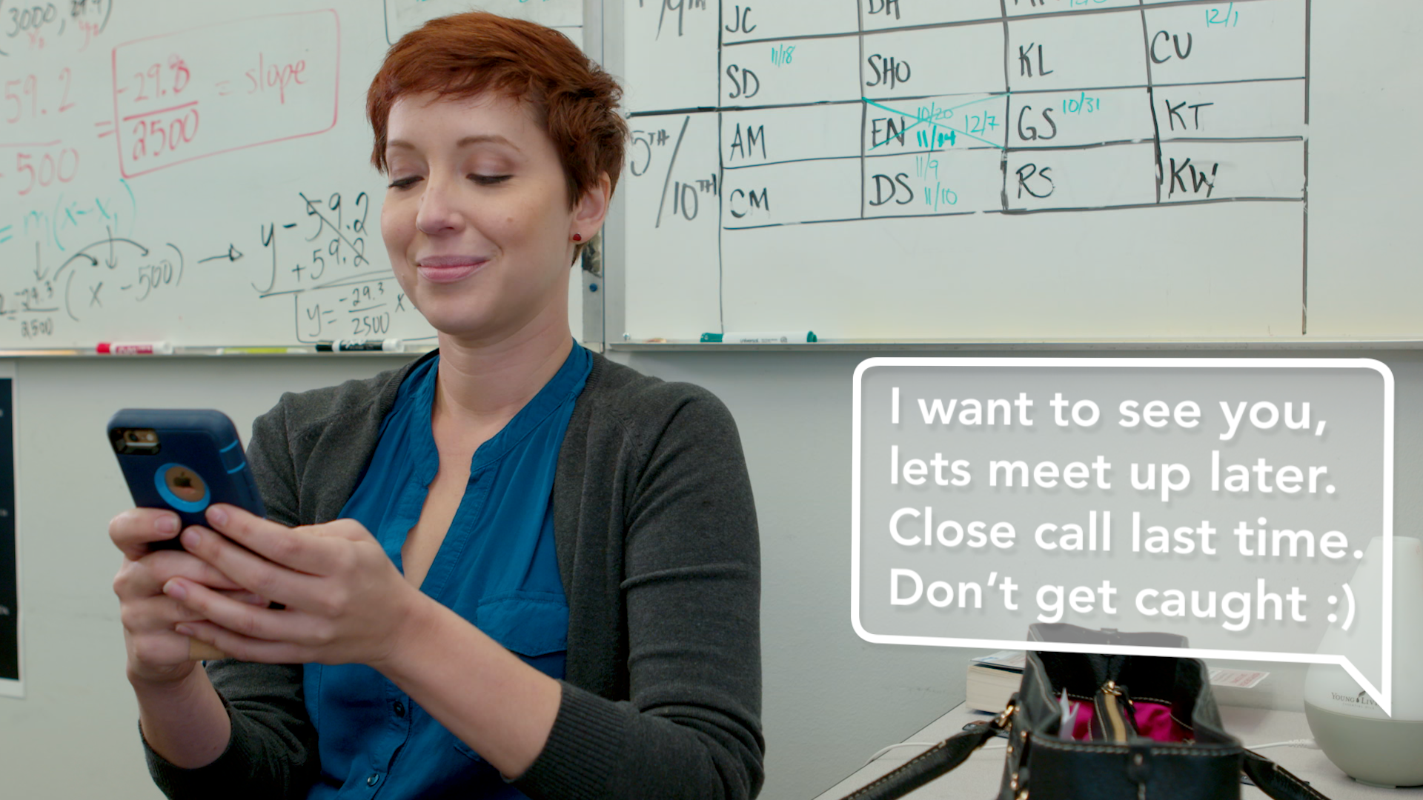

Video Scenario
Notes:
Directions for Presenter: Italics
Information for Presenter to Convey: Bold
Presenter’s Notes: (Time: 5 Minutes)
Video Scenario for Presenter’s Reference:
A teacher sends frequent text, phone, and social media messages to one of her high school students. The messages clearly indicate sexual misconduct has occurred. The parent of the student meets with the principal to notify her of the inappropriate relationship after the parent discovers her son’s social media interactions with the teacher.

Slide 18

Video Scenario Debrief
Notes:
Directions for Presenter: Italics
Information for Presenter to Convey: Bold
Presenter’s Notes: (Time: 5 Minutes)
Large Group Discussion
SAY: Let’s take a few minutes to discuss what you just saw.
Ask one question at a time. Call on volunteers to share responses.
What thoughts came to mind as you watched the scenario unfold?
What inappropriate actions did the teacher exhibit?
Would most parents have handled the situation in the same way that the student’s mother did? What are your thoughts?
How could this type of inappropriate teacher-student relationship be prevented?
FEEDBACK: If participants do not state them, stress the following points: (1) The teacher called the student and requested to see him under the cloak of secrecy; (2) This was not the first time the teacher had been alone with the student; (3) The teacher sent racy pictures and a suggestive message to the student; and (3) The mother told her son that she was going to report the incident because she loved him and wanted to protect him from being hurt further. Emphasize that everyone has the responsibility to report incidents. Refer back to the video scenario throughout the remainder of the module.

Slide 19

Sobering Statistics
Notes:
Directions for Presenter: Italics
Information for Presenter to Convey: Bold
Presenter’s Notes: (Time: 30 Seconds)
SAY: Knowing that an inappropriate relationship between an educator and a student can happen quickly reinforces the reason why the statistics are extremely sobering.
According to Doug Phillips, director of educator investigations with the Texas Education Agency, “There has been more than a 99 percent increase in the number of investigations into inappropriate student-teacher relationships in Texas in the past seven years.”
Let’s take a look at the trend over the last four years.
Advance the slide to show the four-year statistics of the number of investigations that were opened.

Slide 20
Cases Opened on Inappropriate Relationships with a Student / Minor
Notes:
Notes: (Time: 1½ Minutes)
Paired and Large Group Dialogue
SAY: As you can see, the number of educator misconduct investigations has been increasing each year.
There were 188 cases involving inappropriate relationships opened during the 2014–2015 school year.
Roughly 100 of these educators were arrested.
As of August 31, 2016, there were a total of 1,090 opened cases, including all types of educator misconduct investigations.
SAY: Talk to the person seated next to you to determine the implications for Texas schools.
Ask for volunteers to share their perspective about the rise in the number of cases. Emphasize the historical increases.
Source Cited: Texas Education Agency Division of Educator Investigations.
e 20

Slide 21

Treading on Dangerous Ground
Treading on Dangerous Ground
Notes:
Directions for Presenter: Italics
Information for Presenter to Convey: Bold
Presenter’s Notes: (Time: 30 Seconds)
Transition Slide
SAY: After viewing the statistics and listening to your responses, it reinforces the fact that some educators put themselves in situations where they tread on dangerous ground by crossing boundaries with their students, especially when using social media.
Let’s review information that can help us become more aware of how this happens.
Advance the slide.

Slide 22

Educators and Social Media
Four out of five educators use social media for personal communication. However . . .
More than 62% of educators surveyed have had minimal or no training in the area of interacting with students and parents through social media.
(University of Phoenix College of Education, 2015)
Notes:
Directions for Presenter: Italics
Information for Presenter to Convey: Bold
Presenter’s Notes: (Time: 1 Minute)
SAY: A recent survey indicates that two-thirds of Americans are social media users. Slide information can be summarized verbally or read verbatim.
Although this data shows that the majority of educators use social media, those surveyed believe they have received minimal or no training in how to interact with students and parents through the use of social media.
Knowing this information, we might be able to generalize that increased training for educators in the use of appropriate social media interactions with students could have a positive impact on decreasing inappropriate educator-student relationships.
Sources Cited:
Perrin, A. (2015, October). Social Media Usage: 2005–2015. Pew Research Center. Retrieved from http://www.pewinternet.org/files/2015/10/PI_2015-10-08_Social-Networking-Usage-2005-2015_FINAL.pdf
University of Phoenix. (2015, August). Despite embracing new technology, 87 percent of K-12 educators have not integrated social media into the classroom. University of Phoenix College of Education. Retrieved from http://www.phoenix.edu/news/releases/2015/08/87_percent_k-12_educators_not_integrated_social_media_into_classroom.html

Slide 23
STUDENTS
GROOMING
Awareness
Social Media
Notes:
Directions for Presenter: Italics
Information for Presenter to Convey: Bold
Presenter’s Notes: (Time: 30 Seconds)
SAY: For the purposes of today’s session, we will briefly review a few grooming behaviors that are sometimes used by adults to initiate inappropriate relationships with students.
The information will provide everyone with an awareness of how social media can become an accelerant in exploiting students through the use of grooming strategies.
Source Cited: Shoop, R. Sexual Exploitation in Schools: How to Spot It and Stop It. Thousand Oaks, CA: Corwin Press.

Slide 24

Actions That Can Appear as Grooming Through the Use of Social Media
Frequently calling or sending text messages just to check in
Sending pictures, jokes, or information that is inappropriate
Sending messages that are becoming increasingly friendly or sexual in nature
Conducting social media interactions in secrecy
Notes:
Directions for Presenter: Italics
Information for Presenter to Convey: Bold
Presenter’s Notes: (Time: 1 Minute)
Participants who have completed Module 1 will have been introduced to grooming phases. This section is related to grooming that involves social media communications.
SAY: As a quick review, grooming is when an adult engages in increasingly inappropriate boundary violations to gain the trust of a student.
These are just a few examples of how an adult can use social media to groom a student.
Click on the slide advancer four times to display each bulleted item. Read each bulleted item as it displays.
SAY: Grooming strategies set the stage for a possible sexual relationship with a student by determining their level of vulnerability.
Social media interactions with the student can fuel grooming opportunities because of the unique capability to communicate secretly and frequently.
These are just a few examples of what is termed “grooming students.” There are several more actions that fall under this category.
Source Cited: Shoop, R. Sexual Exploitation in Schools: How to Spot It and Stop It. Thousand Oaks, CA: Corwin Press.

Slide 25

Appropriate vs. Inappropriate
Notes:
Directions for Presenter: Italics
Information for Presenter to Convey: Bold
Presenter’s Notes: (Time: 30 Seconds)
SAY: We have covered a lot of information. I would like to conduct a quick check for understanding regarding appropriate versus inappropriate social media communications. I will read a couple of example texts between a teacher and a student.
Advance to the next slide for the check for understanding activity.

Slide 26
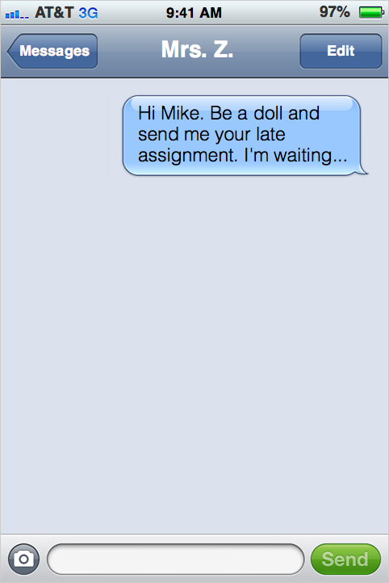
Notes:
Directions for Presenter: Italics
Information for Presenter to Convey: Bold
Presenter’s Notes: (Time: 15 Seconds)
Read the text message from Mrs. Z to participants. Advance the slide to display the student’s response.

Slide 27
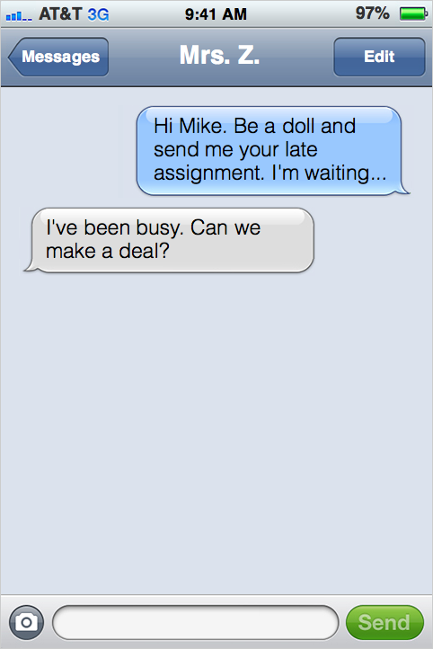
Notes:
Directions for Presenter: Italics
Information for Presenter to Convey: Bold
Presenter’s Notes: (Time: 15 Seconds)
Read the reply from the student (Mike). Advance the slide to display the teacher’s response.

Slide 28
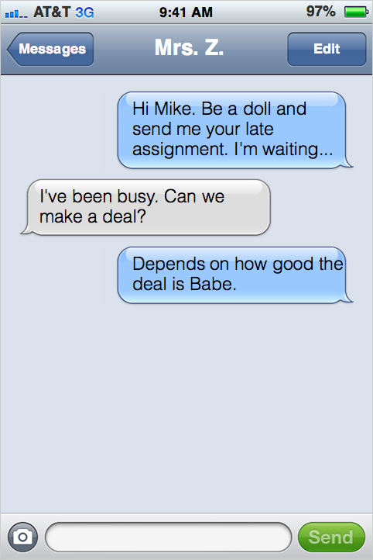
Notes:
Directions for Presenter: Italics
Information for Presenter to Convey: Bold
Presenter’s Notes: (Time: 15 Seconds)
Read the response from Mrs. Z. Advance to the next slide.

Slide 29
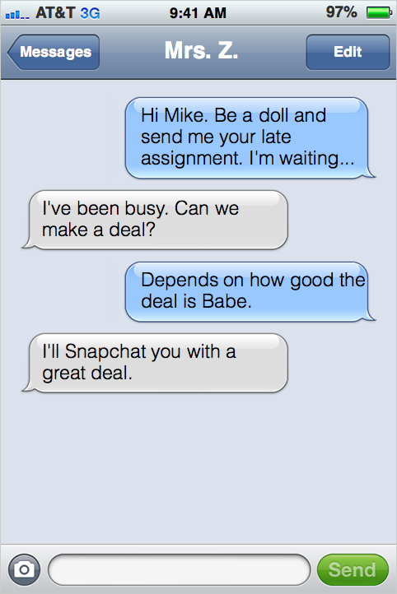
Notes:
Directions for Presenter: Italics
Information for Presenter to Convey: Bold
Presenter’s Notes: (Time: 15 Seconds)
Read the final response from the student. Advance to the next slide to discuss the string of messages.

Slide 30

Notes:
Directions for Presenter: Italics
Information for Presenter to Convey: Bold
Presenter’s Notes: (Time: 3 Minutes)
Large Group Discussion
SAY: What alarms are going off based on the content of these text messages?
Participants should respond that the text messages are inappropriate. Probe for reasons if none are given. Participants should state that the teacher initiated the inappropriate text interaction. Emphasize the point with the following statement.
SAY: In this string of text messages, the teacher initiated an interaction that was not professional and clearly crossed a boundary with the student. Mrs. Z opened the door to the inappropriate banter that occurred between them. Although the student should not have responded like he did, it was the teacher’s responsibility to prevent this type of banter.
Now, let’s briefly review one more teacher-student interaction.
Advance the slide.
Important Note: On the last slide in this series of text messages, participants will be asked to determine what they would do if they received an inappropriate message from a student.

Slide 31
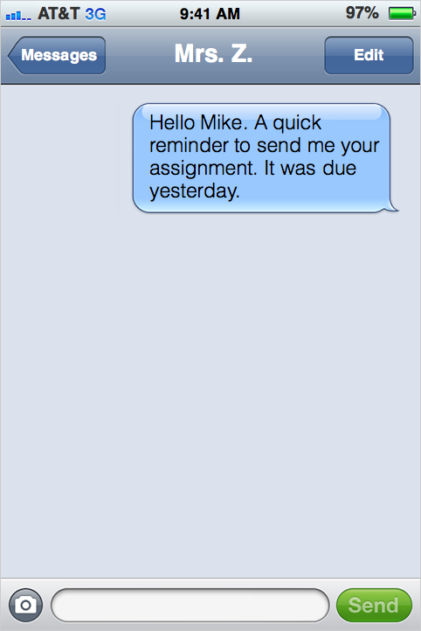
Notes:
Directions for Presenter: Italics
Information for Presenter to Convey: Bold
Presenter’s Notes: (Time: 15 Seconds)
Read the text message from Mrs. Z to participants. Advance the slide to display the student’s response.

Slide 32
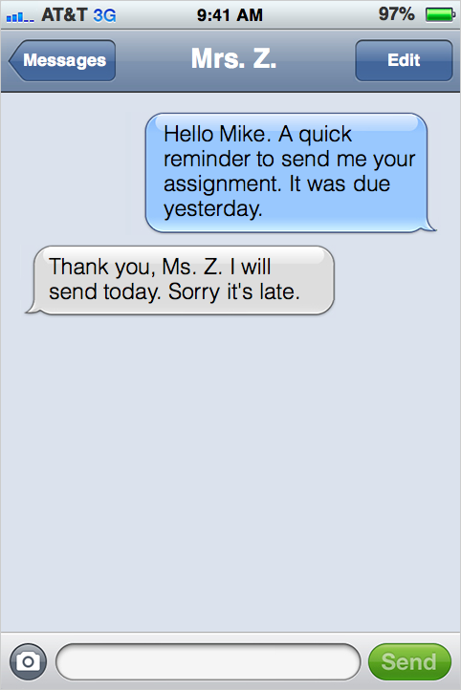
Notes:
Directions for Presenter: Italics
Information for Presenter to Convey: Bold
Presenter’s Notes: (Time: 15 Seconds)
Read the reply from the student. Advance the slide to display the teacher’s response.

Slide 33
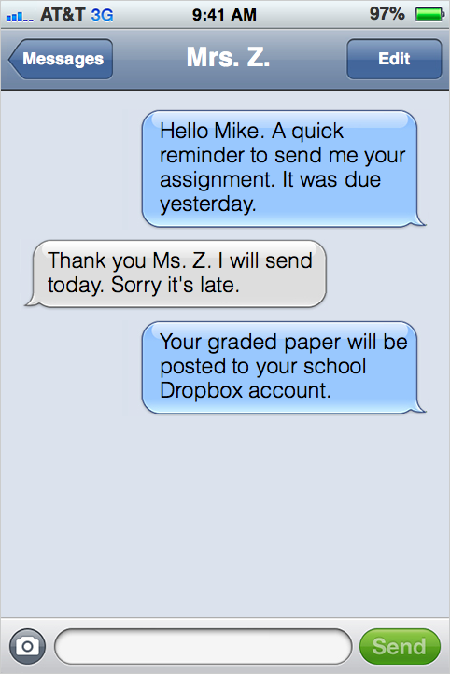
Notes:
Directions for Presenter: Italics
Information for Presenter to Convey: Bold
Presenter’s Notes: (Time: 30 Seconds)
Read the final response from Mrs. Z. Advance the slide to display the discussion slide.

Slide 34

Notes:
Directions for Presenter: Italics
Information for Presenter to Convey: Bold
Presenter’s Notes: (Time: 3 Minutes)
Large Group Discussion
SAY: What aspects of this text interaction provide evidence of appropriate communication between a teacher and a student?
Briefly provide time for participants to respond to the large group. Look for responses such as “The communication was professional, courteous, and specific” and “The teacher referenced a school-issued Dropbox account for assignment uploading.”
ADDITIONAL INFORMATION IF NEEDED:
These are a few examples of appropriate use of social media communication with students:
An English teacher tweets a weekly thought-provoking question to use as a stimulus for a class discussion via the school’s Twitter account.
A social studies teacher establishes a collaborative forum (set up for professional use only) to discuss issues or share ideas on Facebook.
A principal tweets reminders to students of upcoming school events such as “At this week’s assembly, we will announce the school captains and student of the month nominees” via the school’s Twitter account.
SAY: What would you do if you began to receive text messages from one of your students that were showing signs of inappropriate connotations?
Ask for a couple of volunteers to share their thoughts. Look for possible responses such as “We are the professionals. We are not a student’s friend,” “The student should be informed that his/her messages are not appropriate,” and “It would be wise to inform the campus administrator as well.”
SAY: As an educator, we must hold firm to boundaries when complex situations are presented. We must find ways to redirect inappropriate behavior by students that can blur relationship lines. At all times, we must ensure that we keep clear boundaries between ourselves and our students.
SAY: You’ve provided great information. It’s time to direct our attention to what the law expects from us regarding appropriate use of social media with our students.
Advance the slide.

Slide 35

Inappropriate
Social Media
Communications
Notes:
Directions for Presenter: Italics
Information for Presenter to Convey: Bold
Presenter’s Notes: (Time: 30 Seconds)
SAY: The Texas Administrative Code provides us with guidance to determine whether an online communication with a student is inappropriate.
The following factors MAY be considered in assessing whether the social media communication is inappropriate.
Advance the slide to display the factors identified in the the Educators’ Code of Ethics Standard 3.9.
Source Cited: 19 TAC § 247.2

Slide 36

What was the nature, purpose, timing, and amount of the communication?
Notes:
Directions for Presenter: Italics
Information for Presenter to Convey: Bold
Presenter’s Notes: (Time: 30 Seconds)
SAY: This is the first factor that should be considered when determining if a social media communication is considered inappropriate.
Click on the slide advancer to display the question and read it to participants. Advance to the next slide.
Source Cited: 19 TAC § 247.2

Slide 37

Was the communication made openly, or did the educator attempt to conceal it?
Notes:
Directions for Presenter: Italics
Information for Presenter to Convey: Bold
Presenter’s Notes: (Time: 30 Seconds)
Read the question on the slide and advance to the next slide.
Source Cited: 19 TAC § 247.2

Slide 38

Could the communication
be interpreted as
soliciting contact or a
romantic relationship?
Notes:
Directions for Presenter: Italics
Information for Presenter to Convey: Bold
Presenter’s Notes: (Time: 30 Seconds)
Read the question on the slide and advance to the next slide.
Source Cited: 19 TAC § 247.2

Slide 39

Was the communication sexually explicit?
Did it involve discussion of a sexual nature regarding either the educator or the student?
Notes:
Directions for Presenter: Italics
Information for Presenter to Convey: Bold
Presenter’s Notes: (Time: 30 Seconds)
Large Group Dialogue
Read the questions on the slide.
SAY: The exchange of INAPPROPRIATE text messages we reviewed earlier violated this ethics standard. The messages involved secrecy, sexual connotations, frequent communications, romantic involvement, etc.
Source Cited: 19 TAC § 247.2

Slide 40
The Law and the Consequences
Loss of Career
Loss of Freedom
Notes:
Directions for Presenter: Italics
Information for Presenter to Convey: Bold
Presenter’s Notes: (Time: 30 Seconds)
SAY: The law is specific and leaves no room for interpretation regarding inappropriate relationships with students.
The CONSEQUENCES for having an inappropriate educator-student relationship are specific as well.
Click on the slide advancer TWICE to display both bulleted items.
SAY: The loss of career and the loss of freedom are two consequences that can be devastating.

Slide 41

Utilization Guidelines
Notes:
Directions for Presenter: Italics
Information for Presenter to Convey: Bold
Presenter’s Notes: (Time: 30 Seconds)
This is a transition slide.
SAY: Let’s review a few social media guidelines that support appropriate teacher-student interactions.

Slide 42
Social Media Utilization Guidelines
Be aware of what you post online. You represent not only yourself, but also your school district.
Follow your district’s policy for electronic and online communication.
Be transparent by maintaining openness, visibility, and accountability.
(O’Donovan, 2012)
Notes:
Directions for Presenter: Italics
Information for Presenter to Convey: Bold
Presenter’s Notes: (Time: 30 Seconds)
Read the information on the slide. Elaborate as needed.
Source Cited: O’Donovan, E. (2012, August). Social media: Guidelines for school administrators. District Administration. Retrieved from http://www.districtadministration.com/article/social-media-guidelines-school-administrators

Slide 43
Social Media Utilization Guidelines
Consider all electronic communication to be accessible and a matter of record.
Choose appropriate subject matter and words that are courteous, grammatically correct, and professional.
(O’Donovan, 2012)
Notes:
Directions for Presenter: Italics
Information for Presenter to Convey: Bold
Presenter’s Notes: (Time: 30 Seconds)
Read the information on the slide and elaborate as needed.
SAY: The more consistent we are as a school district and as individual educators, the greater the propensity for developing positive ways to communicate with our students, especially through the use of social media.
Source Cited: O’Donovan, E. (2012, August). Social media: Guidelines for school administrators. District Administration. Retrieved from http://www.districtadministration.com/article/social-media-guidelines-school-administrators

Slide 44

Would your online account pass muster?
Notes:
Directions for Presenter: Italics
Information for Presenter to Convey: Bold
Presenter’s Notes: (Time: 30 Seconds)
SAY: In reflecting on these social media guidelines, it’s important to note that administrators are catching on and checking up. The Washington Post reported about a Missouri superintendent who, during interviews, insists that job applicants show him their Facebook page.
It makes one stop to think about how our individual social media pages would fare in that situation.
SAY: Districts have approved platforms for use with students. If you choose to use your own source outside of what is stated in your district’s policy, you are opening yourself up to disciplinary action, including possible termination.
The school district may choose to insert an image of their local policy or highlights from their policy to discuss with staff members during this session. If participants are not aware of their local policy, this will be helpful information in order to provide greater training support for staff members.
Source Cited: Simpson, M. (2010). Social Networking Nightmares. NEA Office of General Counsel. Retrieved from http://www.nea.org/home/38324.htm

Slide 45

Notes:
Directions for Presenter: Italics
Information for Presenter to Convey: Bold
Presenter’s Notes: (Time: 30 Seconds)
SAY: There are several strategies school districts can implement to decrease and eliminate the number of violations. Let’s take a look at a few.
Advance slide.

Slide 46

Strategies to Decrease Incidents
Provide educator ethics training that focuses on
appropriate use of social media.
Strengthen and communicate district social
media utilization policies and guidelines.
Notes:
Directions for Presenter: Italics
Information for Presenter to Convey: Bold
Presenter’s Notes: (Time: 30 Seconds)
SAY: Schools can provide educator ethics training with a special emphasis on social media.
They can strengthen and communicate district social media utilization policies and guidelines.

Slide 47
Strategies to Decrease Incidents
Report suspected incidents consistently and
in a timely manner.
Expand accountability for withholding
information.
Acknowledge that schools will enforce a
zero-tolerance policy.
Notes:
Directions for Presenter: Italics
Information for Presenter to Convey: Bold
Presenter’s Notes: (Time: 30 Seconds)
SAY: In addition, schools should report incidents consistently and in a timely manner, expand accountability for withholding information, and acknowledge that schools will enforce a zero-tolerance policy regarding educator misconduct.
Advance the slide.

Slide 48
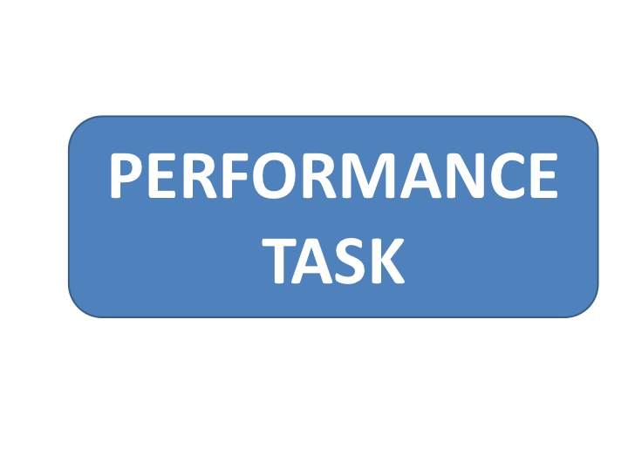
Notes:
Directions for Presenter: Italics
Information for Presenter to Convey: Bold
Presenter’s Notes: (Time: 7 Minutes)
Ask participants to find the section in their journal titled “Social Media Scenarios.”
SAY: It’s time to apply what we have learned. Please complete the performance task. The instructions included in your journal will guide your group work. I will walk around to provide clarification as needed.
Participants will work in groups but also record their responses in their respective journals. The groups will select only one scenario to complete. There are two scenario choices.
Once groups have finished completing the activity, the presenter will call on two or three groups to provide their responses. IF PARTICIPANTS DO NOT IDENTIFY THE EXPECTED RESPONSES that should result from this activity, use the Performance Task Key to guide them in reviewing the correct/expected responses.

Slide 49

Notes:
Directions for Presenter: Italics
Information for Presenter to Convey: Bold
Presenter’s Notes: (Time: 3 Minutes)
Ask participants to turn to the journal reflection page titled “Educator-Student Interaction, Including Social Media.” Read the reflection prompt shown below to participants. Provide 3-5 minutes for participants to complete their journal reflection.
How can a teacher balance the use of social media for instruction without crossing personal and inappropriate boundaries with students? Please provide specific examples.

Slide 50

Notes:
Directions for Presenter: Italics
Information for Presenter to Convey: Bold
Presenter’s Notes: (Time: 5 Minutes)
SAY: Each participant is required to complete an assessment based on the information received in this training. You must receive a score of 100 to receive credit for this module training.
You can provide each participant with the Module 2 assessment to complete as a culminating activity. Districts can alternately choose to have participants complete the assessment during a follow-up session or have them complete the assessment on their own within a designated period of time and submit it to their campus principal.

Slide 51

Notes:
Directions for Presenter: Italics
Information for Presenter to Convey: Bold
Presenter’s Notes: (Time: 1 Minute)
Before concluding the training session, ask participants if they have any questions about the information they received today. Answer any questions as applicable.

Slide 52
References
Bacon-Blood, L. (2015, January). Louisiana no. 3 for inappropriate teacher-student relationships, former U.S. education official says. The Times-Picayune. Retrieved from http://www.nola.com/education/index.ssf/2015/01/llouisiana_no_3_for_inappropriate_teacher-student_relationships_former_us_education_official_says.html
Miller, N. (2016, May). Jay Dee Burns receives sentence of 60 years in prison. Odessa American Online. Retrieved from http://www.oaoa.com/news/crime_justice/courts/article_28b9a59e-1203-11e6-911e-8bdd8ad682d3.html
Niederberger, M. (2015, May). Schools tighten social media contacts. The Washington Times. Retrieved from http://www.washingtontimes.com/news/2015/may/30/schools-tighten-teacher-student-social-media-conta/?page=all
O’Donovan, E. (2012, July/August). Social media: Guidelines for school administrators. District Administration. Retrieved from http://www.districtadministration.com/article/social-media-guidelines-school-administrators
Perrin, A. (2015, October). Social Media Usage: 2005–2015. Pew Research Center. Retrieved from http://www.pewinternet.org/files/2015/10/PI_2015-10-08_Social-Networking-Usage-2005-2015_FINAL.pdf
Shoop, R. Sexual Exploitation in Schools: How to Spot It and Stop It. Thousand Oaks, CA: Corwin Press.
Simpson, M. (2010). Social networking nightmares. NEA Office of General Counsel. Retrieved from http://www.nea.org/home/38324.htm
Notes:
Directions for Presenter: Italics
Information for Presenter to Convey: Bold
Presenter’s Notes:
References for sources cited. You do not need to reference this slide.

Slide 53
References
Sterkel, M. (2016, February). Burns rejects plea deal [digital image]. Odessa American Online. http://www.oaoa.com/news/crime_justice/courts/article_f56a1608-d7db-11e5-b352-43f5acd290c0.html
Stiner, L. (2012, October). Is social media to blame for inappropriate student-teacher relationships? ABC News 7 The Panhandle Spirit. Retrieved from http://abc7amarillo.com/news/local/is-social-media-to-blame-for-inappropriate-student-teacher-relationships
Texas Education Agency. (2016). Texas Administrative Code: Chapter 247.2. Retrieved from https://texreg.sos.state.tx.us/public/readtac$ext.TacPage?sl=R&app=9&p_dir=&p_rloc=&p_tloc=&p_ploc=&pg=1&p_tac=&ti=19&pt=7&ch=247&rl=2
Texas Education Agency. (2016). Texas Administrative Code: Chapter 249.5. Retrieved from https://texreg.sos.state.tx.us/public/readtac$ext.TacPage?sl=R&app=9&p_dir=&p_rloc=&p_tloc=&p_ploc=&pg=1&p_tac=&ti=19&pt=7&ch=249&rl=5
United States Department of Education. (2008). Educator sexual misconduct: What school staff need to know and do. Helpful Hints for School Emergency Management, 3(2). Retrieved from http://rems.ed.gov/docs/HH_Vol3Issue2.pdf
University of Phoenix. (2015, August). Despite embracing new technology, 87 percent of K-12 educators have not integrated social media into the classroom. University of Phoenix College of Education. Retrieved from http://www.phoenix.edu/news/releases/2015/08/87_percent_k-12_educators_not_integrated_social_media_into_classroom.html
f
Notes:
Directions for Presenter: Italics
Information for Presenter to Convey: Bold
Presenter’s Notes:
References for sources cited. You do not need to reference this slide.

