Slide 1
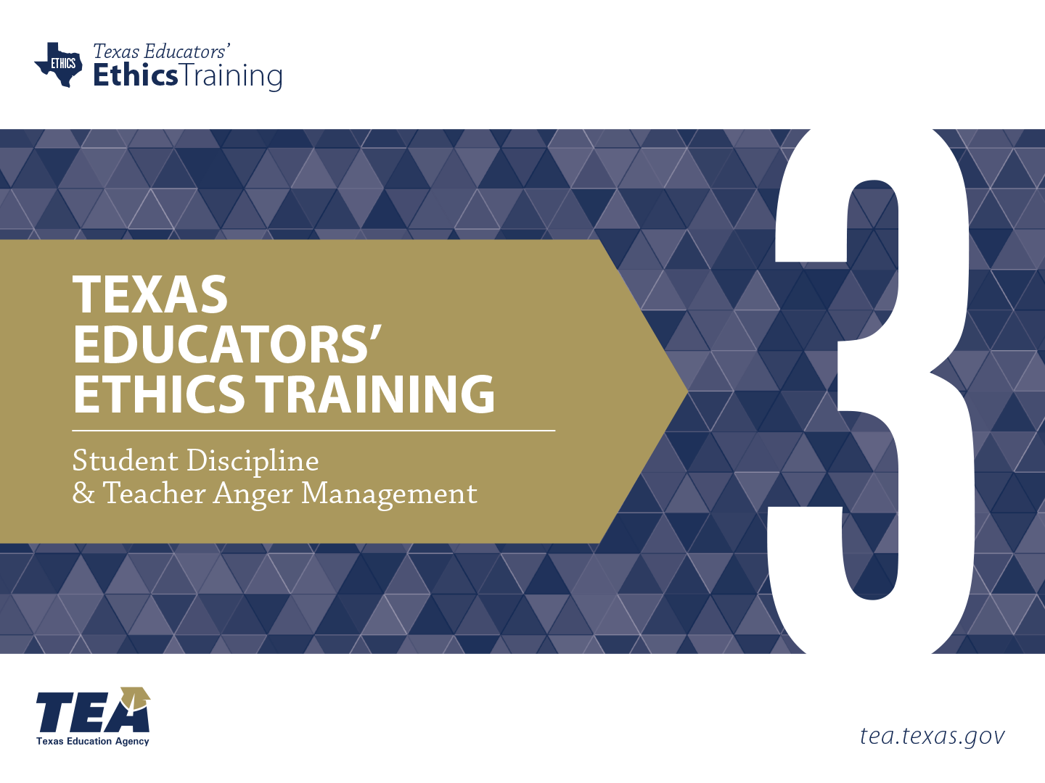
Notes:
Directions for Presenter: Italics
Information for Presenter to Convey: Bold
Presenter’s Notes: (Time: 30 Seconds)
Welcome participants. If this is a new group of participants, introduce yourself to the group.
SAY: This is the third of six ethics training modules for Texas educators. Module 3 will focus on Student Discipline and Teacher Anger Management.
You will need to have copies of two narratives for slides 7 and 47. You will read these narratives aloud at the appropriate time.
It is advisable to have participants seated at tables to encourage group dialogue. Participants will also be provided with a reflection journal.
Materials for Participants:
Journal
Materials for Presenter:
PowerPoint for Module 3
Two Narratives for Slides 7 and 47
LCD Projector, Screen, Speakers, and Computer
Slide Advancer
Participant Toolbox is recommended (index cards, sticky notes, markers, pencils/pens, etc.)
Copies of Module Assessment
Performance Task Key
Assessment Key

Slide 2


Purpose
Emphasize the importance of student discipline and anger management and the role they play in supportive learning environments.
Notes:
Directions for Presenter: Italics
Information for Presenter to Convey: Bold
Presenter’s Notes: (Time: 30 Seconds)
SAY: The purpose of this training is to emphasize the importance of student discipline and anger management and the role they play in supportive learning environments.
When we think of ethical violations, we immediately think of inappropriate teacher-student relationships.
Other type of violations occur. One that we hear about, though maybe not as often as inappropriate relationships, is a teacher harming a student physically, mentally, or emotionally.

Slide 3

Stimulating Thinking
How does student behavior impact teacher behavior?
2. How does teacher anger impact student achievement?
Notes:
Directions for Presenter: Italics
Information for Presenter to Convey: Bold
Presenter’s Notes: (Time: 1½ Minutes)
SAY: As we prepare to begin our training session, these are the overarching essential questions that we will conceptualize today. Please respond to the essential questions while you wait for the training session to begin. You may use the Module 3 note-taking section in your journal to record your responses.
Note-Taking Strategy: Participants can use the Module 3 note-taking section of their journal to record their responses to the essential questions.

Slide 4
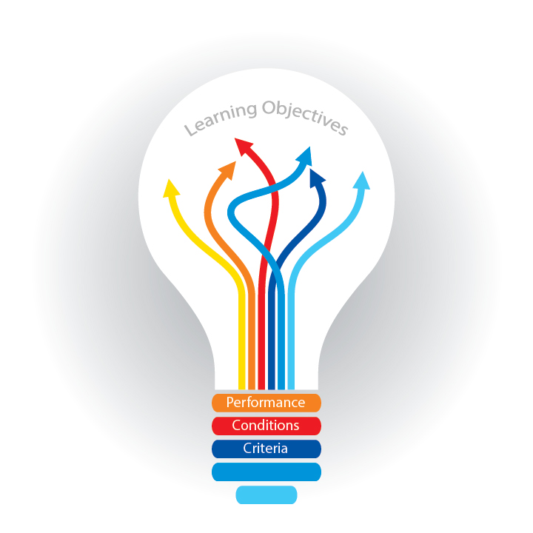
Participants will
explore strategies to create a supportive learning environment;
identify techniques that can de-escalate confrontations; and
identify techniques that disengage challenging behavior.
Notes:
Directions for Presenter: Italics
Information for Presenter to Convey: Bold
Presenter’s Notes: (Time: 30 Seconds)
SAY: Let’s take a moment to review the session objectives. Today we will discuss strategies to create a supportive learning environment; identify techniques that can de-escalate confrontations; and identify techniques that disengage challenging behavior.
The first bullet deals with student discipline and how we can work to create a supportive learning environment.
The last two bullets deal with anger management and how we can de-escalate a volatile situation and avoid consequences related to ethical violations.

Slide 5

Goal of the Educators’ Code of Ethics
To protect the safety and welfare of Texas schoolchildren and school personnel
19. Tex. Admin. Code §247.1.
Notes:
Directions for Presenter: Italics
Information for Presenter to Convey: Bold
Presenter’s Notes: (Time: 30 Seconds)
SAY: If only it were as simple as this statement.
Please note that Chapter 247.1 of the Texas Administrative Code addresses the safety and welfare of Texas schoolchildren AND school personnel.
It all boils down to protecting those students we serve on a daily basis.

Slide 6

At the Heart of the Matter
Teachers are ROLE MODELS
Notes:
Directions for Presenter: Italics
Information for Presenter to Convey: Bold
Presenter’s Notes: (Time: 30 Seconds)
This is a transition slide.
SAY: Now that we have an understanding of what our training purpose and objectives are, let’s get to the heart of the matter.
What do you think of this statement?
Teachers are ROLE MODELS!
Give the participants an opportunity to share a few responses. You want to hear that teachers can build AND destroy with mere words.

Slide 7
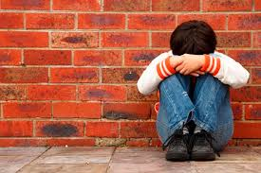
Notes:
Directions for Presenter: Italics
Information for Presenter to Convey: Bold
Presenter’s Notes: (Time: 1½ Minutes)
Presenter will need to read the entire quote.
SAY: I’m going to read a quote about an actual situation that occurred in a classroom.
“His teacher had urged him all year to be more organized, but he still had trouble keeping his work area neat. The boy’s papers and other materials were often scattered around, and when his classmates were ready to move on to the next activity, he lagged behind, trying to corral the clutter.”
“On this particular day, the teacher had lost her patience. According to a district report, she chastised her student: ‘Your area looks like a pigsty. Piggy, piggy! Oink, oink!’ Exactly what happened next has been difficult to pin down. But by the time another teacher entered the classroom, the boy had been surrounded by his classmates, who taunted him with oinks and other pig sounds. Alone in the center, the boy was sobbing.”
“By some accounts, his teacher—a veteran of 38 years—encouraged the children to join the chant. She told district officials she didn’t notice when they began to taunt him, although she did agree it wasn’t appropriate behavior. The children themselves turned out to be somewhat unreliable witnesses. They were just kindergartners.”
Source Cited: Koenig, D. (2011). Bully at the blackboard. Teaching Tolerance, 40. Retrieved from http://www.tolerance.org/bully-at-blackboard

Slide 8

How did this real-life incident make you feel?
Notes:
Directions for Presenter: Italics
Information for Presenter to Convey: Bold
Presenter’s Notes: (Time: 3 Minutes)
SAY: How did this incident make you feel?
Allow a minute for participants to discuss at their tables how the incident made them feel. After they have had time to discuss the incident among themselves, ask for two or three volunteers to share what was discussed in their groups.
SAY: Because all students see their teachers as “in charge,” especially younger students, victims of this type of harsh behavior who do not have any power to change what is happening to them are at risk of experiencing anxiety, fear, low self-esteem, low attendance, and decreased student performance.

Slide 9

Our Responsibility
Educators MUST put an end to any verbal or physical abuse that they witness or suspect is happening.
Notes:
Directions for Presenter: Italics
Information for Presenter to Convey: Bold
Presenter’s Notes: (Time: 30 Seconds)
SAY: Unfortunately, teachers sometimes make mistakes and demonstrate bad judgment in disciplining their students.
Training can help teachers know how to respond appropriately in difficult situations.
It is our responsibility to report what we know when the actions of a colleague are inappropriate.
We cannot simply look the other way as if it never happened.
Our students depend on us not only to educate them, but also to look out for their well-being.

Slide 10

What We Know
Because of a small minority of teachers, there is an undercurrent of harmful conduct toward students that exists and does damage to students, colleagues, and the public’s faith in schools.
Notes:
Directions for Presenter: Italics
Information for Presenter to Convey: Bold
Presenter’s Notes: (Time: 30 Seconds)
SAY: There is good news and bad news.
The good news is that the majority of teachers are positive role models and transformational figures in the lives of their students.
The bad news is that the handful of teachers who do harm students not only damage their students, but also our profession.
Unfortunately, the abusive behavior that some educators exhibit toward both students and colleagues crosses a line that can NEVER be excused or tolerated.
Source Cited: McEvoy, A. (2014). Abuse of power. Teaching Tolerance, 48. Retrieved from http://www.tolerance.org/magazine/number-48-fall-2014/abuse-of-power

Slide 11

Compassionate Teachers Transform Lives
Notes:
Directions for Presenter: Italics
Information for Presenter to Convey: Bold
Presenter’s Notes: (Time: 30 Seconds)
SAY: THIS WE KNOW!
Since the beginning of time, teachers have transformed lives through the relationships they build with students.
Without a doubt, strong relationships build strong academic performance.
Source Cited: McEvoy, A. (2014). Abuse of power. Teaching Tolerance, 48. Retrieved from http://www.tolerance.org/magazine/number-48-fall-2014/abuse-of-power

Slide 12

How Do We Create a
Supportive Learning Environment?
Notes:
Directions for Presenter: Italics
Information for Presenter to Convey: Bold
Presenter’s Notes: (Time: 3 Minutes)
SAY: How DO teachers create a supportive learning environment?
Give participants an opportunity to identify strategies that teachers use to create supportive learning environments. Provide one minute to discuss and then ask for responses.

Slide 13

Texas Education Code § 37.083
(a) Each school district shall adopt and implement a discipline management program to be included in the district improvement plan.
Notes:
Directions for Presenter: Italics
Information for Presenter to Convey: Bold
Presenter’s Notes: (Time: 1 Minute)
SAY: The Texas Education Code clearly states that every district in the state of Texas must adopt and implement a discipline management program. This is a requirement for the district. But what about the campus and the classroom? How can we create a supportive learning environment for our students in every classroom?
The next few slides introduce three very important strategies to create a supportive learning environment.

Slide 14

1st Strategy: Define
Acceptable Behavior
Establishing clearly defined parameters of acceptable behavior is a critical part of classroom discipline.
Notes:
Directions for Presenter: Italics
Information for Presenter to Convey: Bold
Presenter’s Notes: (Time: 1 Minute)
SAY: Before we talk about student discipline and teacher anger, we need to establish that the cornerstone for every classroom is a strong plan that defines parameters of what is acceptable and what is unacceptable.
It may seem like a pretty simple statement, but the impact of NOT having clearly defined parameters of acceptable behavior is significant.
A huge takeaway from this training is the importance of having a clear behavioral management plan for your classroom.
Students should know exactly what your expectations are and what the consequences are for not following those expectations.

Slide 15
Student Discipline Management
Creating a safe learning environment that contains clear, consistent, fair, and flexible boundaries is a primary requirement for all classrooms.
Notes:
Directions for Presenter: Italics
Information for Presenter to Convey: Bold
Presenter’s Notes: (Time: 1 Minute)
Read the information on the slide.
SAY: There are several practices that a teacher can use to prevent an out-of-control situation.
It is critical for every classroom to have a clear discipline plan that is supported by and aligned with the campus and district discipline plan.
Being proactive helps prevent you from being reactive. Using classroom behavior management strategies can help you avoid facing power struggles with disruptive students.
This can make all the difference in the world.

Slide 16

A classroom without a management plan is a classroom on the verge of chaos.
Notes:
Directions for Presenter: Italics
Information for Presenter to Convey: Bold
Presenter’s Notes: (Time: 30 Seconds)
SAY: A classroom without a management plan that is followed with fidelity can at any moment implode and create a volatile and life-changing situation.
Having a plan will not guarantee a non-disruptive classroom, but it will decrease the chances tremendously.
It is very easy to lose control of your authority in a classroom if there are no identified expectations.

Slide 17

What is the second most important aspect in creating supportive learning environments?
Notes:
Directions for Presenter: Italics
Information for Presenter to Convey: Bold
Presenter’s Notes: (Time: 1½ Minutes)
SAY: Let’s look at this question.
If having a classroom management plan is first and foremost, what is the second most important aspect in creating a supportive learning environment?
Provide a short amount of time for participants to write down their thoughts.
Let’s hear what your thoughts are. What is another important aspect of creating supportive learning environments?
As the participants share their responses, be sure to look for terms like “instruction,” “the lesson,” and “engaging classroom.”

Slide 18
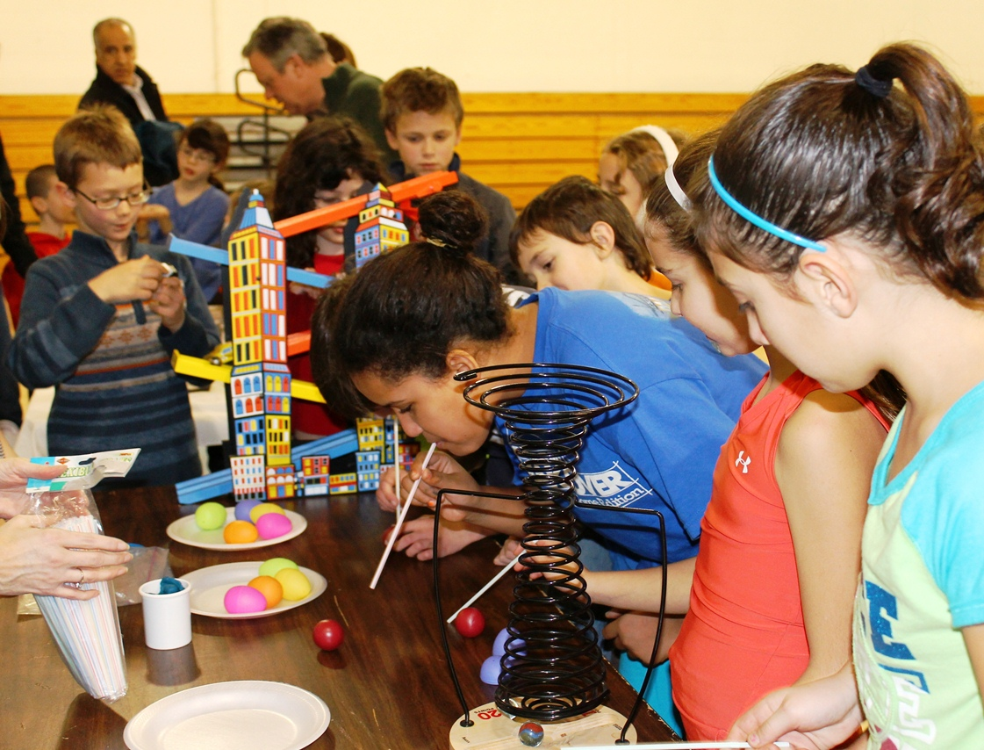
2nd Strategy: Engage Students
Notes:
Directions for Presenter: Italics
Information for Presenter to Convey: Bold
Presenter’s Notes: (Time: 1 Minute)
SAY: The following important questions should be considered:
Is my lesson authentically engaging?
Is my lesson well-planned and relevant?
Does my lesson connect to real-life experiences?
Is my lesson content appropriate and challenging?
When teachers do not plan for the daily instruction, it leaves room for misbehavior.
To recap, here are two important questions to ask yourself:
Do I have a structured classroom management plan?
Are my lessons engaging for my students?
Again, this will not guarantee that there will not be major disruptions, but it can certainly decrease the chances.

Slide 19

3rd Strategy: Model
Positive Behavior
Creating a positive environment where students feel safe and cared for is an important component of a successful learning environment.
Notes:
Directions for Presenter: Italics
Information for Presenter to Convey: Bold
Presenter’s Notes: (Time: 1 Minute)
Read the information on the slide.
SAY: Being a role model can be a difficult task, but it is an important responsibility. Our students observe our actions and listen to what we say and how we speak.
Teachers are role models for their students all day, every day.
Creating a positive environment where students feel safe and helping them develop behavioral skills they will use the rest of their lives is an important component of a successful learning environment.
Source Cited: Kohl, S. (n.d.). Modeling positive behavior in the classroom. National Education Association. Retrieved from: http://www.nea.org/tools/52062.htm

Slide 20

As a Reminder
Implement a classroom management plan
Create authentic student engagement
Model positive behavior
Which strategy is most difficult to implement?
Which strategy is the one that is missing from many classrooms?
Notes:
Directions for Presenter: Italics
Information for Presenter to Convey: Bold
Presenter’s Notes: (Time: 4 Minutes)
SAY: As a reminder, three critical components of curbing challenging behavior are:
Implementing a management plan,
Creating authentic student engagement activities, and
Modeling positive behavior.
Small Group Activity: Ask participants to work at their table and answer the following two questions:
Which strategy (in your opinion) is the most difficult to implement?
Participants should say the first and second strategies are the most difficult to implement.
Which strategy (in your opinion) is the one that is missing from many classrooms?
Participants should say the first and second strategies are the most difficult to accomplish and therefore often missing from classrooms.
SAY: If only this would guarantee that we would never lose control. Unfortunately, it will not guarantee that, but it can certainly help strengthen our learning environment. Losing control is NOT what we want to do.

Slide 21
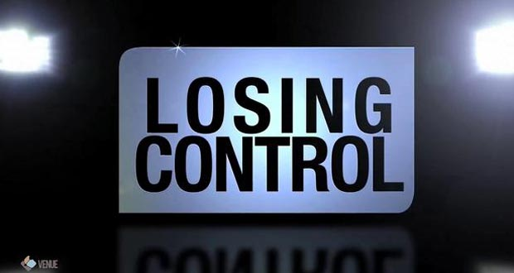
Notes:
Directions for Presenter: Italics
Information for Presenter to Convey: Bold
Presenter’s Notes: (Time: 30 Seconds)
This is a transition slide.
SAY: Losing personal control of our words or actions can have a devastating effect on others and ourselves.

Slide 22
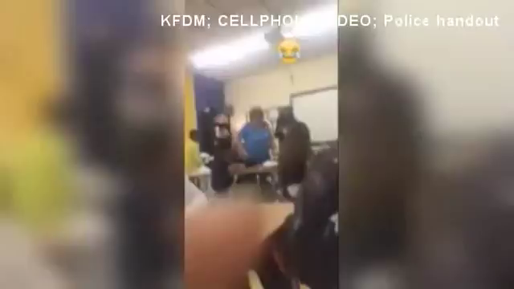
KDFM.com News
Kara Dixon Reporting
Notes:
Directions for Presenter: Italics
Information for Presenter to Convey: Bold
Presenter’s Notes: (Time: 2 Minutes)
SAY: This video was recorded by a student in the class.
The smiley face in the video was added by the student.
The video clip was confiscated as evidence by the school district and the police.
It was then requested by the media to use in their news stories.
Show the video clip.

Slide 23

How does the loss of control happen?
Notes:
Directions for Presenter: Italics
Information for Presenter to Convey: Bold
Presenter’s Notes: (Time: 3 Minutes)
SAY: This incident was a very recent occurrence.
Although we do not know what led up to the incident, the frustration and anger the teacher felt toward the student was unwarranted. Unfortunately, incidents like these happen in a split second.
This happens because teachers feel the need to confront the student instead of walking away or calling for assistance.
Eleven seconds changed this teacher’s life.
Turn to your table partners and discuss what went wrong here.

Slide 24
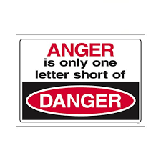
Loss of Control
When faced with students who are extremely disruptive, ANGER is usually the emotion that rises to the top.
Notes:
Directions for Presenter: Italics
Information for Presenter to Convey: Bold
Presenter’s Notes: (Time: 30 Seconds)
Read the slide information.
SAY: The reality is that we do become angry with students who are continually disruptive and sometimes aggressive.
What do we need to do to understand and manage anger?
Managing unruly behavior is one of the most difficult, frustrating, and possibly frightening aspects of being a teacher.

Slide 25

Loss of Control
Anger is a normal, healthy human emotion. Out-of-control anger becomes destructive. It can ruin lives.
Notes:
Directions for Presenter: Italics
Information for Presenter to Convey: Bold
Presenter’s Notes: (Time: 30 Seconds)
Read the slide information.
SAY: I think it would be unfair to ask anyone not to ever feel angry. It is an emotion that we have all experienced.
The key word is “control.” Losing control creates an extremely unhealthy learning environment.
Uncontrolled anger can result in verbal, mental, emotional, and/or physical abuse.
Frequent or misplaced anger can hurt our reputations and others around us, destroy our relationships, limit opportunities, and negatively impact our health.

Slide 26


Loss of Control
Two or three disruptive students can consume a large portion of instructional time. The frustration is REAL.
Notes:
Directions for Presenter: Italics
Information for Presenter to Convey: Bold
Presenter’s Notes: (Time: 30 Seconds)
Read the slide information.
SAY: The loss of control can occur quickly.
Students and teachers can go from zero to 10 in a matter of a few exchanges.
It is a fine line between being in control and losing control.
Let’s watch a video that depicts a scenario that could happen at any school. As you watch the video, take notes on what the teacher could have done differently.

Slide 27
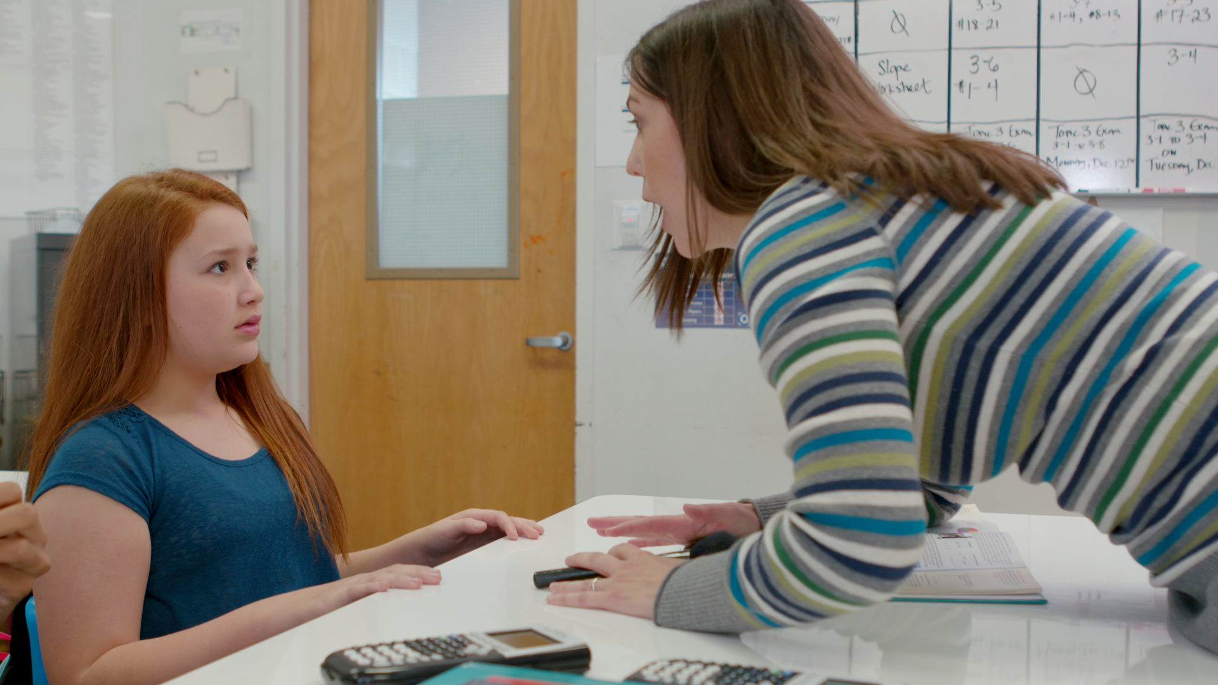

Video Scenario
Notes:
Directions for Presenter: Italics
Information for Presenter to Convey: Bold
Presenter’s Notes: (Time: 6 Minutes)
Video Scenario for Presenter’s Reference:
A middle school math teacher is struggling with classroom management. She speaks disrespectfully to the students and has not created a structure and routine for positive behavior in her classroom. She shows no patience when dealing with her students. An incident takes place in her classroom where she loses control and assaults a student.

Slide 28

Video Scenario Reflection
Notes:
Directions for Presenter: Italics
Information for Presenter to Convey: Bold
Presenter’s Notes: (Time: 3 Minutes)
SAY: What thoughts came to mind as you watched the scenario unfold?
Could this scenario happen at your school?
What could the teacher have done differently?
Allow two minutes for participants to discuss the video with one another at their tables. Ask the groups to identify a reporter who will share the group’s response. Call on two or three groups to share what they discussed.
Refer back to the video scenario throughout the remainder of the module.

Slide 29

Anger Management
The key is to control anger before anger
controls you.
Notes:
Directions for Presenter: Italics
Information for Presenter to Convey: Bold
Presenter’s Notes: (Time: 30 Seconds)
Read the information on the slide.
SAY: While this is easier said than done, it must be done to prevent irreparable damage.
As educators, we have to practice consistent anger management techniques to effectively address challenging behavioral problems in our schools.
The ultimate goal of anger management is to learn how to control your reactions when disruptive students increase your frustration and anger levels.

Slide 30

Anger Management
Count to 20 before you respond.
Manage your thoughts.
Consider the facts of the situation.
Notes:
Directions for Presenter: Italics
Information for Presenter to Convey: Bold
Presenter’s Notes: (Time: 30 Seconds)
SAY: The next several slides provide some strategies to help you remain in control during the anger cycle. When faced with a challenging student behavior situation, you could
count to 20 before you respond;
manage your negative thoughts with positive thinking; and
consider the facts of the situation so that you can calm your anger reactions.
SAY: More than likely, you will determine that it is unproductive to respond with anger.

Slide 31

Anger Management
Listen effectively.
Be assertive, NOT aggressive.
Notes:
Directions for Presenter: Italics
Information for Presenter to Convey: Bold
Presenter’s Notes: (Time: 1 Minute)
Read the information on the slide.
SAY: Two more strategies that may work for you when you feel angry include
- listening effectively, and
being assertive, NOT aggressive. When you become aggressive, you’re only focused on winning.
SAY: These strategies take practice and should become habits that we incorporate into our personal and professional lives. The more you practice, the more it will become second nature to respond with a controlled behavior.
Source Cited: MindTools. (n.d.). Anger Management: Williams’ 12 Strategies for Controlling Aggression. Retrieved from https://www.mindtools.com/pages/article/newTCS_97.htm

Slide 32

Avoid the Power Struggle
Notes:
Directions for Presenter: Italics
Information for Presenter to Convey: Bold
Presenter’s Notes: (Time: 1 Minute)
This is a transition slide.
SAY: Power struggles are unfortunately common occurrences in schools. It is important to identify strategies to de-escalate and disengage challenging student behavior.
- What is the difference between de-escalating behavior and disengaging behavior?
Give participants an opportunity to respond.
SAY: To de-escalate is to reduce the level of intensity. To disengage is to withdraw or to release. Let’s start with how we de-escalate.

Slide 33

De-escalating Behavior
The primary objective is to remain calm and quickly assess the situation.
Notes:
Directions for Presenter: Italics
Information for Presenter to Convey: Bold
Presenter’s Notes: (Time: 30 Seconds)
SAY: The most important objective for a teacher when faced with defiant or violent behavior from a student is to remain calm and quickly assess the situation to determine if de-escalation is possible or immediate assistance is needed.
Keeping the student calm is another important objective to achieve during disruptive behavioral incidents.
Source Cited: Wright, J. (2013). Dodging the Power-Struggle Trap: Ideas for Teachers. Retrieved from http://www.interventioncentral.org/behavioral-interventions/challenging-students/dodging-power-struggle-trap-ideas-teachers

Slide 34

De-escalating Behavior
Avoid questioning the student.
Avoid arguing with the student.
Notes:
Directions for Presenter: Italics
Information for Presenter to Convey: Bold
Presenter’s Notes: (Time: 30 Seconds)
SAY: Just like the instructional tools we need to help students learn the content we teach, we also need tools to de-escalate a volatile situation. Here are a few suggestions that may help you.
Avoid questioning the student. Some teachers force students to explain their behavior. Questioning them usually escalates anger and resentment.
Avoid arguing with the student. Arguing with an agitated student creates a situation where he or she is on equal ground with you. This can quickly lead to an altercation between the teacher and the student.

Slide 35
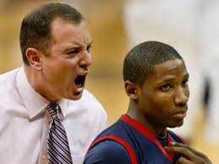
De-escalating Behavior
Avoid raising your voice, intimidating the student, or using phrases that can escalate the problem.
Notes:
Directions for Presenter: Italics
Information for Presenter to Convey: Bold
Presenter’s Notes: (Time: 30 Seconds)
SAY: Avoid raising your voice or intimidating the student. This can make the situation worse.
A power struggle can be avoided if the teacher does not choose to take part in the conflict.
Avoid using phrases that can escalate the problem: “You’re always wrong.” “I will not put up with your rotten behavior.” “I demand that you . . .” “That’s stupid!”
Source Cited: Conflict Resolution Education Connection. (n.d.). Teaching Anger Management Skills. Retrieved from http://www.creducation.org/resources/anger_management/teaching_anger_management_skills.html

Slide 36

De-escalating Behavior
Do not block escape passages. Show accepting body language. Never place your hands on the student.
(Wright, 2013)
Notes:
Directions for Presenter: Italics
Information for Presenter to Convey: Bold
Presenter’s Notes: (Time: 30 Seconds)
Read the information on the slide.
SAY: These strategies are intended to be used as alternative methods to help increase teachers’ ability to respond efficiently and effectively when students exhibit varying emotional and disruptive behavioral outbursts.
Source Cited: Wright, J. (2013). How to Calm the Agitated Student: Tools for Effective Behavior Management. Retrieved from http://www.interventioncentral.org/sites/default/files/pdfs/pdfs_blog/behavior_calm_agitated_student_Wright_16_April_2013.pdf

Slide 37
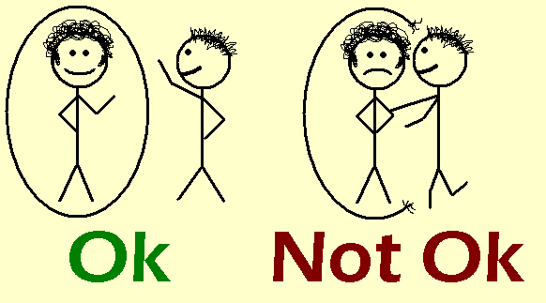
De-escalating Behavior
Keep appropriate personal space.
Provide reassurance.
Be aware of cultural
differences.
(Wright, 2013)
Notes:
Directions for Presenter: Italics
Information for Presenter to Convey: Bold
Presenter’s Notes: (Time: 30 Seconds)
SAY: Keep appropriate personal space, provide reassurance, and always be aware of cultural differences.
Source Cited: Wright, J. (2013). Dodging the Power-Struggle Trap: Ideas for Teachers. Retrieved from http://www.interventioncentral.org/behavioral-interventions/challenging-students/dodging-power-struggle-trap-ideas-teachers

Slide 38

Disengaging Challenging Behaviors
Notes:
Directions for Presenter: Italics
Information for Presenter to Convey: Bold
Presenter’s Notes: (Time: 30 Seconds)
SAY: An important step in averting a power struggle between a teacher and a student is to utilize disengaging tactics.
These type of tactics provide a teacher with the ability to remain calm and confident in diffusing disruptive incidents.
Remember what “disengage” means: to withdraw or to release; to stop the behavior.
Advance to the next slide and read the disengaging tactics.

Slide 39

Disengaging Behavior
Disengaging tactics allow the teacher to keep his or her cool in order to manage the conflict situation in an appropriate manner.
(Wright, 2013)
Notes:
Directions for Presenter: Italics
Information for Presenter to Convey: Bold
Presenter’s Notes: (Time: 30 Seconds)
It is really important to make this point.
SAY: Using disengaging tactics does not mean that teachers should accept misbehavior from students without consequences for such behavior.
Source Cited: Wright, J. (2013). Dodging the Power-Struggle Trap: Ideas for Teachers. Retrieved from http://www.interventioncentral.org/behavioral-interventions/challenging-students/dodging-power-struggle-trap-ideas-teachers

Slide 40

Disengaging Behavior
Keep cool under pressure.
Respond in a neutral and calm tone.
Keep dialogue brief.
Use non-confrontational words.
(Wright, 2013)
Notes:
Directions for Presenter: Italics
Information for Presenter to Convey: Bold
Presenter’s Notes: (Time: 30 Seconds)
SAY: Strategies to disengage include
keeping cool under pressure to avoid a behavioral power struggle;
responding to an angry or hostile student in a neutral and calm tone and keeping dialogue brief when addressing the non-compliant student; and
using non-confrontational words that will not bait the student’s reaction.
Source Cited: Wright, J. (2013). Dodging the Power-Struggle Trap: Ideas for Teachers. Retrieved from http://www.interventioncentral.org/behavioral-interventions/challenging-students/dodging-power-struggle-trap-ideas-teachers

Slide 41

Disengaging Behavior
Divert the student’s attention.
Provide an opportunity to cool down.
Offer the student a path to saving face.
Removal from the classroom for a brief time may be needed.
(Wright, 2013)
Notes:
Directions for Presenter: Italics
Information for Presenter to Convey: Bold
Presenter’s Notes: (Time: 1 Minute)
SAY: While it is often difficult to take time to think about your reactions, it is important to offer students a way to calm down. You can do that by diverting the student’s attention from the disruptive situation.
You can provide the student an opportunity to cool down and a path to saving face.
Removing the student from the classroom for a brief time may be needed.
Source Cited: Wright, J. (2013). Dodging the Power-Struggle Trap: Ideas for Teachers. Retrieved from http://www.interventioncentral.org/behavioral-interventions/challenging-students/dodging-power-struggle-trap-ideas-teachers

Slide 42

WARNING!
These strategies should be used when the behavior:
is primarily verbal;
shows no signs of escalating; and
does not represent a safety risk.
(Wright, 2013)
Notes:
Directions for Presenter: Italics
Information for Presenter to Convey: Bold
Presenter’s Notes: (Time: 30 Seconds)
Read the information on the slide.
SAY: It is important to note the type of disruptive behavior. Most importantly, ask yourself if this situation poses a safety risk to you or your students.
Source Cited: Wright, J. (2013). How to Calm the Agitated Student: Tools for Effective Behavior Management. Retrieved from http://www.interventioncentral.org/sites/default/files/pdfs/pdfs_blog/behavior_calm_agitated_student_Wright_16_April_2013.pdf

Slide 43

CAUTION!
If the student is suspected of presenting a safety risk to self or others, the teacher should call for immediate assistance.
(Wright, 2013)
Notes:
Directions for Presenter: Italics
Information for Presenter to Convey: Bold
Presenter’s Notes: (Time: 30 Seconds)
SAY: It is important to know when you need outside assistance to keep from getting hurt or having someone else get hurt in your classroom.
Read the information on the slide.
Source Cited: Wright, J. (2013). How to Calm the Agitated Student: Tools for Effective Behavior Management. Retrieved from http://www.interventioncentral.org/sites/default/files/pdfs/pdfs_blog/behavior_calm_agitated_student_Wright_16_April_2013.pdf

Slide 44

Losing Control
?
What are the
Notes:
Directions for Presenter: Italics
Information for Presenter to Convey: Bold
Presenter’s Notes: (Time: 30 Seconds)
This is a transition slide.
SAY: There are consequences to all behavior.
Depending on the behavior, it can result in a positive or negative consequence.
When teachers lose control of their emotions or anger, there can be very serious consequences.

Slide 45

Chapter 249.3
Abuse—Includes the following acts or omissions:
Mental or emotional injury to a student
Causing a situation in which the student sustains a
mental or emotional injury
Physical injury
(D) Sexual conduct
19 Tex. Admin. Code §249.3
Notes:
Directions for Presenter: Italics
Information for Presenter to Convey: Bold
Presenter’s Notes: (Time: 30 Seconds)
SAY: Chapter 249.3 of the Texas Administrative Code defines abuse.
Read the information on the slide and advance to the next slide. Make sure to note that abuse is often considered physical, but mental and emotional abuse can occur as well.

Slide 46

State Board for Educator Certification (SBEC) Sanctions
Disciplinary action can include
restriction,
reprimand,
suspension, and
revocation or surrender of certificate.
Notes:
Directions for Presenter: Italics
Information for Presenter to Convey: Bold
Presenter’s Notes: (Time: 30 Seconds)
SAY: The code not only defines abuse, but also provides information on possible sanctions.
In addition to these sanctions from SBEC, there is always the possibility of termination, the filing of a lawsuit, and even criminal repercussions.
A recent interactive survey revealed that 82 percent of teachers and 77 percent of principals say the current legal climate has changed the way they work.
Source Cited: Hopkins, G. (2004, August). Has the threat of lawsuits changed our schools? Education World. Retrieved from http://www.educationworld.com/a_admin/admin/admin371.shtml

Slide 47

of
ACTIONS
Notes:
Directions for Presenter: Italics
Information for Presenter to Convey: Bold
Presenter’s Notes: (Time: 30 Seconds)
SAY: The impact of our daily interactions with students are far-reaching. The following quote says it all.
"I've come to the frightening conclusion that I am the decisive element in the classroom.
It's my personal approach that creates the climate. It's my daily mood that makes the weather.
As a teacher, I possess tremendous power to make a child's life miserable or joyous.
I can be a tool of torture or an instrument of inspiration.
I can humiliate or humor, hurt or heal.
In all situations, it is my response that decides whether a crisis will be escalated or de-escalated
and a child humanized or de-humanized."
Advance to the next slide.

Slide 48

"I've come to the frightening conclusion that I am the decisive element in the classroom.”
Haim Ginott (1965)
Between Parent and Child
Notes:
Directions for Presenter: Italics
Information for Presenter to Convey: Bold
Presenter’s Notes: (Time: 1 Minute)
Use the copy of the narrative below found in the Presenter Guide under Module 3: Student Discipline and Teacher Anger Management.
SAY: Teachers are the most influential people in the world. They can build or destroy. Never forget the influence you hold on a daily basis.
Read from the handout:
"I've come to the frightening conclusion that I am the decisive element in the classroom. It's my personal approach that creates the climate. It's my daily mood that makes the weather. As a teacher, I possess tremendous power to make a child's life miserable or joyous. I can be a tool of torture or an instrument of inspiration. I can humiliate or humor, hurt or heal. In all situations, it is my response that decides whether a crisis will be escalated or de-escalated and a child humanized or de-humanized."

Slide 49
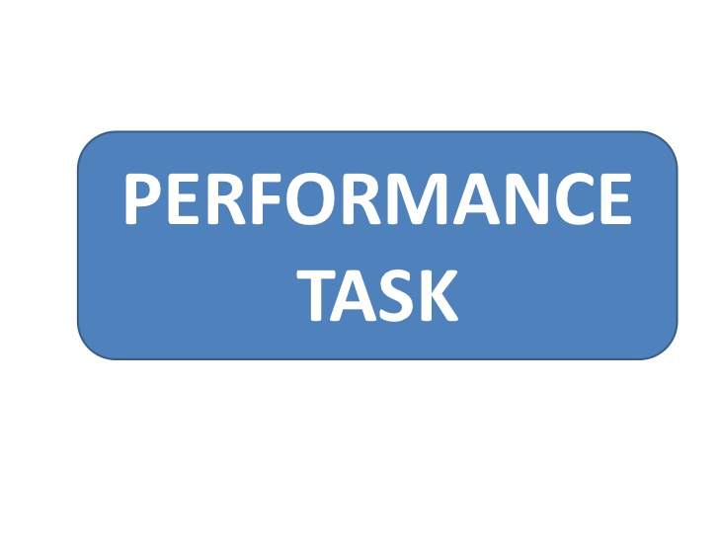
Notes:
Directions for Presenter: Italics
Information for Presenter to Convey: Bold
Presenter’s Notes: (Time: 8 Minutes)
SAY: It’s time to apply what we have learned. Please complete the performance task for this module. The detailed instructions will guide your group work. I will walk around to provide clarification as needed.
Ask participants to find the section in their journal titled “Behavior Scenario Activity.” Participants will work in table groups but also record their responses in their respective journals.
You may have to explain what is being asked. Participants first need to identify strategies to de-escalate or diffuse the incident. They then should identify how the teacher should respond once the incident has been de-escalated to address the behavior of the student.
Once groups have finished completing the activity, call on a couple of table groups to provide their responses. IF PARTICIPANTS DO NOT IDENTIFY THE EXPECTED RESPONSES that should result from this activity, use the Performance Task Key to guide them in reviewing the correct/expected responses for each scenario.

Slide 50

Notes:
Directions for Presenter: Italics
Information for Presenter to Convey: Bold
Presenter’s Notes: (Time: 2 Minutes)
Ask participants to turn to the journal reflection page titled “Student Discipline and Teacher Anger Management.” Read the reflection prompts shown below to participants. Provide two minutes for participants to complete their journal reflection.
How well does my classroom management plan work?
How does my behavior impact student behavior?

Slide 51

Notes:
Directions for Presenter: Italics
Information for Presenter to Convey: Bold
Presenter’s Notes: (Time: 5 Minutes)
SAY: Each participant is required to complete an assessment based on the information received in this training. You must receive a score of 100 to receive credit for this module training.
You can provide each participant with the Module 3 assessment to complete as a culminating activity. Districts can alternately choose to have participants complete the assessment during a follow-up session or have them complete the assessment on their own within a designated period of time and submit it to their campus principal.

Slide 52

Notes:
Directions for Presenter: Italics
Information for Presenter to Convey: Bold
Presenter’s Notes: (Time: 1 Minute)
Before concluding the training session, ask participants if they have any questions about the information they received today. Answer any questions as applicable.

Slide 53
References
Conflict Resolution Education Connection. (n.d.). Teaching Anger Management Skills. Retrieved from http://www.creducation.org/resources/anger_management/teaching_anger_management_skills.html
Dixon, K. (2016, April). Viral video leads to teacher assault charge. KFDM.com. Retrieved from http://kfdm.com/news/local/viral-video-leads-to-teacher-assault-charge
Hopkins, G. (2004, August). Has the threat of lawsuits changed our schools? Education World. Retrieved from http://www.educationworld.com/a_admin/admin/admin371.shtml
Koenig, D. (2011). Bully at the blackboard. Teaching Tolerance, 40. Retrieved from http://www.tolerance.org/bully-at-blackboard
McEvoy, A. (2014). Abuse of power. Teaching Tolerance, 48. Retrieved from http://www.tolerance.org/magazine/number-48-fall-2014/abuse-of-power
MindTools. (n.d.). Anger Management: Williams’ 12 Strategies for Controlling Aggression. Retrieved from https://www.mindtools.com/pages/article/newTCS_97.htm
Kohl, S. (n.d.). Modeling positive behavior in the classroom. National Education Association. Retrieved from http://www.nea.org/tools/52062.htm
Texas Education Agency. (2013). Texas Administrative Code: Chapter 37.083. Retrieved from http://codes.findlaw.com/tx/education-code/educ-sect-37-083.html
Notes:
Directions for Presenter: Italics
Information for Presenter to Convey: Bold
Presenter’s Notes:
References for sources cited. You do not need to reference this slide.

Slide 54
References
Texas Education Agency. (2014, February). Texas Administrative Code: Chapter 247.1. Retrieved from https://texreg.sos.state.tx.us/public/readtac$ext.TacPage?sl=R&app=9&p_dir=&p_rloc=&p_tloc=&p_ploc=&pg=1&p_tac=&ti=19&pt=7&ch=247&rl=1
Texas Education Agency. (2013). Texas Administrative Code: Chapter 249.3. Retrieved from https://texreg.sos.state.tx.us/public/readtac$ext.TacPage?sl=R&app=9&p_dir=&p_rloc=&p_tloc=&p_ploc=&pg=1&p_tac=&ti=19&pt=7&ch=249&rl=3
Wright, J. (2013). Dodging the Power-Struggle Trap: Ideas for Teachers. Retrieved from http://www.interventioncentral.org/behavioral-interventions/challenging-students/dodging-power-struggle-trap-ideas-teachers
Wright, J. (2013). How to Calm the Agitated Student: Tools for Effective Behavior Management. Retrieved from http://www.interventioncentral.org/sites/default/files/pdfs/pdfs_blog/behavior_calm_agitated_student_Wright_16_April_2013.pdf
Notes:
Directions for Presenter: Italics
Information for Presenter to Convey: Bold
Presenter’s Notes:
References for sources cited. You do not need to reference this slide.

