Slide 1
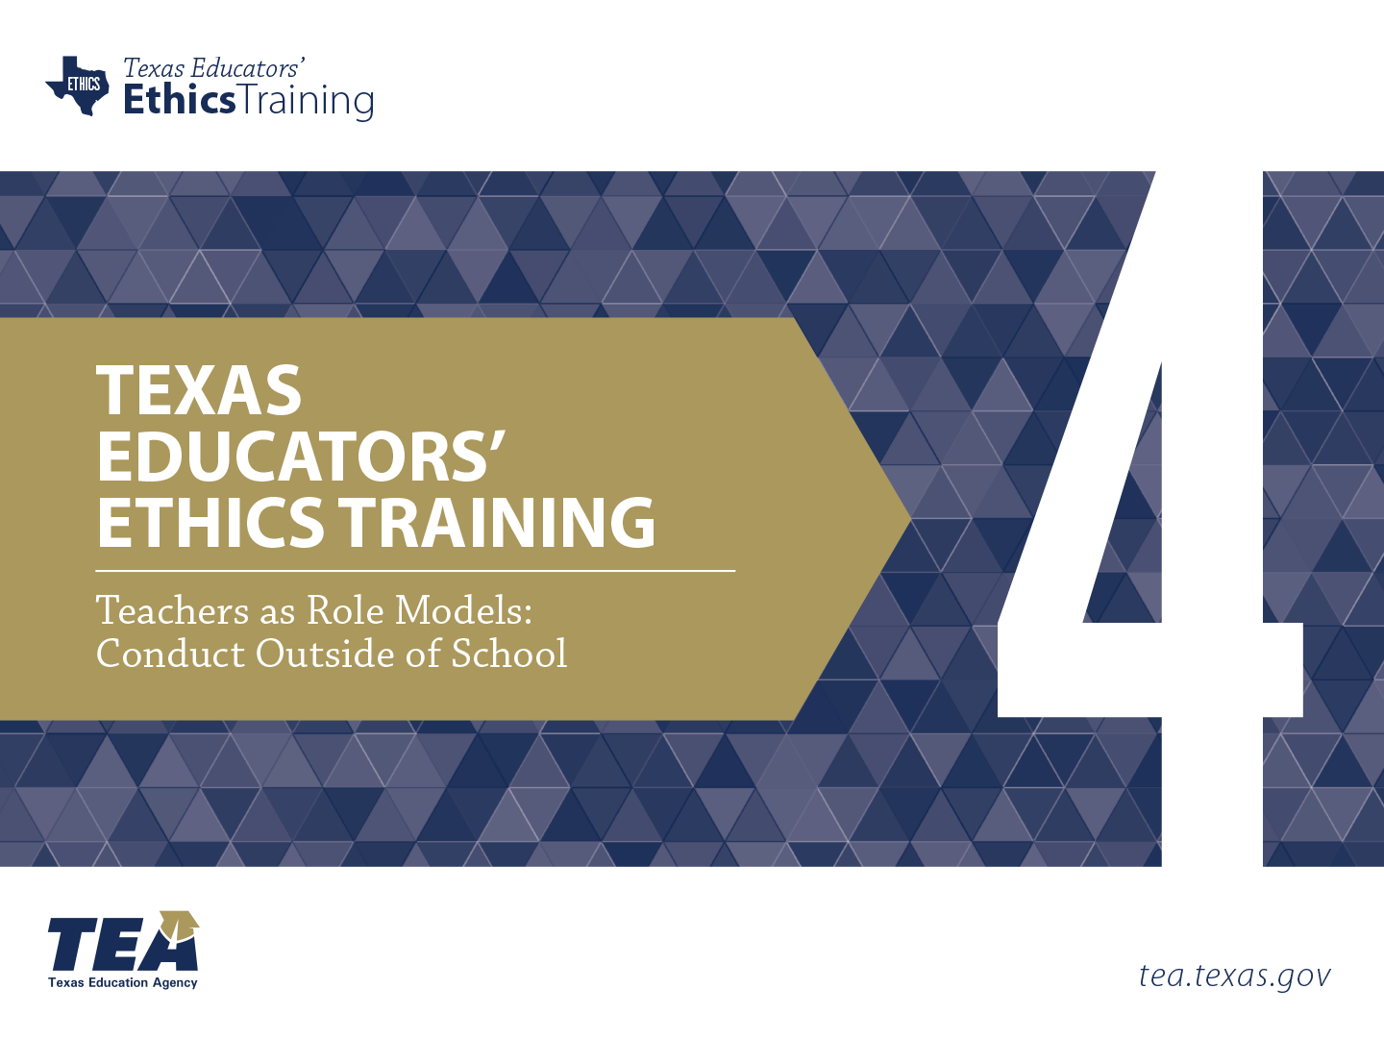
Notes:
Directions for Presenter: Italics
Information for Presenter to Convey: Bold
Presenter’s Notes: (Time: 1 Minute)
Welcome participants. If this is a NEW group of participants, the presenter(s) should introduce themselves to the group.
SAY: This is the fourth of six ethics training modules for Texas educators. Module 4 will focus on Teachers as Role Models: Conduct Outside of the School.
It is advisable to have participants seated at tables to encourage group dialogue. Participants will also be provided with a reflection journal.
Materials for Participants:
Journal
Materials for Presenter:
PowerPoint for Module 4
LCD Projector, Screen, Speakers, and Computer
Slide Advancer
Participant Toolbox is recommended (index cards, sticky notes, markers, pencils/pens, etc.)
Copies of Module Assessment

Slide 2


Understand the influence teachers can have on students when modeling behavior, values, and skills outside of the classroom.
Notes:
Directions for Presenter: Italics
Information for Presenter to Convey: Bold
Presenter’s Notes: (Time: 1 Minute)
SAY: The focus of this module will be to understand the influence teachers can have on students when modeling behavior, values, and skills outside of the classroom.
Advance to the next slide.

Slide 3

Stimulating Thinking
What responsibility do educators have to their profession outside of the regular school day?
How can educators strike a positive balance between their personal and professional lives?
Notes:
Directions for Presenter: Italics
Information for Presenter to Convey: Bold
Presenter’s Notes: (Time: 2 Minutes)
SAY: As we prepare to begin our training session, these are the overarching essential questions that we will conceptualize today.
Ask participants to popcorn out some possible answers for 20-30 seconds. This will ensure that participants realize that they will be answering questions throughout the training and will also give the presenter an opportunity to hear some of their thinking which may be help determine what to emphasize later in the training.
Note-Taking Strategy: Ask participants to use the Module 4 note-taking section of their journal to record their responses to both essential questions. They can respond to the essential questions while they are waiting for the session to begin.

Slide 4

Participants will
analyze how educator actions reflect directly on the status of the education profession and the community at large;
identify characteristics and responsibilities of being a role model for students outside of school;
generate a list of red flag areas of vulnerability educators should be aware of regarding behavior outside of school; and
review consequences of actions from negative out-of-school educator conduct.
Notes:
Directions for Presenter: Italics
Information for Presenter to Convey: Bold
Presenter’s Notes: (Time: 1 Minute)
SAY: Our learning objectives for this module include: (Read the slide bullets.)
Advance to the next slide.

Slide 5
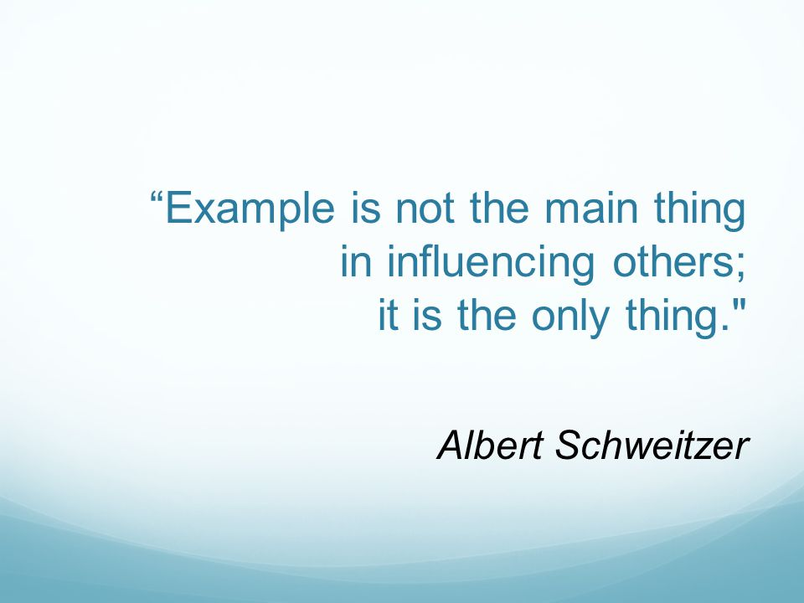
Notes:
Directions for Presenter: Italics
Information for Presenter to Convey: Bold
Presenter’s Notes: (Time: 30 Seconds)
Read the quote on the slide. The notes section below can be read verbatim or summarized verbally for participants.
SAY: As educators, we are important role models for students. They model themselves after us by imitating our actions and attitudes. This quote emphasizes this view.
There is great assurance that the majority of educators bring an abundance of dedication, dignity, and expertise to the profession.

Slide 6

Student Perspective
Notes:
Directions for Presenter: Italics
Information for Presenter to Convey: Bold
Presenter’s Notes: (Time: 2 Minutes)
Paired Group Activity
SAY: Knowing that the dialogue during today’s session will focus on the influence that educator role models have on students, it’s equally important to understand the perspective of our students and how they view the impact of educators on their lives.
SAY: Turn to your elbow partner and share what you believe students perceive as attributes of a positive role model. Jot your responses on a Post-It note so that we can review your information in a few minutes. Provide about 30 seconds for partners to share perceived attributes.
Advance slide.

Slide 7

Student Perspective
Passion and Ability to Inspire
Clear Set of Values
Commitment to Community
Selflessness and Acceptance of Others
Ability to Overcome Obstacles
(Price-Mitchell, 2011)
Notes:
Directions for Presenter: Italics
Information for Presenter to Convey: Bold
Presenter’s Notes: (Time: 2½ Minutes)
The notes below can be read verbatim or summarized verbally for participants.
SAY: Marilyn Price-Mitchell conducted a research study of students that described how the attributes of their role models influenced and inspired them to strive to be their best selves in school and in the community. This is an important point of the study.
From this study, the top five qualities of role models described by students were identified. Briefly read the bulleted list from the slide.
What is interesting is that in a poll of 50 adult Facebook readers of this study, these same qualities were mentioned as adults reflected on their own role models.
The biggest difference was that adults did not rank “commitment to community” as high as the students.
However, the students stated that their number one attribute of a role model was the ability to inspire others. This is an interesting finding.
After sharing the attributes from the study, have participants connect their answers and voice any that they feel were missing.
Sources Cited for Notes: Price-Mitchell, M. (2011). What is a role model? Five qualities that matter to teens. Roots of Action. Retrieved from http://www.rootsofaction.com/what-is-a-role-model-five-qualities-that-matter-for-role-models

Slide 8
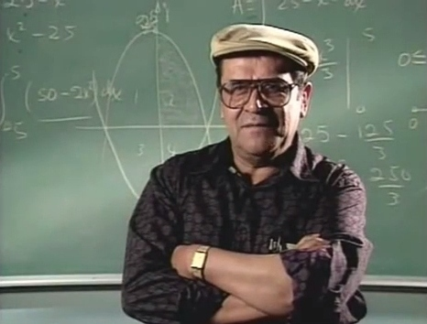
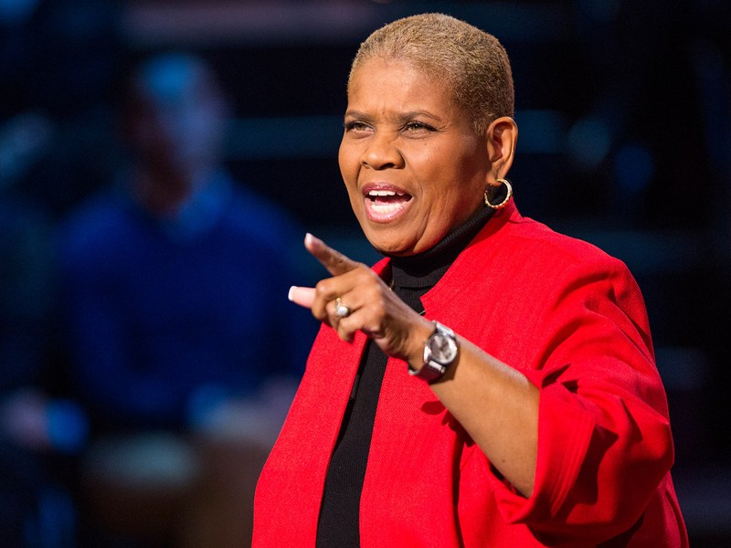
Positive Educator
Role Models
What we do matters both inside and outside of school.
Notes:
Directions for Presenter: Italics
Information for Presenter to Convey: Bold
Presenter’s Notes: (Time: 1½ Minute)
SAY: Based on the results of this study, the impact of a positive role model has a tremendous impact on how students evolve as learners and engaged citizens.
What we do as educators matters both inside and outside of school.
How many of you remember these two famous educator role models?
Jaime Escalante was a high school teacher who successfully inspired his dropout prone students to learn calculus. His story was portrayed in the movie “Stand and Deliver.”
Rita Pierson spent 40 years of her life as an educator and anti-poverty advocate. She was well-known for her mantra, Every Child Deserves a Champion.
Both Escalante and Pierson have significantly impacted the lives of both students and educators.
Unfortunately, we must also remember that students can be impacted by negative role models as much as they are impacted by positive role models.
Sources Cited: Internet Movie Database (IMDb). (2016). Stand and Deliver Plot Summary. http://www.imdb.com/title/tt0094027/plotsummary; PBS Educational Media. (2013. ) Rita Pierson’s Funny and Inspiring TED Talks. http://www.pbs.org/wnet/ted-talks-education/speaker/rita-pierson/

Slide 9



Notes:
Directions for Presenter: Italics
Information for Presenter to Convey: Bold
Presenter’s Notes: (Time: 30 Seconds)
Large Group Participation
SAY: Now it time for Headline News of the day.
I’m going to review a few news headlines. As each headline is displayed, you will need to determine which headlines are true and which might be false.
Please use a “thumbs-up” for TRUE and a “thumbs-down” for FALSE for each headline reviewed. Click on slide advancer to show the “thumbs up and thumbs down” images.
Advance the slide.

Slide 10


Teacher Busted for Drugs Suspended by District
Teacher Resigns After Twerking Video
Teacher Fired for Stripping While on Leave
HS Principal Lied About Hypnotizing Students
Texas on Record-Setting Pace for Inappropriate Teacher-Student Relationships
Notes:
Directions for Presenter: Italics
Information for Presenter to Convey: Bold
Presenter’s Notes: (Time: 2 Minutes)
Click on the slide advancer to display the first headline.
SAY: Is this headline true or false? Read the headline on the slide. Participants should indicate a thumbs-up or thumbs-down response.
Click on the slide advancer a SECOND time to display the correct answer. Continue to click on slide advancer until all headlines and “thumbs up” images have been displayed.
SAY: Given that all of these headlines are “true”, the actions of these educators do not model behavior that reflect what we perceive as positive role models.
Advance the slide.
Sources Cited for Headlines: See Reference Page

Slide 11

Notes:
Directions for Presenter: Italics
Information for Presenter to Convey: Bold
Presenter’s Notes: (Time: 30 Seconds)
SAY: The good news is that there are many positive news stories about educator role models that DO make headlines.
Here are a some awe-inspiring headlines that capture the essence and heart of great educators.

Slide 12

A Thank You to the Teacher
Who Saw What No One Else Did
Eleven Education Leaders Had Their
Lives Changed by Amazing Teachers
Assistant Principal Organizes
Fundraisers for Students
Notes:
Directions for Presenter: Italics
Information for Presenter to Convey: Bold
Presenter’s Notes: (Time: 1 Minute)
Click on the slide advancer to display each headline.
Read each one as headlines are displayed on the screen. Then state the following:
SAY: These are real-life examples of where the media spotlight should continue to be for the education profession both inside and outside of school.
Now that we have reviewed both positive and challenging aspects of being a role model, let’s take a few minutes to view a video scenario that demonstrates the negative impact of a teacher’s actions outside of school.
Sources Cited: Baker, K. (2014, May). Making waves [Web log post]. Retrieved from http://www.huffingtonpost.com/kamrin-baker/making-waves_1_b_5980324.html
Colangelo, L. (2016, July). Manhattan assistant principal organized fundraiser for students, prepares them for college. New York Daily News. Retrieved from http://www.nydailynews.com/new-york/education/hometown-heroes/manhattan-assistant-principal-organizes-fundraisers-students-article-1.2719835
Klein, R. (2014, May). These 11 education leaders had their lives changed by amazing teachers. The Huffington Post. Retrieved from http://www.huffingtonpost.com/2014/05/06/education-leaders-inspiringteachers_n_5273743.html

Slide 13
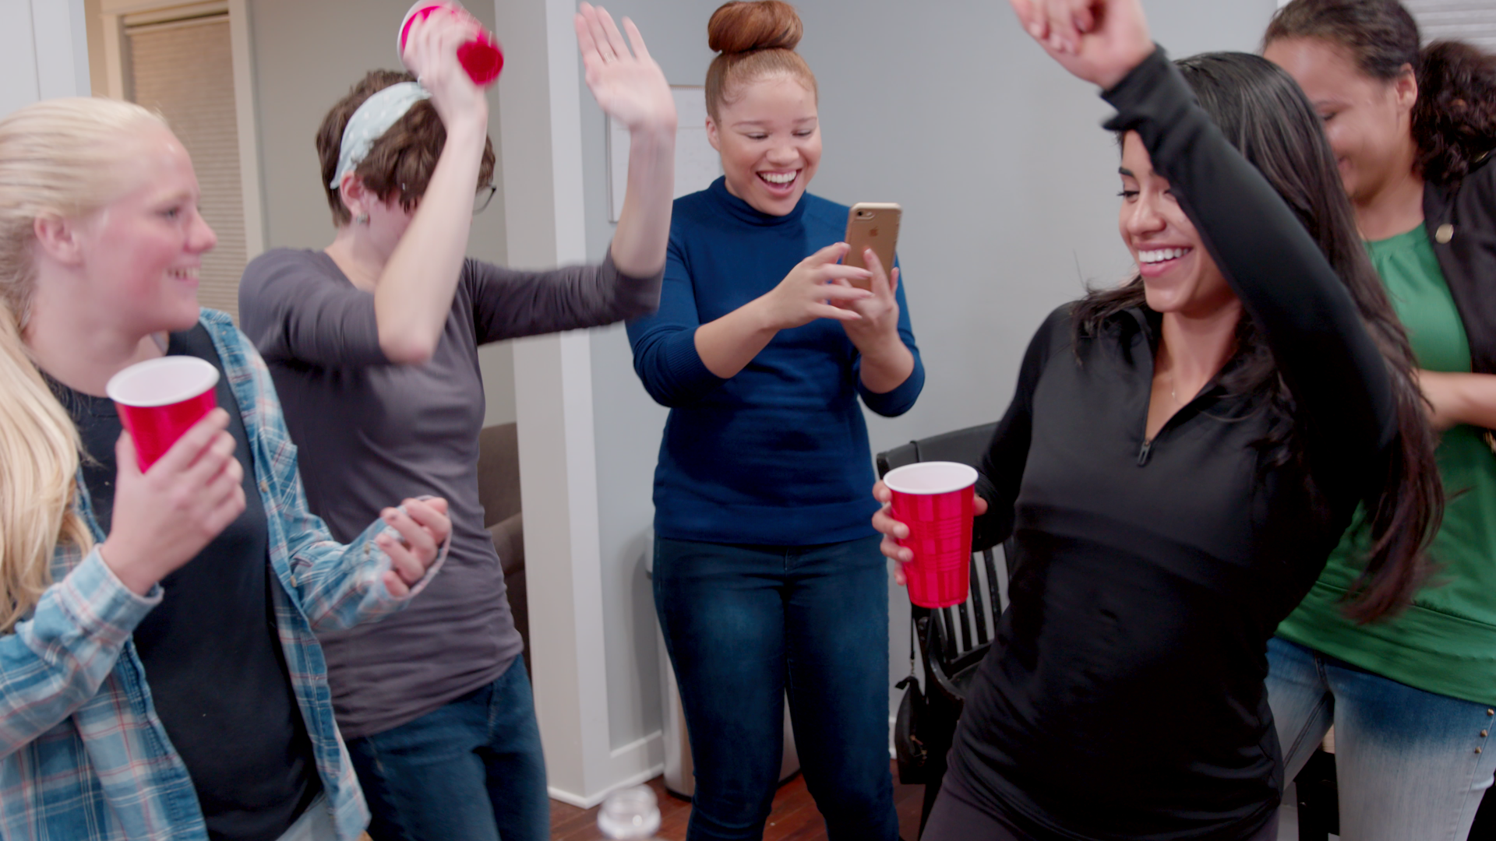

Video Scenario
Notes:
Directions for Presenter: Italics
Information for Presenter to Convey: Bold
Presenter’s Notes: (Time: 5 Minutes)
The video will be embedded here.
Video Scenario for Presenter’s Reference:
Teacher as a Role Model: Outside of School Module 4 Video Script: The high school girl’s basketball team wins a district title. The girls are celebrating after the game at the coach’s house with dancing and singing. The coach walks into the living room of her house and joins the girls by singing and dancing. During the course of the celebration, the coach decides to teach the girls how to twerk. The twerking lesson is sexually suggestive. One of the students captures the twerking lesson on her phone video and posts it to several social media sites.

Slide 14

Video Scenario Reflection
Notes:
Directions for Presenter: Italics
Information for Presenter to Convey: Bold
Presenter’s Notes: (Time: 5 Minutes)
SAY: How could this scenario have had a different outcome? Discuss with your table group and identify two or three different ways this situation could have been avoided. Please be ready to share your solution for a different outcome.
Allow two or three minutes for the participants to dialogue with each other in their groups. Call on two or three table groups to share what they discussed.
Presenter Feedback: If participants do not state it, share the possible different outcomes included below:
The teacher should not have conducted a twerking demonstration. Her actions did not reflect behavior of a positive teacher role model.
The teacher should have been aware that her actions could possibly be shared on social media.
The celebration should not have been held at the teacher’s home, especially since no other adults were present to supervise.
Parent chaperones and/or other school personnel should have been in attendance.
SAY: Every community is different and has a culture that is more accepting or more lax regarding certain actions. However, as educators, we are bound to district policies and state law. This is a clear expectation that we must adhere to at all times. Now, let’s take a few minutes to focus on how equally important it is to be a positive role model outside of school as it is inside of school.
Refer back to the video scenario throughout the remainder of the module.

Slide 15
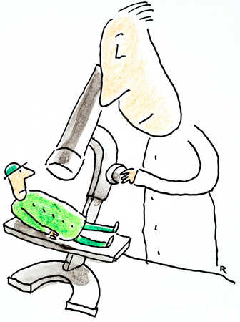
Life Under a Microscope
Notes:
Directions for Presenter: Italics
Information for Presenter to Convey: Bold
Presenter’s Notes: (Time: 30 Seconds)
SAY: With the increase in social media networking and local media coverage, educators’ personal and professional lives are more vulnerable to public visibility than ever before.
The rules are different when you’re an educator.
While some may disagree, you really never stop being an educator. It can be seen as a 24/7 job. Social media is the lens in which many now follow you.

Slide 16


Our Private Lives Aren’t So Private Anymore…
W
Why?
Notes:
Directions for Presenter: Italics
Information for Presenter to Convey: Bold
Presenter’s Notes: (Time: 1 Minute)
SAY: Our private lives aren’t so private anymore. Click on slide advancer to show the caption, “Why?”
SAY: Michael Simpson, former Assistant General Counsel for the National Education Association, specializes in the First Amendment of the Constitution.
He states that the exploding popularity of social networking sites has created an excessive interest in teachers’ private lives by both school administrators and the media.
Newspapers across the country search social networking sites for scandalous postings by local educators. Unfortunately, there are many posts on these sites that meet this criteria.
Our behavior outside of the school day is just as important as it is during the school day. No news is good news.
SAY: (Lead-in for the next slide.) Let’s look at a couple of examples that demonstrate actions by educators outside of the school day that created problems for themselves, the education profession, and the school districts they represented.
Source Cited: Simpson, M. (2010). Social networking nightmares. National Education Association. Retrieved from: http://www.nea.org/home/38324.htm

Slide 17
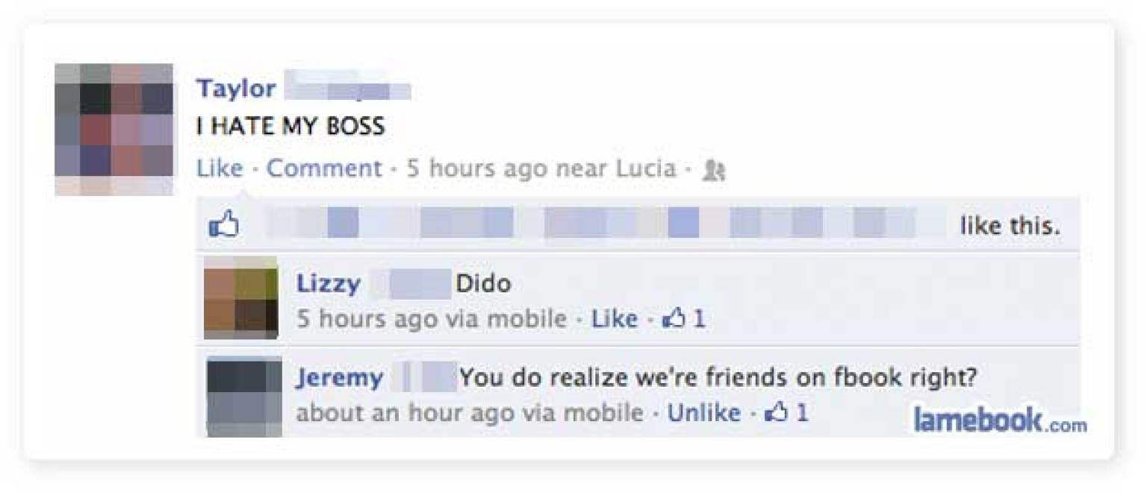
The Impact of a Personal Online Post
Photo Reposted by lamebook.com
Notes:
Directions for Presenter: Italics
Information for Presenter to Convey: Bold
Presenter’s Notes: (Time: 30 Seconds)
SAY: During a teacher’s personal time, he posted the following online comment. Read the Facebook post to participants. Then state the following:
SAY: Broadcasting to your online friends during your personal time about how much you hate your boss is not going to help your professional standing, especially if your boss is one of those online friends.
Advance to the next slide for the outcome of this out-of-school incident.

Slide 18

Consequences of Actions
The professional relationship with his principal became strained.
The principal lost respect and trust for the teacher.
Notes:
Directions for Presenter: Italics
Information for Presenter to Convey: Bold
Presenter’s Notes: (Time: 1 Minute)
SAY: There were consequences because of this teacher’s online post. Click on the slide advancer to display the two bullets and read information to participants.
Feedback: Emphasize that the teacher should have been mindful that his online post did not reflect good judgment and should have refrained from posting negative or inappropriate information online.
SAY: Remember that in this case…
- many people (both personal and professional acquaintances) will read the post(s); and
- negative feelings about one’s boss or colleague should be kept private to ensure that the professional relationship is kept in tact.
Lets take a look at one more outside-of-school educator misconduct incident.

Slide 19
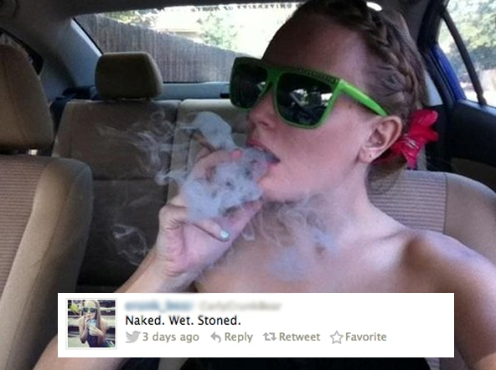
Picture Courtesy of the Daily Dot News and Photos via @crunk_bear/Twitter
Notes:
Directions for Presenter: Italics
Information for Presenter to Convey: Bold
Presenter’s Notes: (Time: 30 Seconds)
First, let participants look at this teacher’s social media post.
SAY: In this online post, the teacher made the decision to tweet to all her followers about being stoned. She also posted several pictures of herself in various states of undress.
Advance the slide.

Slide 20
Consequences of Actions
Loss of respect and credibility from colleagues, administrators, students, parents, board members, and community.
Loss of employment.
Loss of future employment/certification.
Notes:
Directions for Presenter: Italics
Information for Presenter to Convey: Bold
Presenter’s Notes: (Time: 3 Minutes)
SAY: The consequences were life-changing.
Click on the slide advancer to display the two bulleted items. Make the following statement:
SAY: The actions of this teacher, outside of the school day, negatively impacted her ability to effectively do her job in the classroom. The loss of respect and trust on the part of the school community was monumental. Subsequently, this teacher was fired from her job. Ask participants the following question:
SAY: What could have been done to help this teacher avoid the consequences of her actions? Let participants “popcorn out” responses.
Feedback: Participant responses should state that the teacher should have been mindful that her actions did not reflect good judgment and should have refrained from posting inappropriate information and pictures online. If colleagues previously noted a pattern regarding her personal online posts or actions, they may have been able to speak to her privately or they could have spoken to their administrator.
SAY: Remember that in this case the teacher did not represent herself as a positive role model for students, her school, or the community by promoting drug use and public nudity, and her reputation was irreparably damaged.

Slide 21

Can you teach good judgment?
Notes:
Directions for Presenter: Italics
Information for Presenter to Convey: Bold
Presenter’s Notes: (Time: 30 Seconds)
SAY: Can you teach good judgment? (This is a rhetorical question).
SAY: After reviewing some of these headlines and online posts, you can see that these educators didn’t make good decisions during their personal time outside of school. Their judgment was clouded. Some more than others.
SAY: As the Harvard Business Review put it, “Some people just have a flair for good judgment—whether it is an ability to identify issues or develop instincts to make sound decisions—and others simply do not. For those who have difficulty in making good decisions, this is an area that can be improved.” (Aaker, 2011).
Source Cited for Notes: Aaker, D. (2011, July). Great CEOs are born, not made. Harvard Business Review. Retrieved from https://hbr.org/2011/07/what-makes-a-great-ceo

Slide 22
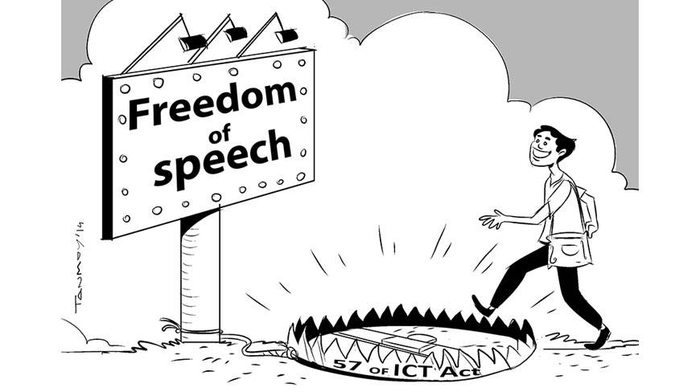

Ramifications
Really?
Notes:
Directions for Presenter: Italics
Information for Presenter to Convey: Bold
Presenter’s Notes: (Time: 3 Minutes)
Small and Large Group Discussion
SAY: Reflecting on the teacher’s actions we just discussed, how would you feel if she was your child’s teacher? What concerns would you have? Allow time for participants to discuss the questions. Call on volunteers to share responses. Hopefully, participants will state that they would be worried if their family member were in this teacher’s class because of her lack of good judgment, drug use, etc.
(FEEDBACK)
SAY: The school districts in the majority of the incidents we reviewed believed each teacher's behavior outside of school was deemed to be immoral or inappropriate, and they were disciplined accordingly.
The reality of the situation is that school districts have the authority to enforce its interpretation of morality and professionalism upon its teachers.
As much as we think that we can, we are not free to say or post everything that we want to communicate to the world. Certain limitations do apply for educators under certain circumstances.
Sources Cited: The University of Texas College of Education. (2013). Social media professionalism for teachers. Retrieved from http://community.edb.utexas.edu/socialmedia/ideassm_training_content/menu-training/0

Slide 23

Educators as Role Models
Notes:
Directions for Presenter: Italics
Information for Presenter to Convey: Bold
Presenter’s Notes: (Time: 30 Seconds)
SAY: What do we know about educators as role models and the impact on the profession?
Advance the slide.

Slide 24

A Role Model
A role model is a person whose behavior is imitated by others.
Notes:
Directions for Presenter: Italics
Information for Presenter to Convey: Bold
Presenter’s Notes: (Time: 30 Seconds)
SAY: We know that a role model is a person whose behavior is imitated by others.
We learn through their commitment to excellence, as well as through their ability to help us realize our own potential as individuals.
Everyday, our behavior can and will influence the lives of students in more ways that we can ever imagine.
Source Cited for Notes: Bashir, S., Bajwa, M., & Rana, S. (2014). Teacher as a role model and its impact on female students. International Journal of Research. Retrieved from http://granthaalayah.com/Articles/Vol1Iss1/02_IJRG14_A07_03.pdf

Slide 25

Why it matters
Notes:
Directions for Presenter: Italics
Information for Presenter to Convey: Bold
Presenter’s Notes: (Time: 15 Seconds)
This is a transition slide.
SAY: This next section will focus on ethics and expectations for educator role models and why it matters.

Slide 26

A general principle of the law states that…
An educator’s good moral character constitutes the essence of the role model that the educator represents to students both inside and outside the classroom.
19 TAC §249.5
Notes:
Directions for Presenter: Italics
Information for Presenter to Convey: Bold
Presenter’s Notes: (Time: 1 Minute)
SAY: Take a moment to read silently the information on the slide. When all participants have read the statement on the slide, state the following:
SAY: The law underscores what is expected of us as educator role models inside and outside of the school environment.
Now that we’ve spent time reviewing both positive and challenging qualities related to being a role model, especially as it pertains to conduct outside of the classroom, let’s narrow the focus in order to identify additional components inherent to this training.
Advance the slide.

Slide 27

Community Expectations for Educator Actions Outside of the School Day
Notes:
Directions for Presenter: Italics
Information for Presenter to Convey: Bold
Presenter’s Notes: (Time: 15 Seconds)
SAY: Community members also have specific expectations for educators. The following are three major expectations, as seen through the eyes of the communities educators serve.
Advance the slide.

Slide 28

The community expects educators to
be keenly aware that their actions reflect on the profession and the schools they represent;
demonstrate the highest level of professional judgment inside and outside of the school day; and
Connecticut’s Teacher Education and Mentoring Project (2012)
Notes:
Directions for Presenter: Italics
Information for Presenter to Convey: Bold
Presenter’s Notes: (Time: 30 Seconds)
SAY: The community expects that educators be keenly aware that their actions reflect on the profession and the schools they represent. They also expect educators to demonstrate the highest level of professional judgment.
Advance the slide.

Slide 29
The community expects educators to
understand that their presence within the community should be reflective of a law-abiding, trustworthy, and respectful citizen.
Connecticut’s Teacher Education and Mentoring Project (2012)
Notes:
Directions for Presenter: Italics
Information for Presenter to Convey: Bold
Presenter’s Notes: (Time: 30 Seconds)
SAY: Community members also expect that an educator’s presence within the community should be reflective of a law-abiding, trustworthy, and respectful citizen.
These qualities and expectations are not different from what we would want for everyone who lives and/or works within our community.
As educators, we continue to strive to reach these expectations daily.
However, it is important to take a few minutes to check the pulse of our group regarding some of the challenging aspects of being a role model outside of the school day.
Advance the slide.

Slide 30

Discuss the challenges of being a role model for students outside of school.
Notes:
Directions for Presenter: Italics
Information for Presenter to Convey: Bold
Presenter’s Notes: (Time: 3 Minutes)
Small and Large Group Dialogue
SAY: At your tables, discuss the challenges of being a role model for students “outside of the school day”.
Include examples, as applicable. One example is the pressure of being “on” 24/7. Please be prepared to share your responses with the larger group.
Provide participants with two minutes to discuss the discussion prompt. Take another minute to call on two or three tables time to share their group responses.
If possible, chart the challenges that are shared with the larger group.
FEEDBACK: Acknowledge that it can indeed be a challenge, but we have specific responsibilities as educators that we must live up to and represent for the greater good of the profession and our students.
Response examples from participants may include: Loss of perceived personal freedom; the inability to separate their personal life from their professional life; worrying about type of attire when going out in public; etc.

Slide 31
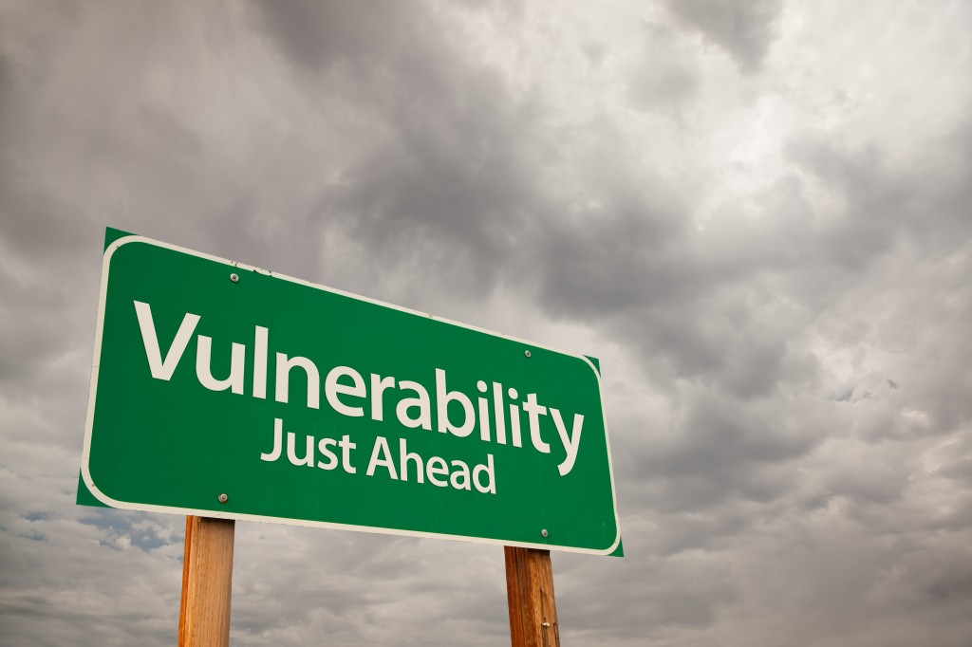
Behavioral Red Flags
Notes:
Directions for Presenter: Italics
Information for Presenter to Convey: Bold
Presenter’s Notes: (Time: 3 Minutes)
Small Group Collaboration; Click on the slide advancer a second time to display the second caption included on the slide.
SAY: You’ve provided great insight into what you believe are challenges that come with the role of educator outside of the school day.
I would like for you to collaborate at your tables to generate a few specific areas of caution and vulnerability that educators should be aware of regarding their actions or behavior outside of school. These areas can be considered as behavioral “red flags.” You probably discussed a few of these areas during the table talk activity.
Using one of the blank note pages in the Module 4 section of your journals, generate a collaborative list of areas in which educators should proceed with caution regarding their actions or involvement outside of the school day. Add a brief reason why these are behavioral red flags. Emphasize this pertains to out-of-school actions or behavior.
I will model your first entry: “Drug use.” This is a “behavioral red flag.” This type of illegal behavior can compromise an educator’s job and standing in the community.
Allow participants 2½ minutes to collaborate in order to generate their list of areas. The next slide will provide participants with an opportunity to share their list.

Slide 32

What red flag behaviors did you generate?
Notes:
Directions for Presenter: Italics
Information for Presenter to Convey: Bold
Presenter’s Notes: (Time: 3 Minutes)
Large Group Discussion and Feedback
SAY: What out-of-school “red flag” behaviors or actions did your groups generate? Call on two or three tables to provide them with the opportunity to share their findings.
SAY: The information included on the next three slides will highlight several areas of caution and vulnerability educators should heed regarding their actions, behavior, or involvement outside of the school day.
As I review the list, please compare the information to what you generated in your groups. It is important to ensure that we are all on the same page in our understanding of these areas of caution and vulnerability.
Advance the slide and briefly review the areas that experts identify as areas of caution and vulnerability for educators regarding out-of-school behavior/actions.

Slide 33

Areas of Caution and Vulnerability
Attire
  Professional or casual vs. inappropriate attire
Language
  Appropriate vs. inappropriate or vulgar language
Notes:
Directions for Presenter: Italics
Information for Presenter to Convey: Bold
Presenter’s Notes: (Time: 1 Minute)
Read the slide information and advance to the next slide. Elaborate as applicable.
SAY: Did you identify any areas that were not included on the experts’ “red flag” areas of caution and vulnerability?
If they identified any other additional areas, provide them with the opportunity to share.
SAY: The “red flag” areas that we just reviewed can be challenging for educators who find themselves in situations that may compromise their employment and their standing in the community.

Slide 34

Areas of Caution and Vulnerability
Social Media – Private/Public Posts
  Pictures or posts that are viewed as inappropriate,
  lewd, etc.
Use of Alcohol
  Social drinking vs. out-of-control drinking that
  adversely impacts behavior and driving
Notes:
Directions for Presenter: Italics
Information for Presenter to Convey: Bold
Presenter’s Notes: (Time: 30 Seconds)
Read the slide information and advance to the next slide. Elaborate as applicable.

Slide 35

Areas of Caution and Vulnerability
Part-Time Employment/Hobbies Outside of Teaching
  Is this employment/hobby viewed as appropriate by my
  community? When in doubt, ask your administrator.
Involvement in ANY Illegal Activity
  Drugs
  Assault
  Theft
Notes:
Directions for Presenter: Italics
Information for Presenter to Convey: Bold
Presenter’s Notes: (Time: 30 Seconds)
Read the slide information and advance to the next slide. Elaborate as applicable.

Slide 36

Consequences of Actions
Notes:
Directions for Presenter: Italics
Information for Presenter to Convey: Bold
Presenter’s Notes: (Time: 30 Seconds)
The information on the slide can be verbally summarized, or the presenter can read the items verbatim. Advance to the next slide.
SAY: If educators do not fully understand the laws of the State of Texas and the policies of their school districts, or if they choose to ignore these laws and policies, serious consequences and disciplinary actions can result.
Our actions outside of the school day can have a domino effect. These actions can cause a negative disruption in what happens inside our schools and in our personal lives. The consequences, as we noted earlier, can be devastating.
Source Cited: The University of Texas College of Education. (2013). Social media professionalism for teachers. Retrieved from http://community.edb.utexas.edu/socialmedia/ideassm_training_content/menu-training/0

Slide 37

Reprimand
Suspension
Termination
Loss of Certification
Incarceration
Notes:
Directions for Presenter: Italics
Information for Presenter to Convey: Bold
Presenter’s Notes: (Time: 30 Seconds)
SAY: These are a few of the possible consequences educators can face because of misconduct outside of the school day. Click on the slide advancer to display the five bulleted items.
- These are outcomes no one ever wants to face.

Slide 38

Chapter 247: Statement of Purpose:
The Texas educator, in maintaining the dignity of the profession, shall respect and obey the law, demonstrate personal integrity, and exemplify honesty and good moral character.
19 TAC § 247.1
How do you define good moral character?
Notes:
Directions for Presenter: Italics
Information for Presenter to Convey: Bold
Presenter’s Notes: (Time: 2½ Minutes)
SAY: Based on the information we have reviewed today, we are reminded that the purpose and scope of the Texas Educators’ Code of Ethics states that… (Read the statement on the slide).
Knowing what is expected of us within the scope of our profession as defined in law is critically important.
Taking all of this into consideration, we must also reference our local district policies. Some policies may require additional expectations that must also be followed by district employees.
SAY: Talk at your tables to discuss what you believe defines good moral character.
Allow participants to dialogue for at least one minute. Then ask one of the table groups to volunteer their findings. Once the group has shared their information, ask the other tables if they have any additional findings they would like to add to the first group’s list. Elaborate, as applicable.
Let’s apply what we learned today by completing a performance task. You will need your journal for this learning activity.

Slide 39
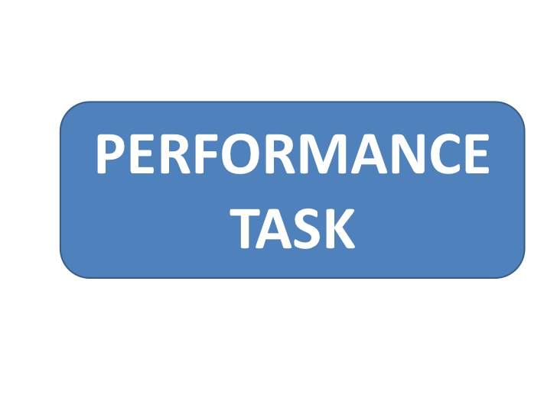
Notes:
Directions for Presenter: Italics
Information for Presenter to Convey: Bold
Presenter’s Notes: (Time: 7 Minutes)
Small and Large Group Analysis; The presenter will ask participants to find the section in their journal titled “Performance Task.”
SAY: Please complete the performance task. The detailed instructions will guide your group work. I will walk around to provide clarification as needed. Participants will work in groups, but will also record individually in their respective journals.
Read both scenarios included with the Performance Task activity included in your journal. Your group should choose only ONE scenario to review.
FEEDBACK: Once groups have finished completing the participant activity, the presenter will call on two or three table groups to provide their responses. IF PARTICIPANTS DO NOT IDENTIFY THE EXPECTED RESPONSES that should result from this activity, use the Performance Task Key to guide participants in reviewing the “correct/expected” outcomes for the scenarios.
Prompt participants to think about how could this become a violation of the law, Code of Ethics, or district policies. Possible responses are as follows:
Scenario 1
Students are under the legal age to be drinking alcoholic beverages.
Drinking with minors is a violation of the law.
The teacher, as well as the other adults, should prevent the students from driving and contact law enforcement to report illegal behavior.
District policies and the Code of Ethics prohibit this type of inappropriate teacher-student actions.
Scenario 2
Unauthorized use of school property and unreported theft to the cargo vehicle.
Code of Ethics violations based on misuse of school property and concealing loss of school property.

Slide 40

Notes:
Directions for Presenter: Italics
Information for Presenter to Convey: Bold
Presenter’s Notes: (Time: 3½ Minutes)
Personal Reflection: Participants will open their journal to the reflection page titled “Teachers as Role Models: Conduct Outside of the School.” The presenter will read the reflection prompt included below to participants. Provide 3-5 minutes for participants to complete their journal reflection.
SAY: Please open your journal to the reflection page titled “Teachers as Role Models: Conduct Outside of the School” and reflect on the following prompt:
As a result of this training module and group discussion, has your viewpoint changed regarding the influence you have on students outside of school? If Yes, explain why. If No, please explain why.
Allow 2½ minutes for participants to complete the reflection question. Then close the session with the following information:
SAY: As we bring this session to a close, let’s reflect on our opening Essential Questions and your responses to this journal response. Did the information you learned regarding the responsibility educators have to their profession outside of the regular school day strengthen your original viewpoint on this topic?
Ask a volunteer to share their response with the whole group.

Slide 41

Notes:
Directions for Presenter: Italics
Information for Presenter to Convey: Bold
Presenter’s Notes: (Time: 5 Minutes)
Assessment of Learning
SAY: Participants are required to complete an assessment based on the information received in this training. They must receive a grade of 100 to receive credit for this module training.
The presenter can provide each participant with the Module 4 assessment to complete as a culminating activity. Districts can alternately choose to have participants complete the assessment during a follow-up session or have them complete the assessment on their own within a designated period of time and submit it to their campus principal.

Slide 42

Notes:
Directions for Presenter: Italics
Information for Presenter to Convey: Bold
Presenter’s Notes: (Time: 1 Minute)
Before concluding the training session, the presenter should ask the participants if they have any questions about the training information they received today. Answer any questions as applicable.

Slide 43
References
Aaker, D. (2011). Great CEOs are born, not made. Harvard Business Review. Retrieved from https://hbr.org/2011/07/what-makes-a-great-ceo
Baker, K. (2014, May). Making waves [Web log post]. Retrieved from http://www.huffingtonpost.com/kamrin-baker/making-waves_1_b_5980324.html
Bashir, S., Bajwa, M., & Rana, S. (2014). Teacher as a role model and its impact on female students. International Journal of Research. Retrieved from http://granthaalayah.com/Articles/Vol1Iss1/02_IJRG14_A07_03.pdf
Connecticut’s Teacher Education and Mentoring Project. (2012). Ethical and professional dilemmas for educators. Retrieved from http://www.ctteam.org/df/resources/Module5_Manual.pdf
Colangelo, L. (2016, July). Manhattan assistant principal organizes fundraiser for students, prepares them for college. New York Daily News. Retrieved from http://www.nydailynews.com/new-york/education/hometown-heroes/manhattan-assistant-principal-organizes-fundraisers-students-article-1.2719835
Internet Movie Database (IMDb). (2016). Stand and Deliver Plot Summary. Retrieved fromhttp://www.imdb.com/title/tt0094027/plotsummary
Notes:
Directions for Presenter: Italics
Information for Presenter to Convey: Bold
Presenter’s Notes:
References for sources cited can be shown briefly. The presenter does not need to make a statement about the sources unless he or she chooses to do so.

Slide 44
References
Mendoza, Madalyn. (2016, April). Elementary teacher wins twerking contest in Mexico, but loses job. My San Antonio. Retrieved from http://www.mysanantonio.com/lifestyle/article/Elementary-teacher-wins-twerking-contest-in-7241476.php
Michigan teacher fired for stripping while on medical leave. (2013, June). 98.7 AMP Radio. Retrieved from http://987ampradio.cbslocal.com/2013/06/27/michigan-teacher-fired-for-stripping-while-on-medical-leave/
PBS Educational Media. (2013. ) Rita Pierson’s Funny and Inspiring TED Talks. http://www.pbs.org/wnet/ted-talks-education/speaker/rita-pierson/
Price-Mitchell, M. (2011). What is a role model? Five qualities that matter to teens. Roots of Action. Retrieved from http://www.rootsofaction.com/what-is-a-role-model-five-qualities-that-matter-for-role-models/
Simpson, M. (2010). Social networking nightmares. National Education Association. Retrieved from http://www.nea.org/home/38324.htm
Teacher busted with drugs, suspended by school district. (2016, February). KRGV.com. Retrieved from http://www.krgv.com/story/31250023/teacher-busted-with-drugs-suspended-by-school-district
Notes:
Directions for Presenter: Italics
Information for Presenter to Convey: Bold
Presenter’s Notes:
References for sources cited can be shown briefly. The presenter does not need to make a statement about the sources unless he or she chooses to do so.

Slide 45
References
Texas on record-setting pace for inappropriate teacher-student relationships. (2016, June). CBS News. Retrieved from http://www.cbsnews.com/news/texas-record-setting-pacer-inappropriate-teacher-student-relationships/
Tumposky, Ellen. (2011, June). Florida High School Principal Lied About Hypnotizing Students Who Later Died. ABC News. Retrieved from: http://abcnews.go.com/US/florida-high-school-principal-lied-hypnotizing-students-died/story?id=13966704
The University of Texas College of Education. (2013). Social media professionalism for teachers. Retrieved from http://community.edb.utexas.edu/socialmedia/ideassm_training_content/menu-training/0
Notes:
Directions for Presenter: Italics
Information for Presenter to Convey: Bold
Presenter’s Notes:
References for sources cited can be shown briefly. The presenter does not need to make a statement about the sources unless he or she chooses to do so.

