Slide 1

Notes:
Directions for Presenter: Italics
Information for Presenter to Convey: Bold
Presenter’s Notes: (Time: 1 Minute)
Welcome participants. If this is a new group of participants, introduce yourself to the group.
SAY: This is the fifth ethics training module for Texas educators. Module 5 will focus on Confronting and Reporting Borderline Behavior.
It is advisable to have participants seated at tables to encourage group dialogue. Participants will also be provided with a reflection journal.
Materials for Participants:
Journal
Materials for Presenter:
PowerPoint for Module 5
LCD Projector, Screen, Computer, and Speakers
Slide Advancer
Participant Toolbox is recommended (index cards, sticky notes, markers, pencils/pens, etc.)
Copies of Module Assessment
Performance Task Key
Assessment Key

Slide 2
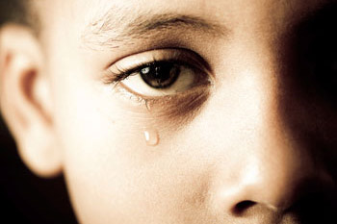

Purpose
Explore the responsibility of educators in identifying and reporting inappropriate behaviors.
Notes:
Directions for Presenter: Italics
Information for Presenter to Convey: Bold
Presenter’s Notes: (Time: 1 Minute)
Read the slide information and advance to the next slide. Elaborate as needed.

Slide 3

Stimulating Thinking
What is my role in reporting inappropriate behavior?
Notes:
Directions for Presenter: Italics
Information for Presenter to Convey: Bold
Presenter’s Notes: (Time: 2 Minutes)
SAY: As we prepare to begin our training session, this is the overarching essential question that we will conceptualize today.
Read the essential question displayed on the slide.
Ask participants to suggest some possible answers for 20-30 seconds. This will ensure that participants realize they will be answering questions throughout the training and will also give you an opportunity to hear some of their thinking, which may help determine what to emphasize later in the training.
Note-Taking Strategy: Ask participants to use the Module 6 note-taking section of their journal to record their responses to the essential question. They can respond to the essential questions in more depth while they are waiting for the session to begin.
Advance to the next slide.

Slide 4

Participants will
identify lack-of-judgment decisions;
identify responsibilities for reporting educator misconduct; and
review and discuss district reporting policies that ensure a safe and ethical climate.
Notes:
Directions for Presenter: Italics
Information for Presenter to Convey: Bold
Presenter’s Notes: (Time: 1 Minute)
SAY: Let’s take a moment to review the session objectives. Today we will identify lack-of-judgment decisions; identify responsibilities for reporting educator misconduct; and review and discuss district reporting policies that ensure a safe and ethical climate.
Before we get started, I would like to let you know that I understand how difficult it is to do what we are going to ask of you, which is to report suspected inappropriate educator-student relationships. For some it may not be difficult, but for others it may not feel comfortable reporting something that may be considered to be an ethical violation.

Slide 5

Caring and Committed Educators
Notes:
Directions for Presenter: Italics
Information for Presenter to Convey: Bold
Presenter’s Notes: (Time: 1 Minute)
Read the bulleted information below or verbally summarize it for participants. Emphasize that following policies and procedures and reporting suspected misconduct incidents are important to the safety of students and school personnel.
SAY: The majority of educators are committed and caring professionals who want only the best for their students.
However, it is important to remember that educator misconduct is a reality and can devastate students, parents, school districts, and entire communities. Acknowledging that (1) there is a problem; (2) educators need training about these issues; and (3) everyone must follow state and local policies can go a long way toward stopping this type of behavior while still allowing staff to engage in APPROPRIATE teacher-student relationships.

Slide 6

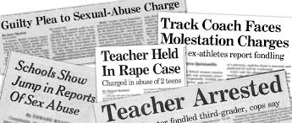
Impact of Educator Misconduct
Notes:
Directions for Presenter: Italics
Information for Presenter to Convey: Bold
Presenter’s Notes: (Time: 1 Minute)
SAY: The faces of educators who have been arrested for having inappropriate educator-student relationships stare back at us from the pages of newspapers and television news stories much too often.
It might be a teacher, paraprofessional, principal, or any other adult in the school.
The students who have forever been scarred from these experiences will never be the same.
The photos you will see next are just a sampling of some of the Texas educators who have been arrested for crossing serious inappropriate relationship boundaries with their students.
Advance to the next slide.

Slide 7
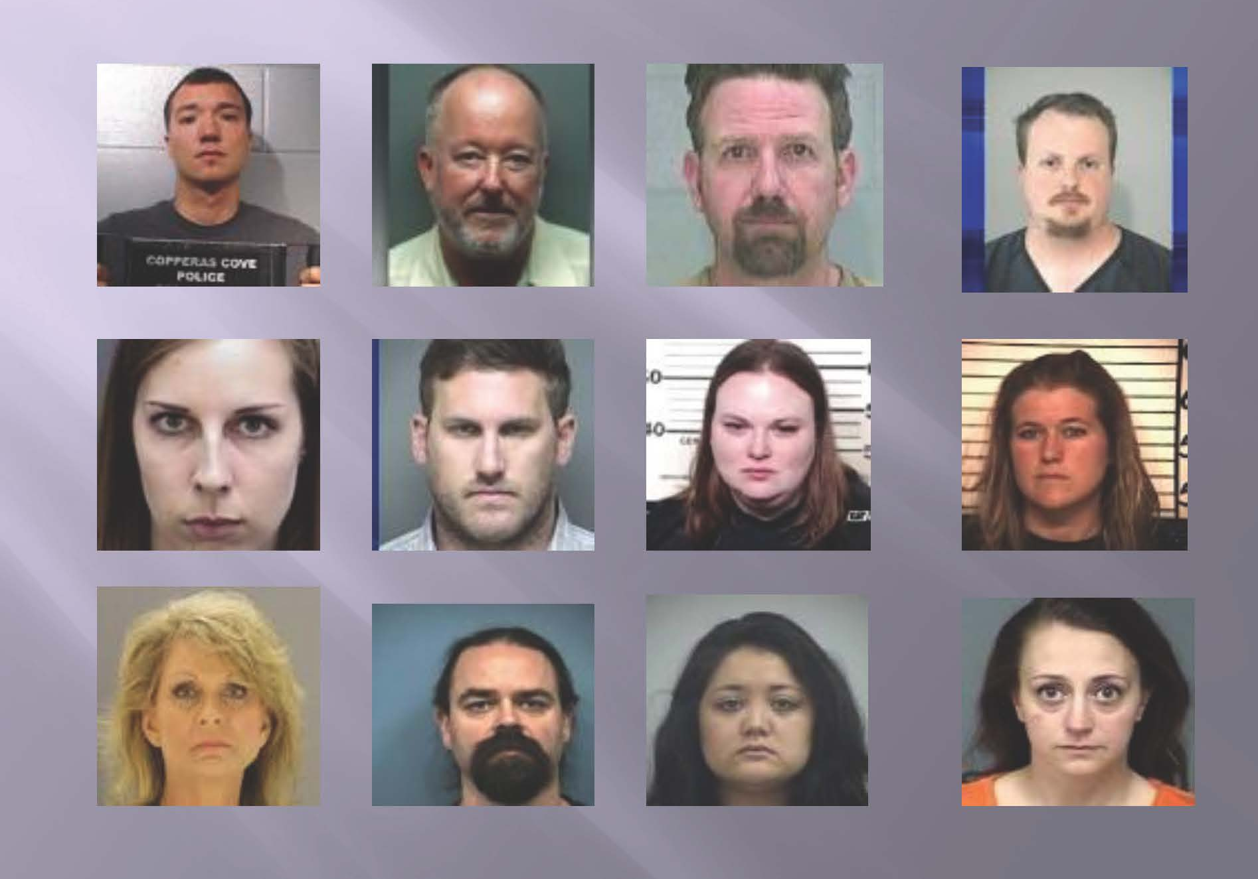
ARRESTED
Photos courtesy of TEA Educator Investigations Unit training session
Notes:
Directions for Presenter: Italics
Information for Presenter to Convey: Bold
Presenter’s Notes: (Time: 30 Seconds)
SAY: In Texas, the number of reports of inappropriate teacher-student relationships has increased dramatically, according to the Texas Education Agency.
We will review and discuss reasons why the number of cases is increasing.
Advance to the next slide.
Source Cited: Huffman, C., and Trahan, J. (2016, April). Texas system for reporting teacher sex allegations broken. WFAA8 News. Retrieved from http://www.wfaa.com/news/local/investigates/texas-system-for-reporting-teacher-sex-allegations-broken/158756956

Slide 8

What does borderline behavior mean?
Notes:
Directions for Presenter: Italics
Information for Presenter to Convey: Bold
Presenter’s Notes: (Time: 2 Minutes)
Read the question on the slide before sharing the following information.
SAY: In order to be part of the solution in decreasing incidents of educator misconduct, it is important to understand the meaning of borderline behavior.
Ask participants to give their definitions of borderline behavior. Elaborate on their responses as applicable.
SAY: Before we discuss borderline behavior more in-depth, let’s watch a video that illustrates the importance of the reporting responsibility in preventing the escalation of educator misconduct.
Advance to the next slide.

Slide 9
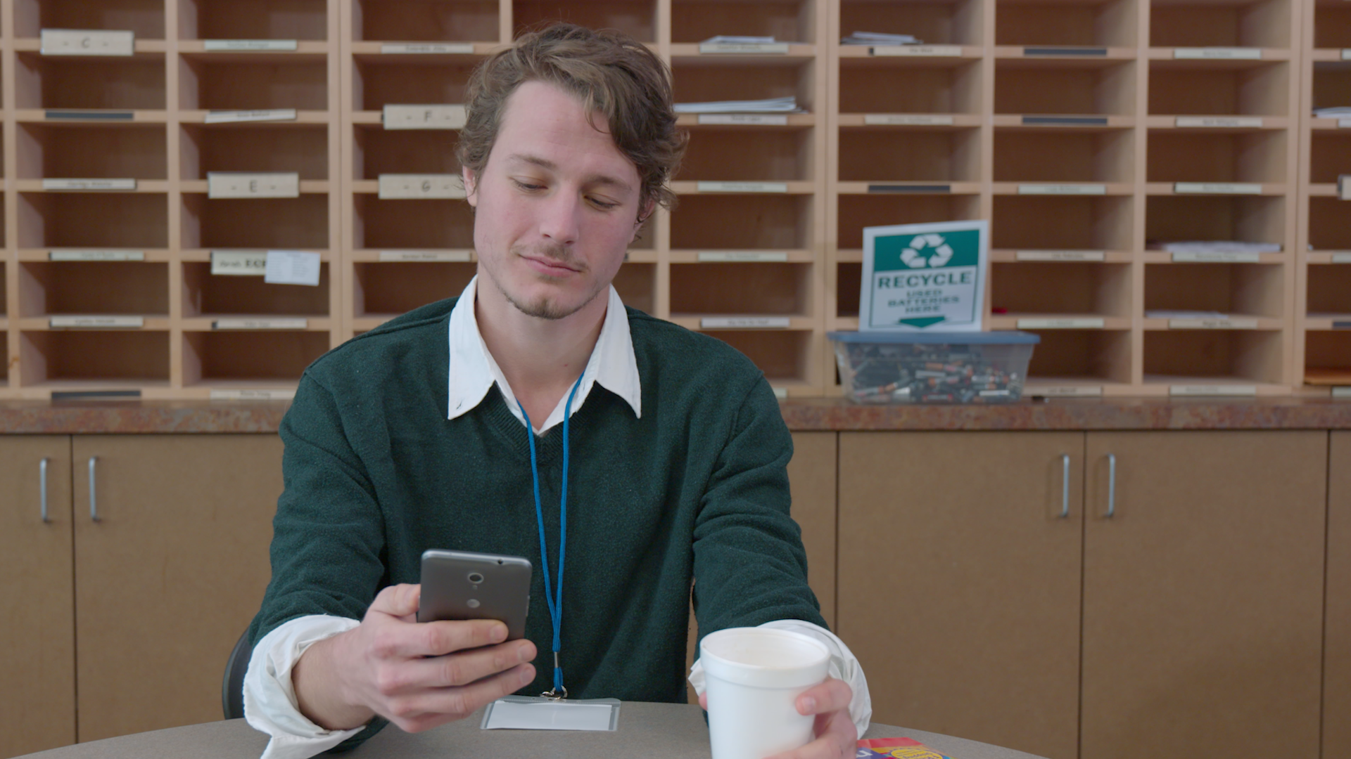

Video Scenario
Notes:
Directions for Presenter: Italics
Information for Presenter to Convey: Bold
Presenter’s Notes: (Time: 5 Minutes)
SAY: This video focuses on confronting and reporting borderline behavior.
Video Scenario for Presenter’s Reference:
A teacher receives a Facebook friend request from a colleague at school. The teacher accepts the friend request and quickly discovers that many students are also Facebook friends with the colleague. After reviewing several posts, the teacher determines that the content of many of them is extremely inappropriate. The teacher reports the information to the campus principal.

Slide 10

Video Scenario Debrief
Notes:
Directions for Presenter: Italics
Information for Presenter to Convey: Bold
Presenter’s Notes: (Time: 10 Minutes)
Use the following questions to prompt small and large group discussion among participants.
SAY: In the video segment, the teacher who included several of his students as “friends” on his Facebook page is definitely on a slippery slope.
How would you have addressed this issue if you were the colleague who discovered the inappropriate online communications?
Allow two minutes for participants to discuss this question with one another at their tables. Ask the tables to identify a reporter who will share their group’s response. Call on two or three groups to share what they discussed.
How prevalent is the practice of including students as “friends” on personal social media accounts among educators?
Call on volunteers to share their responses to this question.
Presenter Feedback: If participants do not state that they would have reported the situation to their principal or other supervisor, it will be important to emphasize that as a fellow educator, our responsibility is to support each other so that a staff member’s practices remain professional in order to keep students safe. Also, state that it is never a good practice to include students on personal social media accounts and that consequences for this are potentially severe. Only district-approved web pages or school social media accounts should be used to communicate with students. Emphasize that everyone should review their district acceptable use policies to ensure compliance.
The responses from participants will provide important data about how they would respond to suspected incidents of misconduct. This information will help identify additional training needs and policy reviews.
Refer back to the video scenario throughout the remainder of the module

Slide 11

Keep me safe.
Notes:
Directions for Presenter: Italics
Information for Presenter to Convey: Bold
Presenter’s Notes: (Time: 30 Seconds)
SAY: The education profession is extremely complex and critically important within our society.
We need to ensure that the professional practice of teaching meets the highest level of educator standards and expectations.
Being aware of behavior or situations that can negatively impact our profession will help us ensure a safe learning environment for our students.

Slide 12

A Common Occurrence
“When I talk to teachers in a school where an educator has been arrested, I hear admissions that they suspected something but, because they were not completely sure, did not want to say anything.” (Shakeshaft, 2013)
Notes:
Directions for Presenter: Italics
Information for Presenter to Convey: Bold
Presenter’s Notes: (Time: 1 Minute)
Read the quote on the slide.
SAY: As adult bystanders, we contribute to an unsafe school environment by remaining silent.
Unfortunately, most educators DON’T know the warning signs and patterns of educator misconduct that may exist.
Thus, many refrain from reporting suspected educator misconduct.
Source Cited: Shakeshaft, C. (2013, February). Know the warning signs of educator sexual misconduct. Phi Delta Kappan, 94(5), 8. Retrieved from http://www.doe.virginia.gov/support/prevention/child_abuse/sexual_misconduct_warning_signs_shakeshaft.pdf

Slide 13
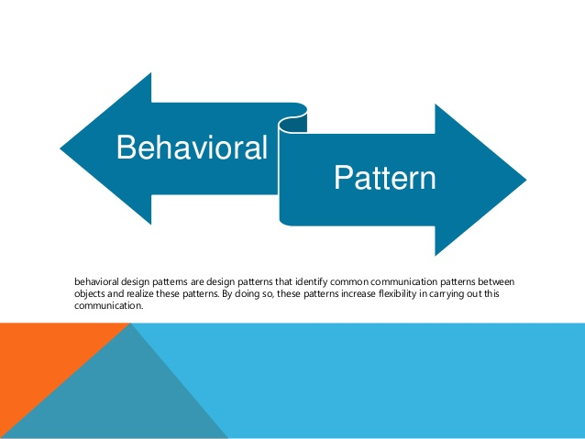
Educators can confront misconduct, specifically sexual misconduct, in schools if they know how to recognize and respond to suspicious patterns.
(Shakeshaft, 2013)
Notes:
Directions for Presenter: Italics
Information for Presenter to Convey: Bold
Presenter’s Notes: (Time: 30 Seconds)
Read the information on the slide verbatim or verbally summarize it for participants before sharing the information below.
SAY: In an earlier training module, you learned about boundary violations.
This section will provide information that will help bring awareness to a pattern of borderline behavior.
Knowing this information will help educators be better prepared to report inappropriate behavior to their administrators.
Source Cited: Shakeshaft, C. (2013, February). Know the warning signs of educator sexual misconduct. Phi Delta Kappan, 94(5), 8. Retrieved from http://www.doe.virginia.gov/support/prevention/child_abuse/sexual_misconduct_warning_signs_shakeshaft.pdf

Slide 14
Lack of Judgment
Boundary Issues
Borderline Behavior
Notes:
Directions for Presenter: Italics
Information for Presenter to Convey: Bold
Presenter’s Notes: (Time: 1 Minute)
SAY: The behavioral pattern that has been identified in cases of inappropriate teacher-student relationships is typically referred to as the lack-of-judgment or slippery slope pattern type.
Although the terms may differ depending on the body of work, the similarities in the pattern type are closely aligned.
Sources Cited:
Shakeshaft, C. (2013, February). Know the warning signs of educator sexual misconduct. Phi Delta Kappan, 94(5), 8. Retrieved from http://www.doe.virginia.gov/support/prevention/child_abuse/sexual_misconduct_warning_signs_shakeshaft.pdf
United States Department of Education. (2008). Educator sexual misconduct: What school staff need to know and do. Helpful Hints For School Emergency Management, 3(2). Retrieved from http://rems.ed.gov/docs/HH_Vol3Issue2.pdf

Slide 15
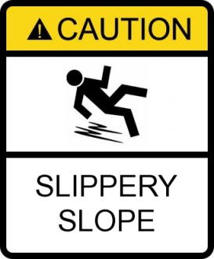
Lack-of-Judgment Pattern
Don’t initially set out to harm students
End up in relationships with students to meet emotional needs
Notes:
Directions for Presenter: Italics
Information for Presenter to Convey: Bold
Presenter’s Notes: (Time: 1 Minute)
SAY: Most adults don’t initially intend to target students to harm them, but the educator-student relationship that develops meets an emotional need (e.g., companionship, loneliness, depression, etc.).
This is the point where some educators can find themselves on a very slippery slope. Before they know it, they have crossed the line into an inappropriate relationship with a student.
The actions of the educator begin to look questionable to other colleagues or students (e.g., always talking to the same student or checking in on him/her; sitting next to him/her in the lunchroom rather than eating with colleagues; allowing the student to get away with unacceptable behavior when in class, etc.).
Educators whose actions have led them down this slippery slope are often astounded that they put themselves in such a precarious situation.
Sources Cited:
Shakeshaft, C. (2013, February). Know the warning signs of educator sexual misconduct. Phi Delta Kappan, 94(5), 8. Retrieved from http://www.doe.virginia.gov/support/prevention/child_abuse/sexual_misconduct_warning_signs_shakeshaft.pdf
United States Department of Education. (2008). Educator sexual misconduct: What school staff need to know and do. Helpful Hints For School Emergency Management, 3(2). Retrieved from http://rems.ed.gov/docs/HH_Vol3Issue2.pdf

Slide 16
The Slippery Slope
Voluntary statement given during investigation:
“Why did I act this way? I honestly don’t know. I
think it had a lot to do with two things: extreme
loneliness and severe depression.”
“Basically, I have no friends, certainly none in this
town. This is probably the reason I’m so
depressed. I started to feel closeness with her and
was drawn to it. I don’t know what I was thinking.”
Notes:
Directions for Presenter: Italics
Information for Presenter to Convey: Bold
Presenter’s Notes: (Time: 1 Minute)
Direct participants to silently read the statement displayed on the slide. When it appears that everyone has read the slide, read the information below.
SAY: This is a statement from a teacher who was investigated for having an inappropriate relationship with one of his students. It emphasizes how the slippery slope effect begins. It also demonstrates how this educator found himself in a situation that jeopardized the student’s well-being and the teacher’s career.
Advance to the next slide.

Slide 17

Notes:
Directions for Presenter: Italics
Information for Presenter to Convey: Bold
Presenter’s Notes: (Time: 30 Seconds)
SAY: Let’s review and discuss a scenario that demonstrates how the decisions made by a teacher changed her life forever.
Advance to the next slide.

Slide 18
Reporting is Everyone’s Responsibility
“I typically remain in my classroom until 5:30 or 6 most afternoons to grade papers, gather lesson resources, etc.
Walking to my car, I frequently observed a teacher leaning against her car engaged in conversation with one of my eighth-grade students. I often left feeling uneasy. It didn’t appear appropriate for this teacher to be chatting with the student in this manner. Their proximity seemed flirtatious. Usually, there were only two cars left in the parking lot: mine and hers.
Two months later, the teacher was suspended for having an inappropriate relationship with the student. Ultimately, she lost her job, and the student transferred to another school. I should have reported what I had observed to my principal. Now it’s too late.”
Notes:
Directions for Presenter: Italics
Information for Presenter to Convey: Bold
Presenter’s Notes: (Time: 1½ Minutes)
Read the statement displayed on the slide before reading the information below.
SAY: In this case, the teacher used lack of judgment. She and the student often spent time engaged in private conversation.
This type of borderline behavior placed the teacher on a very slippery slope.
A colleague often observed the inappropriate behavior of this teacher but failed to report it to the principal.
After the teacher lost her job for having an inappropriate relationship with the student, the colleague realized that she should have reported the suspected misconduct and possibly prevented the escalation of the situation.
Advance to the next slide.

Slide 19

Notes:
Directions for Presenter: Italics
Information for Presenter to Convey: Bold
Presenter’s Notes: (Time: 3 Minutes)
SAY: What would you do if you were the person who witnessed this situation?
Discuss this situation with your tablemates.
Would you report this incident to your principal? Please elaborate on your response.
Select the person whose name begins closest to the letter A to be your group’s reporter.
Provide three minutes for groups to discuss both questions. Advance to the next slide.

Slide 20

Notes:
Directions for Presenter: Italics
Information for Presenter to Convey: Bold
Presenter’s Notes: (Time: 3 Minutes)
Call on two or three volunteers to share their viewpoints with the large group.
The intended outcome of this activity is to determine if participants will report incidents of suspected misconduct. The feedback provided by participants should indicate that they would report what was observed to their administrator. If the discussion feedback does not yield this outcome, emphasize the following:
SAY: Educators in these situations don’t intend to become involved with their students, but unfortunately they let it happen. They are then left to face the consequences of their misconduct.
The outcome of this situation helped administrators intervene. The reporting process is an important responsibility for everyone who is charged with the important task of keeping our students safe.

Slide 21

Rise in Cases of Educator Misconduct
Notes:
Directions for Presenter: Italics
Information for Presenter to Convey: Bold
Presenter’s Notes: (Time: 30 Seconds)
This is a transition slide.
SAY: There is no question that the number of inappropriate teacher-student relationships is increasing in Texas.
Click on the slide advancer to show the data.

Slide 22
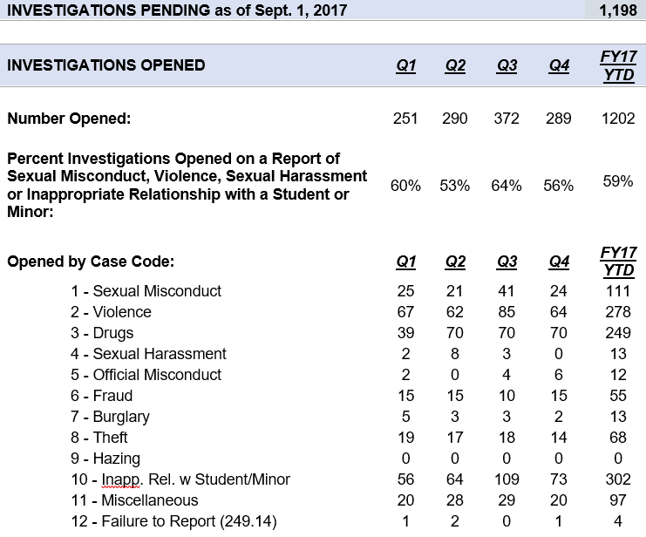
Notes:
Directions for Presenter: Italics
Information for Presenter to Convey: Bold
Presenter’s Notes: (Time: 3 Minutes)
SAY: This slide shows the number and types of educator investigations that have occurred to date.
Click TWICE on the slide advancer to display the animation that will focus the conversation.
Briefly review the data regarding educator investigation case numbers as of 8/31/16. Direct participants to focus on the categories with the highest number of misconduct violations.
SAY: Are the numbers of cases rising because of increased educator violations or because of an increased willingness of people to report what they know? What do you think?
Call on volunteers to provide their viewpoints. Their responses will vary. Advance to the next slide.
Source Cited: Texas Education Agency. (2016). Educator Discipline - FAQs. Retrieved from http://tea.texas.gov/Texas_Educators/Investigations/Educator_Discipline_-_FAQs/

Slide 23

Notes:
Directions for Presenter: Italics
Information for Presenter to Convey: Bold
Presenter’s Notes: (Time: 30 Seconds)
SAY: We hope the reason is because more people are reporting incidents to campus administrators, child protective services, or law enforcement as applicable depending on each case.
Now that we have a greater understanding of the urgency of this situation, we need to take some time to discuss professional responsibilities to address this grave concern.

Slide 24

Professional Responsibility
Professional Responsibility
Notes:
Directions for Presenter: Italics
Information for Presenter to Convey: Bold
Presenter’s Notes: (Time: 30 Seconds)
This is a transition slide.
SAY: As a profession, it’s critical for educators to understand their professional responsibility to report suspected misconduct.
Advance to the next slide.
Source Cited: Pennsylvania Department of Education. (2016). Pennsylvania Professional Standards and Practices Commission. Retrieved from http://www.pspc.education.pa.gov/Educator-Discipline-System-and-Reporting/Mandatory-Reporting/Pages/default.aspx

Slide 25

Many students become victims of some type of educator misconduct.
Notes:
Directions for Presenter: Italics
Information for Presenter to Convey: Bold
Presenter’s Notes: (Time: 30 Seconds)
Read the information on the slide.
SAY: It’s really quite simple. We are responsible for the well-being and safety of the students in our schools.
As a profession, we must protect them by ensuring that state and local policies and procedures on reporting educator misconduct are strengthened.

Slide 26

“If I reported and I was wrong, I would have ruined the life of another teacher.”
(Shakeshaft, 2013)
Notes:
Directions for Presenter: Italics
Information for Presenter to Convey: Bold
Presenter’s Notes: (Time: 30 Seconds)
Read the quote on the slide before elaborating with the information below.
SAY: Charol Shakeshaft is an educational researcher noted for her studies on sexual abuse of students by school personnel. She states that this quote is a common explanation that is given for not reporting a colleague’s questionable behavior.
Now let’s look at it from a different perspective.
Advance to the next slide.

Slide 27

“If I didn’t report and this person had abused, I’d have ruined the life of a student.”
(Shakeshaft, 2013)
Notes:
Directions for Presenter: Italics
Information for Presenter to Convey: Bold
Presenter’s Notes: (Time: 30 Seconds)
Read the quote on the slide before elaborating with the information below.
SAY: Unfortunately, Shakeshaft states that this is NOT an explanation that is given by school personnel when it is discovered that one of the students at their school was harmed because of educator misconduct.
We must make huge strides to ensure that we protect our students by becoming better at understanding the warning signs so that reporting will become more prevalent.

Slide 28

How do I distinguish between what is and isn’t a reportable offense?
Notes:
Directions for Presenter: Italics
Information for Presenter to Convey: Bold
Presenter’s Notes: (Time: 1 Minute)
SAY: As you can see, educators experience an internal struggle when it comes to reporting a colleague for suspected educator misconduct.
One of our most important fundamental responsibilities as educators is to ensure the safety and well-being of our students.
Ask yourself the following questions: Is the student in danger of being harmed in any way? Is the action or behavior exhibited by my colleague appropriate?
Let participants know that the performance task for this module will provide them with the opportunity to review several scenarios that will require them to distinguish between what is or isn’t a reportable offense.

Slide 29

Question to Ponder
Why do cases of educator misconduct go unreported?
Notes:
Directions for Presenter: Italics
Information for Presenter to Convey: Bold
Presenter’s Notes: (Time: 4 Minutes)
Click a second time on the slide advancer to display the question on the slide. Read the question out loud.
SAY: Earlier we discussed whether or not we would report a suspected case of educator misconduct. Now I would like to know WHY you believe cases of educator misconduct go unreported. Share your thoughts with your tablemates.
Please identify two or three reasons based on your group discussion.
Be ready to share your reasons with the whole group.
Call on two or three tables to share the reasons that were identified.
Ask participants to consider possible reasons why students don’t report educator misconduct. Answers may include:
No one will believe me
Educator is popular – retaliation by other students
Child will get in trouble
Educator will get in trouble
SAY: You’ve done a great job in identifying several possible reasons. Let’s review the findings gathered from investigative data regarding reasons for non-reporting.

Slide 30

Findings
Reasons some educators give for not reporting suspected educator misconduct:
Lack of recognition of characteristics associated with inappropriate/abusive behavior
Lack of awareness of legal responsibilities
Fear of negatively affecting the school or educator’s job
Notes:
Directions for Presenter: Italics
Information for Presenter to Convey: Bold
Presenter’s Notes: (Time: 1 Minute)
SAY: There are several reasons educators give for not reporting suspected educator misconduct.
These findings underscore the importance of providing training for all school personnel in knowing what the responsibilities and warning signs are that point to inappropriate educator-student relationships.
Click on the slide advancer to review the findings on the slide one item at a time. After each reason, provide feedback regarding how closely the reasons participants identified in their groups align with the research findings. Celebrate their accuracy. Elaborate as applicable.
Source Cited: Shoop, R. (2003). Sexual Exploitation in Schools: How to Spot It and Stop It. California: Corwin Press.

Slide 31
Findings
Reasons some educators give for not reporting suspected educator misconduct:
Lack of sufficient evidence
Belief that the student will be harmed more than helped if reported
Fear of retaliation and litigation
Notes:
Directions for Presenter: Italics
Information for Presenter to Convey: Bold
Presenter’s Notes: (Time: 1 Minute)
Click on the slide advancer to review the findings on the slide one item at a time. After each reason, provide feedback regarding how closely the reasons participants identified in their groups align with the research findings. Celebrate their accuracy. Elaborate as applicable.
SAY: Educators should never be apprehensive about reporting educator misconduct. Doing what is right for all students should remain the focus of our responsibilities.
Source Cited: Shoop, R. (2003). Sexual Exploitation in Schools: How to Spot It and Stop It. California: Corwin Press.

Slide 32

If you suspect or know something . . .
Notes:
Directions for Presenter: Italics
Information for Presenter to Convey: Bold
Presenter’s Notes: (Time: 1 Minute)
Read the information on the slide before elaborating with the statements below. The information below can be read verbatim or summarized verbally for participants.
SAY: As tragic incidents are reported across our nation on a daily basis, law enforcement agencies and other concerned organizations are making the same request: “If you see something, say something.”
Homeland Security states that if we see something that we know shouldn't be happening—or we believe someone's behavior doesn't seem quite right—we should say something.
Informed, alert communities play a critical role in keeping our nation safe.

Slide 33

What do we need to know about the reporting process?
Notes:
Directions for Presenter: Italics
Information for Presenter to Convey: Bold
Presenter’s Notes: (Time: 30 Seconds)
SAY: There are a few important components of the reporting process that we need to review before we complete this training module.
Reporting what we know if we suspect educator misconduct is a PRIORITY. (This statement needs to be emphasized.)

Slide 34

District Reporting Protocol
Report suspected incidents of educator misconduct to your administrator immediately.
Notes:
Directions for Presenter: Italics
Information for Presenter to Convey: Bold
Presenter’s Notes: (Time: 1½ Minutes)
Click on the slide advancer to display the reporting priority featured on the slide and read it out loud. Then read the information below.
SAY: Following the district’s reporting protocol is imperative. Your campus or department administrator should be your first point of contact in reporting educator misconduct. He or she will be able to act quickly in addressing the concern.
Don’t wait or mull things over or attempt to determine for yourself whether the behavior you have observed has a plausible, innocent explanation.
You may not understand the entire situation, and allowing the conduct to continue could be detrimental.
Maintain confidentiality.
Source Cited: Shoreline School District. (n.d.). Protocol in Dealing with Inappropriate Behavior. Retrieved from http://www.shorelineschools.org/cms/lib011/WA02217114/Centricity/Domain/93/InappropriateBehaviorProtocol.pdf

Slide 35
District Reporting Protocol
Follow district reporting policies and procedures to ensure all appropriate steps are followed.
Notes:
Directions for Presenter: Italics
Information for Presenter to Convey: Bold
Presenter’s Notes: (Time: 3 Minutes)
Click on the slide advancer to display the reporting priority featured on the slide and read it out loud. Then read the information below.
SAY: I want to briefly review our district’s policy with you that details the reporting procedure everyone should follow.
Be prepared with copies of the school district policy that provides the protocol that school district employees should follow in reporting suspected educator misconduct. It is recommended that an image of the district policy be inserted after slide 36 as a reference to the hard copy of the policy given to participants.
Identify key sections of the policy to review with participants PRIOR to the training session.
SAY: Are there any questions about the procedures we have in place that guide the reporting process?
Advance to the next slide.

Slide 36

Supporting a Safe and Ethical Climate
Provide awareness training.
Strengthen policy guidance in identifying, reporting, and investigating incidents, if applicable.
Follow through when confronted with questionable educator behavior.
Enforce a zero tolerance policy regarding professional misconduct.
(Shakeshaft, 2013)
Notes:
Directions for Presenter: Italics
Information for Presenter to Convey: Bold
Presenter’s Notes: (Time: 1½ Minutes)
SAY: Students have the right to expect to have their physical, emotional, academic, and social well-being protected at school by all the adults who work at their school district.
These are additional steps that are important to ensure that a safe and ethical climate is supported.
Use the slide advancer to display each bulleted item and read it out loud.
Source Cited: Shakeshaft, C. (2013, February). Know the warning signs of educator sexual misconduct. Phi Delta Kappan, 94(5), 8. Retrieved from http://www.doe.virginia.gov/support/prevention/child_abuse/sexual_misconduct_warning_signs_shakeshaft.pdf

Slide 37

Are there reporting requirements for superintendents?
YES
Notes:
Directions for Presenter: Italics
Information for Presenter to Convey: Bold
Presenter’s Notes: (Time: 30 Seconds)
Read the question on the slide. Click on the slide advancer to display the word “YES.” Read the information below.
SAY: Yes. There is a specific reporting requirement for superintendents.
Advance to the next slide.
Source Cited: Texas Education Agency. (2016). Educator Discipline - FAQs. Retrieved from http://tea.texas.gov/Texas_Educators/Investigations/Educator_Discipline_-_FAQs/

Slide 38

Superintendent SBEC
Reporting Requirements
Within business days, a superintendent must report
educator misconduct that results in termination or resignation; and
a reported criminal history of an applicant for or holder of a certificate or permit issued by SBEC.
Notes:
Directions for Presenter: Italics
Information for Presenter to Convey: Bold
Presenter’s Notes: (Time: 1 Minute)
Read the information on the slide or provide a verbal summary before reading the statement below.
SAY: Now let’s make some final connections to sum up what we’ve learned.
Source Cited: Texas Education Agency. (2016). Educator Discipline - FAQs. Retrieved from http://tea.texas.gov/Texas_Educators/Investigations/Educator_Discipline_-_FAQs/

Slide 39

Become knowledgeable about the importance of reporting requirements.
Create a safe and ethical climate.
Send a strong message that misconduct
will not be tolerated.
Trust your instincts
Notes:
Directions for Presenter: Italics
Information for Presenter to Convey: Bold
Presenter’s Notes: (Time: 1½ Minutes)
Read the information on the slide or provide a verbal summary before reading the information below.
SAY: Today, we have been able to identify several outcomes in confronting borderline behavior and strengthening the reporting process at all campuses.
With the knowledge that all school personnel have a better understanding about questionable educator behavior and responsibilities for reporting suspected misconduct, the campus will be able to be more vigilant in ensuring an ethical climate, thus eliminating inappropriate incidents.
It will also provide students with a strong message that will allow them to trust that the adults at their school will protect them from harm.
Finally, trust your instincts. If something seems amiss, it frequently is.

Slide 40

Notes:
Directions for Presenter: Italics
Information for Presenter to Convey: Bold
Presenter’s Notes: (Time: 7 Minutes)
Ask participants to find the section in their journal titled “Justify It.”
SAY: I would like for you to work in your groups to complete the Performance Task for this module. I will walk around to provide clarification as needed.
Participants will work in groups but also record their responses in their respective journals.
SAY: Discuss each scenario and determine if it is a reportable violation. Place a checkmark in the first or second column based on your group’s decision to report or not report each incident. Justify your responses in the third column.
FEEDBACK: Once groups have finished completing the participant activity, call on two or three groups to provide their responses. IF PARTICIPANTS DO NOT IDENTIFY THE EXPECTED RESPONSES that should result from this activity, use the Performance Task Key to guide participants in reviewing the expected responses.

Slide 41

Notes:
Directions for Presenter: Italics
Information for Presenter to Convey: Bold
Presenter’s Notes: (Time: 3 Minutes)
Ask participants to turn to the journal reflection page titled “Confronting and Reporting Borderline Behavior.” Read the reflection prompt included below. Provide at least three minutes for participants to complete their journal reflection.
SAY: From your perspective, has your campus made strides to support a safe and ethical climate?
If your response is yes, what strategy or strategies have fostered a safe and ethical climate at your campus?
If your answer is no, what recommendation can you offer to create a safe and ethical climate?

Slide 42

Notes:
Directions for Presenter: Italics
Information for Presenter to Convey: Bold
Presenter’s Notes: (Time: 5 Minutes)
SAY: Each participant is required to complete an assessment based on the information received in this training. You must receive a score of 100 to receive credit for this module training.
You can provide each participant with the Module 6 assessment to complete as a culminating activity. Districts can alternately choose to have participants complete the assessment during a follow-up session or have them complete the assessment on their own within a designated period of time and submit it to their campus principal.

Slide 43

Notes:
Directions for Presenter: Italics
Information for Presenter to Convey: Bold
Presenter’s Notes: (Time: 1 Minute)
Before concluding the training session, ask participants if they have any questions about the information they received today. Answer any questions as applicable.

Slide 44
References
Hill, C., and Kearl, H. (2011). Crossing the line: Sexual harassment at school. American Association of University Women. Retrieved from http://www.aauw.org/files/2013/02/Crossing-the-Line-Sexual-Harassment-at-School.pdf
Huffman, C., and Trahan, J. (2016, April). Texas system for reporting teacher sex allegations broken. WFAA8 News. Retrieved from http://www.wfaa.com/news/local/investigates/texas-system-for-reporting-teacher-sex-allegations-broken/158756956
Pennsylvania Department of Education. (2016). Pennsylvania Professional Standards and Practices Commission. Retrieved from http://www.pspc.education.pa.gov/Educator-Discipline-System-and-Reporting/Mandatory-Reporting/Pages/default.aspx
Shakeshaft, C. (2013, February). Know the warning signs of educator sexual misconduct. Phi Delta Kappan, 94(5), 8. Retrieved from http://www.doe.virginia.gov/support/prevention/child_abuse/sexual_misconduct_warning_signs_shakeshaft.pdf
Shoop, R. (2003). Sexual Exploitation in Schools: How to Spot It and Stop It. California: Corwin Press.
Shoreline School District. (n.d.). Protocol in Dealing with Inappropriate Behavior. Retrieved from http://www.shorelineschools.org/cms/lib011/WA02217114/Centricity/Domain/93/InappropriateBehaviorProtocol.pdf
Texas Education Agency. (2016). Educator Discipline - FAQs. Retrieved from http://tea.texas.gov/Texas_Educators/Investigations/Educator_Discipline_-_FAQs/
Notes:
Directions for Presenter: Italics
Information for Presenter to Convey: Bold
Presenter’s Notes:
References for sources cited. You do not need to reference this slide.

Slide 45
References
Texas Education Agency. (2016). Superintendent Reporting - FAQs. Retrieved from http://tea.texas.gov/Texas_Educators/Investigations/Superintendent_Reporting-FAQs/
United States Department of Education. (2008). Educator sexual misconduct: What school staff need to know and do. Helpful Hints For School Emergency Management, 3(2). Retrieved from http://rems.ed.gov/docs/HH_Vol3Issue2.pdf
Weiss, J. (2015, August). Reports of inappropriate teacher-student relationships still low but on the rise in North Texas. The Dallas Morning News. Retrieved from http://www.dallasnews.com/news/local-news/20150825-latest-cases-once-again-put-spotlight-on-problem-of-inappropriate-teacher-student-relationship.ece
Notes:
Directions for Presenter: Italics
Information for Presenter to Convey: Bold
Presenter’s Notes:
References for sources cited. You do not need to reference this slide.

