Slide 1
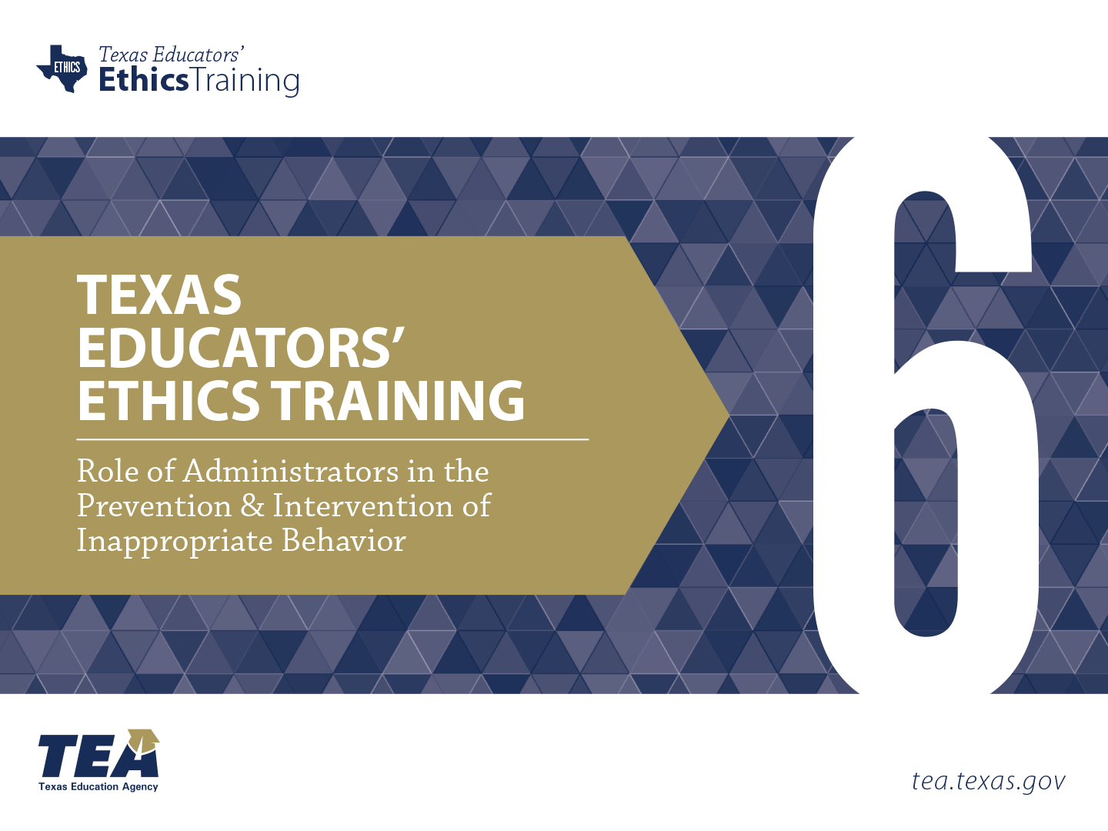
Notes:
Directions for Presenter: Italics
Information for Presenter to Convey: Bold
Presenter’s Notes: (Time: 30 Seconds)
Welcome participants. If this is a new group of participants, introduce yourself to the group.
SAY: This is the sixth and final ethics training module for Texas educators. Module 6 will focus on the Role of Administrators in the Prevention and Intervention of Inappropriate Behavior.
It is advisable to have participants seated at tables to encourage group dialogue. Participants will also be provided with a reflection journal.
Materials for Participants:
Journal
Materials for Presenter:
PowerPoint for Module 6
LCD Projector, Screen, Speakers, and Computer
Slide Advancer
Participant Toolbox is recommended (index cards, sticky notes, markers, pencils/pens, etc.)
Copies of Module Assessment
Performance Task Key
Assessment Key

Slide 2


Describe the role of administrators in the prevention and intervention of inappropriate behaviors.
Notes:
Directions for Presenter: Italics
Information for Presenter to Convey: Bold
Presenter’s Notes: (Time: 30 Seconds)
SAY: The purpose of this training is to describe the role of administrators in the prevention and intervention of inappropriate behaviors.
This module focuses on the role of administrators in preventing and intervening when inappropriate behavior is reported or observed. While the intent of this module is to delineate the role of the administrator in particular, the information we will discuss DOES involve all educators.
For the purposes of this training, the term “administrator” refers to the district superintendent, campus principals, and all those in administrative roles in a district.

Slide 3

Stimulating Thinking
What is the role of administrators in the prevention and intervention of inappropriate behavior?
How can teachers and staff support them in this endeavor?
Notes:
Directions for Presenter: Italics
Information for Presenter to Convey: Bold
Presenter’s Notes: (Time: 1½ Minutes)
SAY: Let’s take a look at two questions to stimulate our thinking and set the stage for the training session today.
Read the slide. Ask for some initial responses to the questions.
SAY: Thank you for those responses. We will come back to these questions at the end of the session and see if we have gained new information that will help us better answer them.

Slide 4
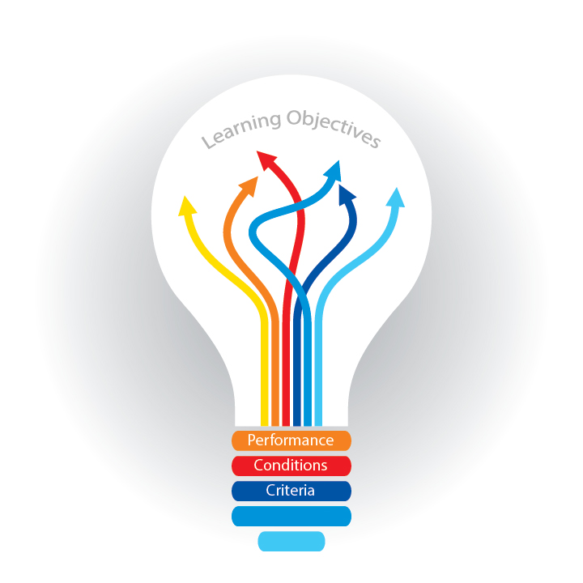
Participants will
understand how district and campus leaders can develop an ethical culture;
identify strategies to prevent inappropriate behaviors; and
identify methods to intervene in any observed or reported inappropriate behavior.
Notes:
Directions for Presenter: Italics
Information for Presenter to Convey: Bold
Presenter’s Notes: (Time: 30 Seconds)
SAY: Let’s take a moment to review the session objectives. Today we will discuss how district and campus leaders can develop an ethical culture; identify strategies to prevent inappropriate behaviors; and identify methods to intervene in any observed or reported inappropriate behavior.
- Each of the objectives will tie directly to the presented information and will be assessed at the end of the training.

Slide 5

Inappropriate Behavior
How often do we read or see news stories about a teacher who has had an inappropriate relationship with a student?
Notes:
Directions for Presenter: Italics
Information for Presenter to Convey: Bold
Presenter’s Notes: (Time: 30 Seconds)
Read the question on the slide.
SAY: Sadly, much too frequently. Too many of our students are being emotionally, physically, and/or mentally harmed.
Whenever I hear a story, read a story, or see a story on TV about a teacher behaving inappropriately, I always think of all the people involved.
I think of the student and the parents. I think of the teacher and the school.
And I think of the administrators and wonder if something could have been done to prevent the situation.
Let’s read some actual reports of educator misconduct.

Slide 6

“A 14-year-old student wrote his cell number on a classroom chalkboard because he wanted a classmate he liked to call him. The student was contacted—not by the girl, but by his 32-year-old teacher. Within days, the two were involved in a sexual relationship.”
Notes:
Directions for Presenter: Italics
Information for Presenter to Convey: Bold
Presenter’s Notes: (Time: 30 Seconds)
Select a participant to read the slide out loud.
Source Cited: Abbott, T. (2015, January). More teachers are having sex with their students. Here’s how schools can stop them. The Washington Post. Retrieved from https://www.washingtonpost.com/posteverything/wp/2015/01/20/more-teachers-are-having-sex-with-their-students-heres-how-schools-can-stop-them

Slide 7

“A 33-year-old teacher began flirting with a 17-year-old student at a school dance. The teacher then sent the student texts, photos, and a video of herself performing lewd acts. The relationship escalated. The teacher pleaded guilty to sexual assault.”
Notes:
Directions for Presenter: Italics
Information for Presenter to Convey: Bold
Presenter’s Notes: (Time: 30 Seconds)
Select a participant to read the slide out loud.
Source Cited: Abbott, T. (2015, January). More teachers are having sex with their students. Here’s how schools can stop them. The Washington Post. Retrieved from https://www.washingtonpost.com/posteverything/wp/2015/01/20/more-teachers-are-having-sex-with-their-students-heres-how-schools-can-stop-them

Slide 8

“A 54-year-old teacher exchanged more than 1,800 text messages with a student, many of them sexually explicit, before the teacher was convicted and sentenced to prison.”
Notes:
Directions for Presenter: Italics
Information for Presenter to Convey: Bold
Presenter’s Notes: (Time: 30 Seconds)
Select a participant to read the slide out loud.
Source Cited: Abbott, T. (2015, January). More teachers are having sex with their students. Here’s how schools can stop them. The Washington Post. Retrieved from https://www.washingtonpost.com/posteverything/wp/2015/01/20/more-teachers-are-having-sex-with-their-students-heres-how-schools-can-stop-them

Slide 9

In 2015, the Washington Post wrote:
“Texas is home to the largest number of teacher sexual misconduct cases in the country. Investigations into alleged inappropriate teacher-student relationships has grown 27 percent over the past three years.”
Notes:
Directions for Presenter: Italics
Information for Presenter to Convey: Bold
Presenter’s Notes: (Time: 1 Minute)
SAY: The Washington Post reported, “Texas is home to the largest number of teacher sexual misconduct cases in the country. Investigations into alleged inappropriate teacher-student relationships has grown 27 percent over the past three years.”
These are OUR schools, OUR students, OUR teachers. OUR profession.
Schools across the state of Texas are experiencing an increased number of teachers engaging in inappropriate behaviors.
(Rhetorical questions) So we must ask ourselves, what are OUR schools doing to prevent such incidents? How are OUR administrators creating professional and ethical school cultures?
This training module will address those particular questions.

Slide 10

Could the previous incidents have been prevented? If so, how?
What strategies could these districts/campuses have implemented to prevent them from happening?
Notes:
Directions for Presenter: Italics
Information for Presenter to Convey: Bold
Presenter’s Notes: (Time: 4 Minutes)
Note that very limited information has been given to the participants about the three police reports. These questions are asked to help set the stage for the information that will be presented in this training session. Read the questions on the slide to the entire group, and then ask each table/group to respond. It is important to note that the groups may simply say “No, these situations could not have been prevented.” As a training facilitator, you should guide their thinking. While EVERY situation may not be able to be prevented, research tells us that there are preventative measures that could decrease the number of incidents of inappropriate behavior.
SAY: While you only have very limited information about these cases, in a general sense, let’s respond to these questions.
Allow participants to discuss the questions at their table, and then ask them to share their responses with the larger group.
SAY: If the district/campus provided training, implemented clear practices and guidance on student-teacher relationships, and provided clear social media guidelines, is it possible that these incidents could have been prevented?
Hopefully, the group will see that when a district/campus places prevention strategies in place, the number of incidents of inappropriate behavior will decrease.
Source Cited: Gino, F., Ordonez, L., & Welsh, D. (2014, September). How unethical behavior becomes habit. Harvard Business Review. Retrieved from https://hbr.org/2014/09/how-unethical-behavior-becomes-habit

Slide 11


Video Scenario
INSERT VIDEO HERE
Notes:
Directions for Presenter: Italics
Information for Presenter to Convey: Bold
Presenter’s Notes: (Time: 6 Minutes)
SAY: Let’s watch a short video highlighting two campus principals being interviewed about building an ethical culture, as well as prevention and intervention strategies.
You may want to take a few notes to help you respond to the video reflection.

Slide 12

Video Scenario Reflection
Notes:
Directions for Presenter: Italics
Information for Presenter to Convey: Bold
Presenter’s Notes: (Time: 2 Minutes)
Use the following question to prompt discussion among participants.
SAY: You listened to two administrators talk about ways to prevent inappropriate behavior. At your table, answer the following question:
What did the principals discuss that might be a good strategy for your school?
SAY: Let’s move into the first major concept of this training session: ethical culture.
Refer back to the video scenario throughout the remainder of the module.

Slide 13

Notes:
Directions for Presenter: Italics
Information for Presenter to Convey: Bold
Presenter’s Notes: (Time: 30 Seconds)
SAY: Got ethics? Ethics is defined as a system of moral principles, such as the “ethics of a culture” or the “principles of a culture.” Ethics tend to be codified into a formal system or set of rules that are explicitly adopted by a group of people. Every school has a culture. Many are known for having a strong academic culture. Some have developed a culture that embraces diversity. And some have even focused on creating an ethical culture. What is OUR ethical culture at our school? What is our system for ethics? (Rhetorical questions)

Slide 14
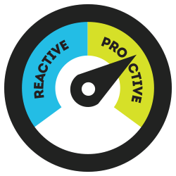
Building and Maintaining Educator Ethics
Addressing inappropriate behavior should be:
PROACTIVE NOT REACTIVE.
Notes:
Directions for Presenter: Italics
Information for Presenter to Convey: Bold
Presenter’s Notes: (Time: 30 Seconds)
SAY: We can build an ethical culture at our campus by enforcing ethical practices. This helps create a strong foundation for the teaching profession. Unfortunately, addressing ethical issues is often reactive versus proactive.
Many of you are aware of Stephen Covey’s 7 Habits of Highly Effective People.
His first habit is “Be Proactive.” Reactive behavior happens AFTER the borderline behavior or inappropriate behavior occurs. Proactive efforts can prevent borderline or inappropriate behavior from occurring in the first place.
Source Cited: Gino, F., Ordonez, L., & Welsh, D. (2014, September). How unethical behavior becomes habit. Harvard Business Review. Retrieved from https://hbr.org/2014/09/how-unethical-behavior-becomes-habit

Slide 15

Building and Maintaining Educator Ethics
Maintaining an ethical workplace is essential.
Notes:
Directions for Presenter: Italics
Information for Presenter to Convey: Bold
Presenter’s Notes: (Time: 1 Minute)
SAY: Just like they plan the academic program, administrators should plan the development of an ethical culture for the district and campus.
We can build our system of moral principles by creating a plan that clearly explains appropriate and inappropriate behavior. This plan sets the stage for the development of a strong ethical culture.
Planning occurs during the summer hiring months, at the start of school, and throughout the school year. It should not and cannot be a one-time discussion.
So whose responsibility is it to maintain an ethical workplace?
Provide time for the group to respond. They should say it is EVERYONE’s.
SAY: Yes, it is EVERYONE’S responsibility to maintain an ethical workplace; however, it is the administrator’s responsibility to create, foster, and maintain an ethical culture.

Slide 16
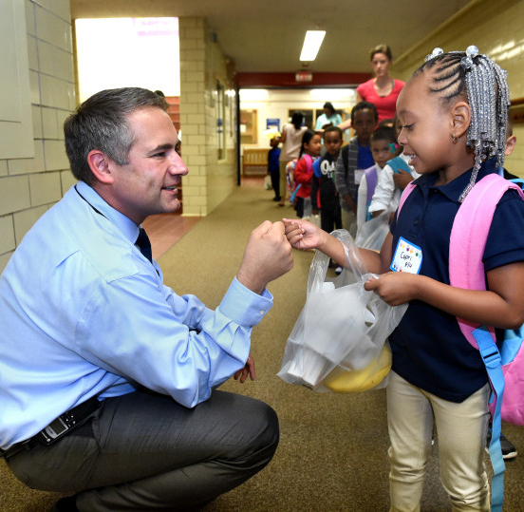
Administrator’s Role
It is important that the campus leaders monitor what is appropriate and what is inappropriate at their campuses.
Notes:
Directions for Presenter: Italics
Information for Presenter to Convey: Bold
Presenter’s Notes: (Time: 30 Seconds)
SAY: It is important for teachers and other school personnel to understand their administrator’s responsibility in preventing incidents of inappropriate behavior as well as building the system of moral principles.
Administrators are dedicated to safeguarding their students and school personnel.
Administrators develop a culture based on ethical behavior. They model appropriate behavior at their campuses and in their personal and professional lives.

Slide 17

The Concept of Leadership
At the core of most definitions of leadership are two functions: providing direction and exercising influence.
Notes:
Directions for Presenter: Italics
Information for Presenter to Convey: Bold
Presenter’s Notes: (Time: 30 Seconds)
SAY: Leaders should always provide direction in many significant areas. By doing so, they exercise influence.
We often see the influence in instructional areas, but can we see the influence in ethical areas? Leaders CAN provide direction AND exercise influence in the areas of appropriate and inappropriate behaviors.
Source Cited: Trevino, L. K., & Brown, M. E. (2005). The role of leaders in influencing unethical behavior in the workplace. In Kidwell, R., & Martin, C. (Eds.), Managing Organizational Deviance. http://dx.doi.org/10.4135/9781452231105.n3

Slide 18

Providing Direction and Exercising Influence Begins with Culture
Notes:
Directions for Presenter: Italics
Information for Presenter to Convey: Bold
Presenter’s Notes: (Time: 1 Minute)
SAY: Words that come to mind when we think of ethical environments or ethical systems include integrity, honesty, and truth.
All of these should and could be part of your culture when leaders create such an environment.
Can we assume that leaders have a responsibility to create an ethical culture that values integrity, honesty, and trustworthiness?
The culture at our school is our brand. We can be known as a strong, ethical campus that values ethics.
Source Cited: Trevino, L. K., & Brown, M. E. (2005). The role of leaders in influencing unethical behavior in the workplace. In Kidwell, R., & Martin, C. (Eds.), Managing Organizational Deviance. http://dx.doi.org/10.4135/9781452231105.n3

Slide 19

Notes:
Directions for Presenter: Italics
Information for Presenter to Convey: Bold
Presenter’s Notes: (Time: 1 Minute)
SAY: And lastly, as goes the leader, so goes the staff.
If ethics is not important to a leader, it will not be important to the staff.
Even with policies, procedures, and professional development in place, an administrator who talks the talk but does not walk the walk will unravel the ethical culture that is in place.
An administrator who does not model what is expected can breed suspicion and destroy all trust. An ethical culture is built by putting some prevention strategies in place for all staff members. Prevention works!
Source Cited: Douglas, E. (2012, October 31). 7 practices to prevent unethical behavior [Blog post]. Retrieved from http://blogs.edweek.org/topschooljobs/k-12_talent_manager/2012/10/7_practices_to_prevent_unethical_behavior.html

Slide 20

Notes:
Directions for Presenter: Italics
Information for Presenter to Convey: Bold
Presenter’s Notes: (Time: 30 Seconds)
This is a transition slide.
SAY: Let’s talk about successful practices to prevent inappropriate behavior.

Slide 21

Prevention Practices
District/Campus
Teacher/Staff
Practice: Implement Policies and Practices
Familiarize yourself with all policies and practices.
Know all district/campus expectations.
Notes:
Directions for Presenter: Italics
Information for Presenter to Convey: Bold
Presenter’s Notes: (Time: 1 Minute)
SAY: Policies help guide our actions.
Clarity leaves little room for excuses such as:
I didn’t know.
I didn’t know we weren’t supposed to provide rides home for students.
I didn’t know we shouldn’t “friend” a student on Facebook.
Check your own campus by asking yourself, “Do we have strong social media policies and practices?” and “Do we have a clear and appropriate dress code for the adults at our school?”
Are there clear guidelines on student-teacher boundary practices? Are there policies that guide our professional behavior? Are there policies that provide guidance on work outside of the school day?
Source Cited: Douglas, E. (2012, October 31). 7 practices to prevent unethical behavior [Blog post]. Retrieved from http://blogs.edweek.org/topschooljobs/k-12_talent_manager/2012/10/7_practices_to_prevent_unethical_behavior.html

Slide 22

Prevention Practices
District/Campus
Teacher/Staff
Practice: Develop Staff Understanding
Receive training on
  building appropriate relationships;
  social media;
  professionalism;
  district/campus ethical expectations; and
  recognizing inappropriate relationships and reporting to administration.
Notes:
Directions for Presenter: Italics
Information for Presenter to Convey: Bold
Presenter’s Notes: (Time: 1 Minute)
Animated slide
SAY: Each campus has a responsibility to develop staff understanding. Some examples of trainings that should be considered are:
Building appropriate relationships;
Social media;
Professionalism;
Expectations; and
Recognizing inappropriate relationships and notifying administration.
Source Cited: Douglas, E. (2012, October 31). 7 practices to prevent unethical behavior [Blog post]. Retrieved from http://blogs.edweek.org/topschooljobs/k-12_talent_manager/2012/10/7_practices_to_prevent_unethical_behavior.html

Slide 23
Prevention Practices
District/Campus
Teacher/Staff
Practice: Develop Staff Understanding
Receive training on
  effects of inappropriate relationships;
  slippery slope;
  grooming students; and
  safeguarding students AND teachers.
Notes:
Directions for Presenter: Italics
Information for Presenter to Convey: Bold
Presenter’s Notes: (Time: 1 Minute)
SAY: Other trainings could be on:
Effects of inappropriate relationships;
Slippery slope;
Grooming students; and
Safeguarding students AND teachers.
Source Cited: Douglas, E. (2012, October 31). 7 practices to prevent unethical behavior [Blog post]. Retrieved from http://blogs.edweek.org/topschooljobs/k-12_talent_manager/2012/10/7_practices_to_prevent_unethical_behavior.html

Slide 24

Prevention Practices
District/Campus
Teacher/Staff
Practice: Put Controls in Place
Practice internal controls to avoid inappropriate behavior.
Participate in routine audits.
Notes:
Directions for Presenter: Italics
Information for Presenter to Convey: Bold
Presenter’s Notes: (Time: 1 Minute)
SAY: Internal controls help a campus avoid incidents of inappropriate behavior. For example, if you have a student council that has multiple fundraisers, what types of controls are in place for raising money?
Who is in charge of it?
Who counts the money?
Who documents the amount and all the transactions?
Who takes it to the bank?
SAY: Even with proper policies and processes in place, it is wise to perform regular audits to help reduce violations. Audits will mitigate risk district-wide.
Source Cited: Douglas, E. (2012, October 31). 7 practices to prevent unethical behavior [Blog post]. Retrieved from http://blogs.edweek.org/topschooljobs/k-12_talent_manager/2012/10/7_practices_to_prevent_unethical_behavior.html

Slide 25

Prevention Practices
District/Campus
Teacher/Staff
Practice: Build an Ethical Culture
Practice
  transparency;
  openness; and
  communication.
Notes:
Directions for Presenter: Italics
Information for Presenter to Convey: Bold
Presenter’s Notes: (Time: 1 Minute)
SAY: Transparency is so important. Is your school culture transparent?
School personnel must see and hear what is going on and make sure everyone feels comfortable standing up and speaking out if they see behavior that is harmful to students.
SAY: Why do most staff members NOT speak out when and if they see behavior that is a possible violation at their campus?
Give the group a few minutes to discuss the question, and then have them share their responses.
Source Cited: Douglas, E. (2012, October 31). 7 practices to prevent unethical behavior [Blog post]. Retrieved from http://blogs.edweek.org/topschooljobs/k-12_talent_manager/2012/10/7_practices_to_prevent_unethical_behavior.html

Slide 26

Prevention Practices
District/Campus
Teacher/Staff
Practice: Acknowledge that Exploitation Exists
Beware of bias.
Pay attention.
Educate parents and students on appropriate behavior.
Notes:
Directions for Presenter: Italics
Information for Presenter to Convey: Bold
Presenter’s Notes: (Time: 1 Minute)
SAY: Not acknowledging there may be a problem is very common. We WANT to think the best of people. We want to believe that this could not happen at our campus. However, we MUST acknowledge that exploitation may exist.
We need to pay attention to everything that is happening at our school.
Beware of bias: “That could never happen at my school with my teachers and my students.”
And don’t forget to educate parents and students on ethical behavior. All of these strategies can build a strong, ethical culture on a campus.

Slide 27

Practice
  Familiarize yourself with all policies/practices.
  Receive training.
  Be transparent, be open, and communicate.
  Beware of bias.
  Pay attention.
  Educate parents/students.
Notes:
Directions for Presenter: Italics
Information for Presenter to Convey: Bold
Presenter’s Notes: (Time: 30 Seconds)
SAY: Let’s go over the prevention practices once again.
Advance each bullet and read each one out loud.

Slide 28

Key Questions
What is our campus doing to prevent inappropriate behavior?
Is there anything else that we could do to to prevent inappropriate behavior?
Notes:
Directions for Presenter: Italics
Information for Presenter to Convey: Bold
Presenter’s Notes: (Time: 3 Minutes)
SAY: After hearing several strategies to prevent inappropriate behavior, how does our campus measure up? What can our campus do to prevent inappropriate behavior?
Give participants two minutes to discuss these questions with their group, and then ask for responses. If they say their campus has not done anything in the area of prevention, remind them that they are now sitting through a training and that this is a first and big step.

Slide 29

Notes:
Directions for Presenter: Italics
Information for Presenter to Convey: Bold
Presenter’s Notes: (Time: 30 Seconds)
This is a transition slide.
SAY: We have discussed prevention; now let’s talk about intervention. It is our hope that if we build an awareness of appropriate behavior, we will not have to intervene because borderline or inappropriate behavior will not exist. However, should we see something that is inappropriate or even questionable, how should we intervene, and what does intervention look like? The next several slides will provide some answers.

Slide 30

Once an investigation has occurred and it has been determined that inappropriate behavior occurred….
Notes:
Directions for Presenter: Italics
Information for Presenter to Convey: Bold
Presenter’s Notes: (Time: 30 Seconds)
SAY: It is important to fully investigate the observed or reported incident. Gather important information to determine if the incident was ethical, borderline, or unethical. Should an administrator find that the incident was borderline or unethical, he or she should take immediate and critical steps to stop or report the behavior.

Slide 31

Intervention: Respond Immediately
Action should be taken immediately to stop the behavior that was reported or observed.
Notes:
Directions for Presenter: Italics
Information for Presenter to Convey: Bold
Presenter’s Notes: (Time: 30 Seconds)
SAY: It is important to make sure time does not lapse once borderline behavior has been observed or reported.
An administrator must take immediate action.
An action may include conferencing with all of the parties involved (however, the investigation should be done individually).
Determining the level or phase of the violation is critical when taking action.
The intervention cannot and should not be put on a back burner to other pressing issues. It must be addressed immediately.
If your policy states ZERO TOLERANCE for a certain behavior, ZERO TOLERANCE is ZERO TOLERANCE. Every district is different; therefore, their respective policies should be followed and enforced.

Slide 32

Intervention: Clarify Expectations
Expectations should be clear, concise, and in writing and leave no room for misunderstanding.
Notes:
Directions for Presenter: Italics
Information for Presenter to Convey: Bold
Presenter’s Notes: (Time: 30 Seconds)
SAY: When intervening, clear expectations should be set. Examples could be:
You will not text any student for any reason at all.
You will not eat lunch with a student alone in your classroom.
You will not allow any child to sit on your lap.
SAY: The expectations should be clear, concise, and in writing. Leave no room for ANY misunderstanding.

Slide 33

Intervention: Clarify Consequences
Consequences for continued borderline behavior should be clear, concise, and in writing.
Notes:
Directions for Presenter: Italics
Information for Presenter to Convey: Bold
Presenter’s Notes: (Time: 1 Minute)
SAY: Consequences are also part of the intervention process.
Once the expectations are clarified, consequences for not meeting them or violating them should be clear and harsh.
A consequence could be: Should you text a student again, you will be formally reprimanded and placed on administrative leave until further notice. It is important to note that if there is a zero tolerance policy in place for texting, this would be a clear violation and therefore would need to have different consequences.
Another example could be: Should you be caught having lunch in your classroom alone with this student or any student, you will be asked to resign from your position.
The purpose of the expectations and the consequence is to stop the behavior immediately and permanently.

Slide 34

Intervention: Monitor Closely
The employee and the situation should be monitored closely.
Notes:
Directions for Presenter: Italics
Information for Presenter to Convey: Bold
Presenter’s Notes: (Time: 30 Seconds)
SAY: Once the expectations have been clarified and the consequences are in place, it is the responsibility of the administrator to closely monitor the situation.

Slide 35

Intervention: Follow Up
Formal conferences and informal observations should continue to ensure the behavior does not occur again.
Notes:
Directions for Presenter: Italics
Information for Presenter to Convey: Bold
Presenter’s Notes: (Time: 30 Seconds)
SAY: Lastly, follow up, follow up, follow up.
If the behavior continues, follow up and follow through with the consequences outlined in the written documentation that was developed.
If the behavior has stopped, continue close observation and monitoring of the situation.

Slide 36

To Intervene or Not to Intervene
Teacher meets a student at Barnes and Noble for coffee and to talk.
Teacher sends a text to remind students of a test the following day in violation of school policy.
Teacher meets with an individual student in a locked classroom.
Teacher has lunch with a student alone in his/her classroom.
Teacher gives all students candy to reward their good behavior.
Teacher provides a ride home to an individual student.
Teacher is “touchy feely” with students.
Select group of male students meets at female teacher’s home for tutoring.
Notes:
Directions for Presenter: Italics
Information for Presenter to Convey: Bold
Presenter’s Notes: (Time: 4 Minutes)
SAY: Let’s practice. When should an administrator intervene, and when should he or she not intervene? Show a thumbs-up if the administrator SHOULD intervene and a thumbs-down if no intervention is needed.
Read each bullet and ask the group to show a thumbs-up if the administrator SHOULD intervene and a thumbs-down if the administrator should NOT intervene. Present each bullet separately by using the slide advancer. Wait the proper amount of time to allow the group to reflect. The correct answers are as follows:
Teacher has lunch with a student alone in his/her classroom: thumbs-up (intervene)
Teacher gives all students candy to reward their good behavior: thumbs-down (no need to intervene)
Teacher provides a ride home to an individual student: thumbs-up (intervene)
Teacher is “touchy feely” with students: thumbs-up (intervene)
Select group of male students meets at female teacher’s home for tutoring: thumbs-up (intervene)
Teacher meets a student at Barnes and Noble for coffee and to talk: thumbs-up (intervene)
Teacher sends a text to remind students of a test the following day in violation of school policy: thumbs-up (intervene)
Teacher meets with individual students in a locked classroom: thumbs-up (intervene)

Slide 37

EVERYONE’S Responsibility
Notes:
Directions for Presenter: Italics
Information for Presenter to Convey: Bold
Presenter’s Notes: (Time: 30 Seconds)
SAY: Before we move to the performance task and apply our learning, let me emphasize that it is important for EVERYONE to intervene if they witness inappropriate behavior. IF YOU SEE SOMETHING, SAY SOMETHING.

Slide 38

Notes:
Directions for Presenter: Italics
Information for Presenter to Convey: Bold
Presenter’s Notes: (Time: 8 Minutes)
SAY: It’s time to apply what we have learned. Please complete the performance task for this module. The detailed instructions will guide your group work. I will walk around to provide clarification as needed.
Ask participants to find the section in their journal titled “Prevention, Intervention, and Creating an Ethical Culture.” Participants will work in table groups but also record their responses in their respective journals.

Slide 39

Notes:
Directions for Presenter: Italics
Information for Presenter to Convey: Bold
Presenter’s Notes: (Time: 3 Minutes)
SAY: Let’s take some time to review our initial essential questions:
What is the role of administrators in the prevention and intervention of inappropriate behavior?
How can teachers support them in this endeavor?
Please respond to the reflection questions in your journal.

Slide 40

Notes:
Directions for Presenter: Italics
Information for Presenter to Convey: Bold
Presenter’s Notes: (Time: 5 Minutes)
SAY: Each participant is required to complete an assessment based on the information received in this training. You must receive a score of 100 to receive credit for this module training.
You can provide each participant with the Module 5 assessment to complete as a culminating activity. Districts can alternately choose to have participants complete the assessment during a follow-up session or have them complete the assessment on their own within a designated period of time and submit it to their campus principal.

Slide 41

Notes:
Directions for Presenter: Italics
Information for Presenter to Convey: Bold
Presenter’s Notes: (Time: 1 Minute)
Before concluding the training session, ask participants if they have any questions about the information they received today. Answer any questions as applicable.

Slide 42
References
Abbott, T. (2015, January). More teachers are having sex with their students. Here’s how schools can stop them. The Washington Post. Retrieved from https://www.washingtonpost.com/posteverything/wp/2015/01/20/more-teachers-are-having-sex-with-their-students-heres-how-schools-can-stop-them
Bradshaw, V. (2012, December). Preventing inappropriate teacher-student relationships [Prezi presentation]. Retrieved from https://prezi.com/e7nwvvxjr77t/preventing-inappropriate-teacher-student-relationships/
Douglas, E. (2012, October 31). 7 practices to prevent unethical behavior [Blog post]. Retrieved from http://blogs.edweek.org/topschooljobs/k-12_talent_manager/2012/10/7_practices_to_prevent_unethical_behavior.html
Gino, F., Ordonez, L., & Welsh, D. (2014, September). How unethical behavior becomes habit. Harvard Business Review. Retrieved from https://hbr.org/2014/09/how-unethical-behavior-becomes-habit
Trevino, L. K., & Brown, M. E. (2005). The role of leaders in influencing unethical behavior in the workplace. In Kidwell, R., & Martin, C. (Eds.), Managing Organizational Deviance. http://dx.doi.org/10.4135/9781452231105.n3
Notes:
Directions for Presenter: Italics
Information for Presenter to Convey: Bold
Presenter’s Notes:
References for sources cited. You do not need to reference this slide.

